Slide 1
Spiritual Care patient story Sarah Crane, Head of Chaplaincy

Slide 2
What is chaplaincy for?
Pastoral
Religious
Spiritual
Notes:
A person’s spirituality is not separate from the body, the mind or material reality,
for it is their inner life…It is about knowing and experiencing deeper meaning and
connection behind apparently random events and processes such as illness and
an awareness of human vulnerability.
(NHS Scotland: Spiritual Care Matters)

Slide 3
Background to research
Our team goal is: To provide, and enable others to deliver, high quality pastoral, spiritual and religious care to all MKUH patients, visitors and staff without prejudice or judgement.
In 2020/21 with some additional funding secured via our Chief Nurse, the team started to look at an idea which had been spotted several years before at United Lincolnshire Hospitals NHS Trust.
(https://www.ulh.nhs.uk/news/spiritual-boxes/ )

Slide 4
The box itself

Slide 5
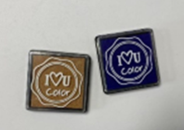
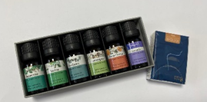
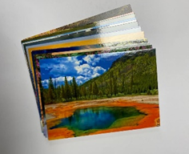
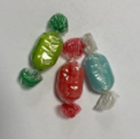
The approach
Notes:
The general aim for the trial was to get a sense for how usable the resources were for members of staff and whether they did indeed seem to be beneficial for the spiritual care of patients. Patients and staff were given an information leaflet so that they could decide whether or not to take part.
The activities we selected were:
Looking at a selection of postcards followed by a conversation around which postcard(s) the patient was most drawn to and why.
Choosing from a selection of coloured ink pads and making fingerprints with them, with discussion of favourite colours and what makes us (and that person in particular) unique.
Sampling the aromas of a variety of essential oils, and discussing memories or thoughts.
Tasting a boiled sweet, and using that as a prompt for reflecting on what the patient considers as the ‘sweet things’ in their life.

Slide 6
Feedback
Questions for patients:
1. Did the activity feel meaningful to you?
If yes, in what way?
2. Were there any obstacles to you engaging in the activity?
3. How beneficial do you feel this has been to you?
Notes:
The average percentage of patients who found the activity meaningful was 80%, within a range of 72-83%, which was really encouraging.
We noted that regardless of religious belief all those we spoke to were keen to talk, quick to acknowledge their loneliness and isolation as well as their anxiety about what was happening to them and what might happen ‘next’. The general consensus was that it was ‘good to chat’.

Slide 7
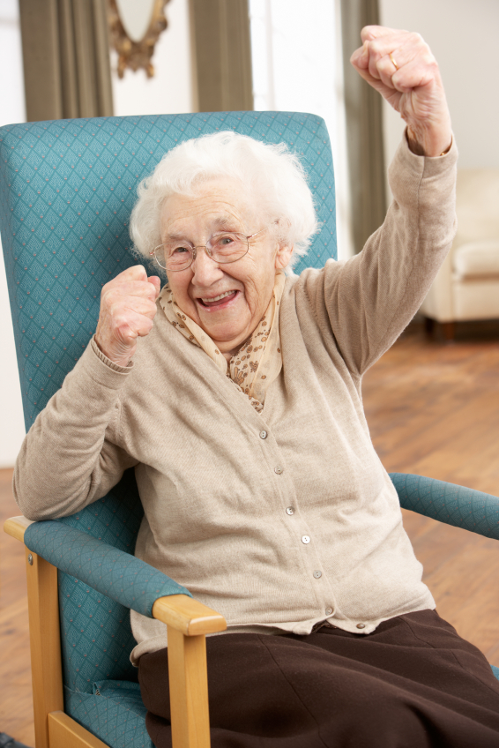
Joyce
Notes:
Dementia, Trauma with RC Boarding school, Very lonely. Missed her home, vocation and daily coffee shop visit – what will they think has happened to me? Frightened and worried about the future.

Slide 8
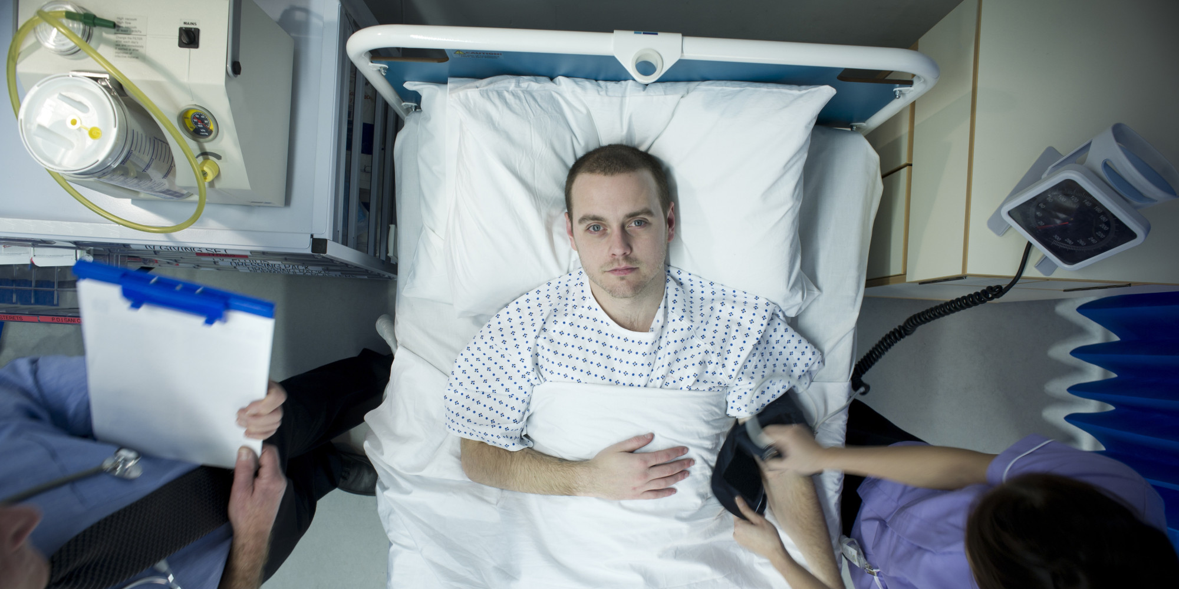
Sam
Notes:
Not able to verbalise. Realised the limitations of the resources – Amanda quickly made these communication sheets to use and was able to establish a rapport with Sam over the days (and subsequent weeks). When his wife found out we were visiting she was concerned about why a chaplain was seeing her husband, we explained and showed her the sheets and she asked for a copy of them so she could use them too. She has since written to the team to thank them for respecting them and their differing beliefs.

Slide 9
Next Steps
Use of boxes at Willen Hospice, Ward 5 and the Campbell Centre.
Team Development plan
Further research project to consider the impact of input on long stay patients.

Slide 10
Questions

