Slide 1


MKUH Annual Meeting
2020

Slide 2


Welcome and Opening Address
Simon Lloyd
Chairman
Milton Keynes University Hospital
NHS Foundation Trust

Slide 3
Review of 2019/20
Professor Joe Harrison
Chief Executive Officer
Milton Keynes University Hospital
NHS Foundation Trust

Slide 4
Vision and values – The MKWay
The MKWay promotes the vision, values, strategy and objectives for #TeamMKUH.
Our four values are:
  We Care
  We Communicate
  We Collaborate W
  We Contribute.
Developed in collaboration with staff, our values reflect what is important to our staff and patients, and set out the way we want to behave as an organisation.

Slide 5
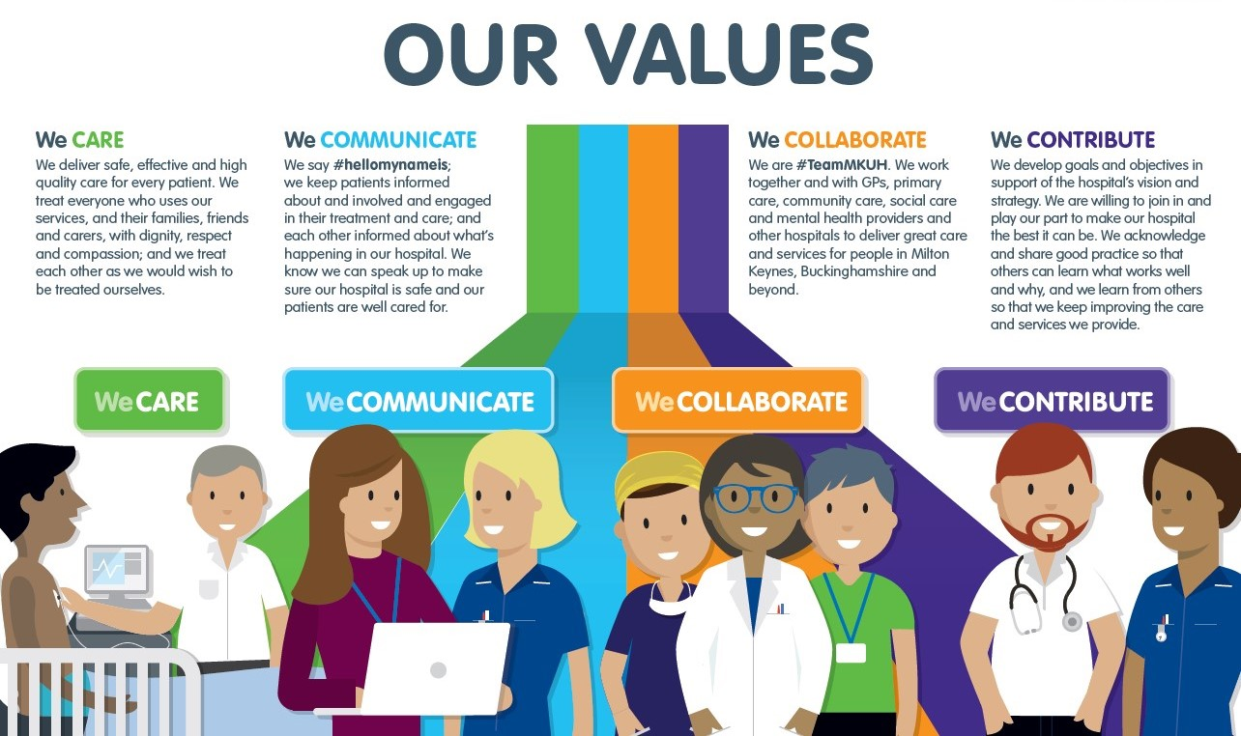

Slide 6

We’ve updated our Trust’s 10 strategic objectives
Improving patient safety
Improving patient experience
Improving clinical effectiveness
Delivering key performance targets
Developing MK at place
Developing teaching and research
Being well governed and financially viable
Investing in our people
Developing our estate
Being innovative and sustainable

Slide 7

CQC inspection – We’re still rated ‘Good’
Inspection held in April and May 2019.
Our overall rating was ‘Good’, which is the same rating we received from our previous inspection in 2016.
4 out of 5 main categories rated ‘Good’; the other rated ‘Requires improvement’.
In summary: We should all be proud to be ‘Good’ – and be preparing to be ‘Outstanding’.

Slide 8
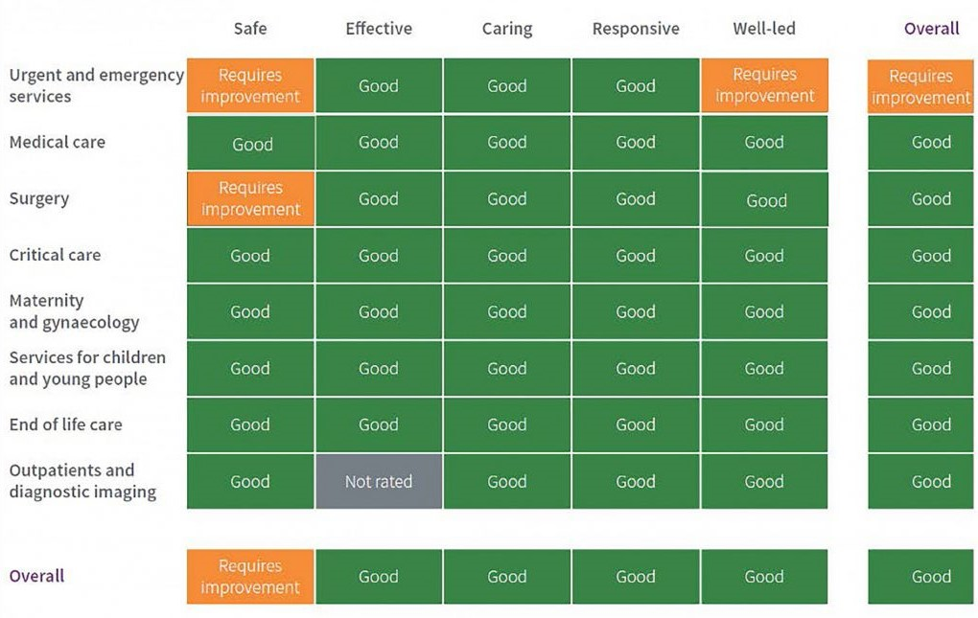
CQC – Overview of ratings

Slide 9
Our Performance
The Trust processed 24% more GP referrals than it had planned to at the beginning of the year.
Demand on the Emergency Department was 0.9% higher than expected.
The impact of Covid-19 affected activity volumes in March 2020. The Trust accommodated 9% fewer emergency admissions through the year than planned - a decrease of 16% compared to 2018/19. This was influenced by the evolution of the Ambulatory Care pathway.
The Trust treated 2% fewer elective admissions than planned and, when compared to elective activity in 2018/19, this represented a decrease of 3.4%.

Slide 10

Covid-19 isolation facility
The isolation facility was opened in February 2020 at the beginning of the pandemic.
It was based at Kents Hill Park Training and Conference Centre and housed 118 guests who had been evacuated from Wuhan, in China, the original epicentre of the pandemic.
The facility was operated mainly by MKUH staff with
support from the health and care system for two weeks.
All guests tested negative for coronavirus three
times during their stay and returned to their
everyday lives in the UK following their stay at the
isolation facility.

Slide 11
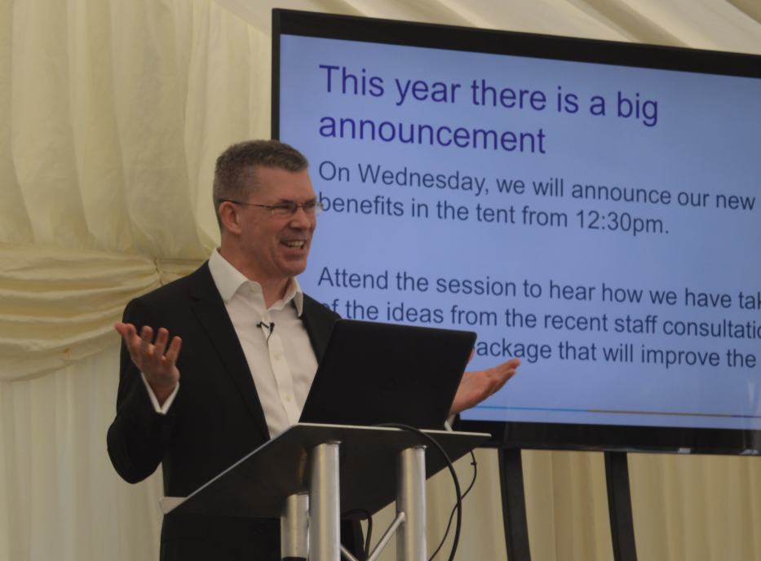

Staff Events
Event in the Tent – May 2019
Staff Awards – November 2019
Staff Benefits: Phase 2 –
Launched in 2019
Virtual Event in the Tent 2020
is happening next week!
Between Tuesday 29
September and Thursday
1 October.

Slide 12
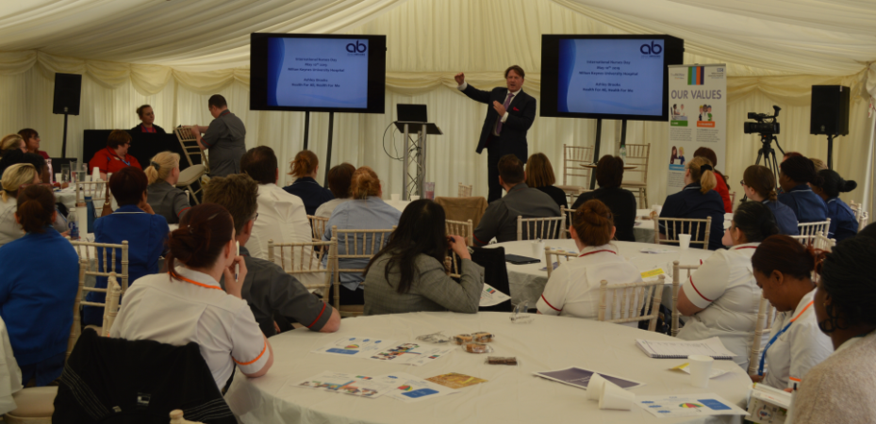
Event in the Tent – May 2019
For the third successive year, in May 2019 we hosted our large-scale staff engagement event – ‘Event in the Tent’.
The event provides a platform to allow staff from all areas to attend dynamic sessions including speakers from health, care and beyond. The new staff benefits package was unveiled at this year’s Event in the Tent.
More than 1,000 staff from across the hospital attended listening to talks by various speakers including Sir Anthony Seldon, Vice Chancellor of the University of Buckinghamshire and NHS Patient Champion Ashley Brooks.

Slide 13
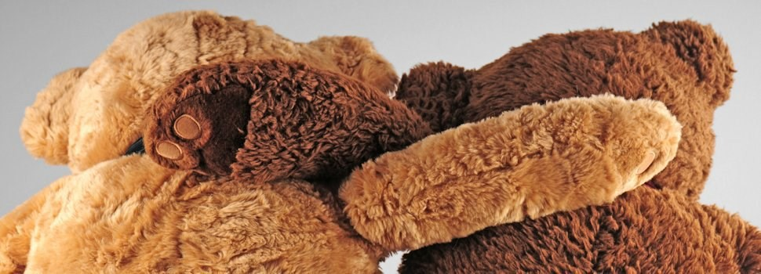
Supporting Our Staff
In November 2019 the Trust carried out its staff survey.
Staff Benefits – Phase 2 package launched in February 2020 which included free parking for all staff, free tea and coffee, subsidised gym membership and car leasing scheme.
The Trust continues to develop its range of staff support initiatives and services:
Vivip Employee Assistance Programme which offers free confidential advice.
We now have 65 Mental Health First Aiders.
We now have 69 staff across the Trust who are part of the Peer-to-peer listening service (P2P).

Slide 14
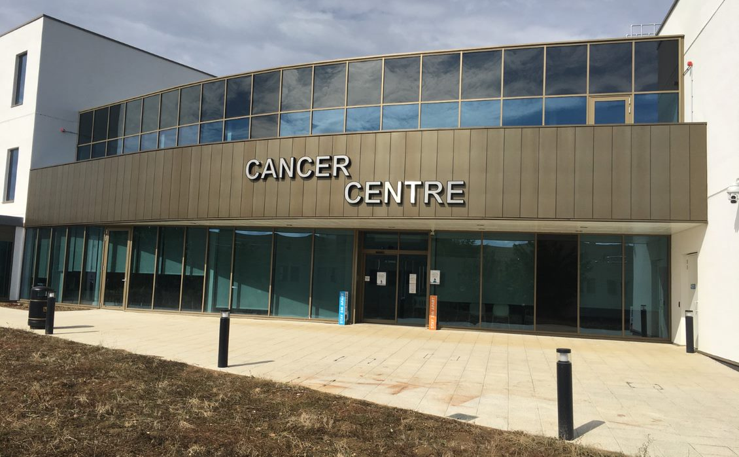
New Cancer Centre
The new Cancer Centre opened in March 2020, bringing all cancer-related services under one roof for more holistic treatment and care.

Slide 15
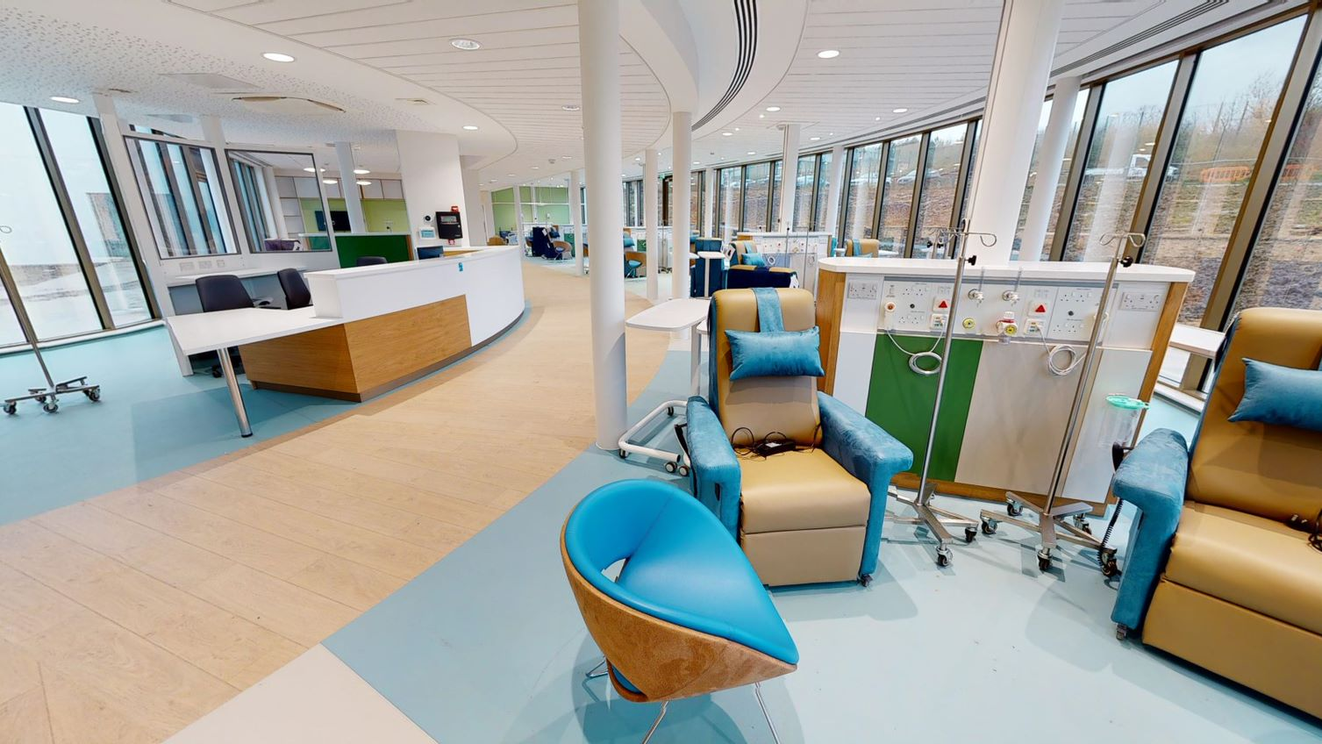
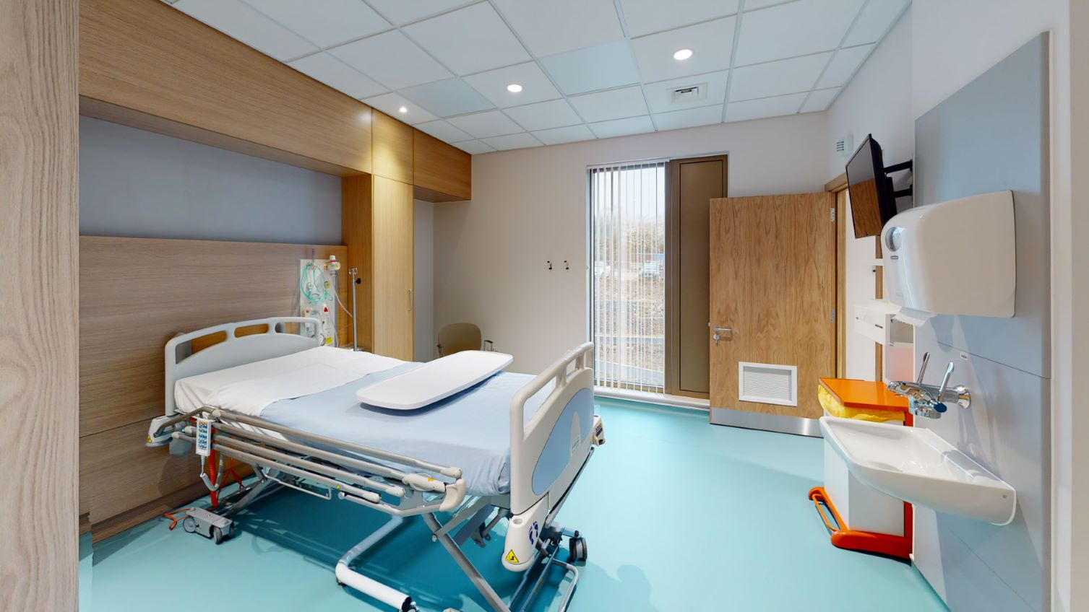
New Cancer Centre
Facilities include a chemotherapy suite, a 24-bed ward, outpatient consultation rooms, family visiting areas and an information and wellbeing area.
The new centre offers oncology, clinical haematology and cancer-related chemotherapy services, inpatient and outpatient services.
The building has been supported by Milton Keynes Council, Macmillan Cancer Support and our Milton Keynes Hospital Charity which raised £900,000 as part of its Cancer Centre Appeal to support the development of the centre.

Slide 16

Research and development
In 2019/20, the Trust:
Was the top recruiting small acute trust in the country for the second year running, with more than 4,500 participants, recruited to 54 studies.
Received £750,000 to deliver National
Institute of Health Research (NIHR) portfolio
research.
Recruited patients to 25 speciality areas.
Continues to embed research into the patient
experience, with many patients participating in
a variety of research initiatives throughout the
year and focusing on a wide range of conditions.

Slide 17
Financial Review of 2019-20
Mike Keech
Director of Finance
Milton Keynes University Hospital
NHS Foundation Trust

Slide 18
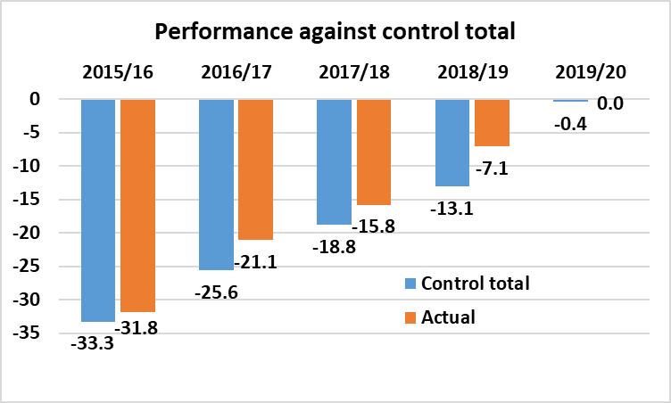
Financial Headlines
On a control total basis the Trust achieved a small surplus of £50k which was £0.5m better than plan (excluding donations).
This was a £7.1m improvement on the previous year and £31.8m better than the Trust’s highest reported deficit in 2015/16.
£m
SOURCE: FT monitoring returns

Slide 19
Financial performance
£30.6m (12.3%) increase in income, of which £22.4m relates to clinical income from tariff increases and additional funding for activity growth. The Trust also received £1.9m of funding in support of its response to COVID-19.
£24.3m (9.6%) increase in costs reflecting continued investment by the Trust in its services to support improvements in patient safety and experience, staff health and well-being and clinical effectiveness.
SOURCE: Annual plan / accounts & FT Monitoring returns

Slide 20
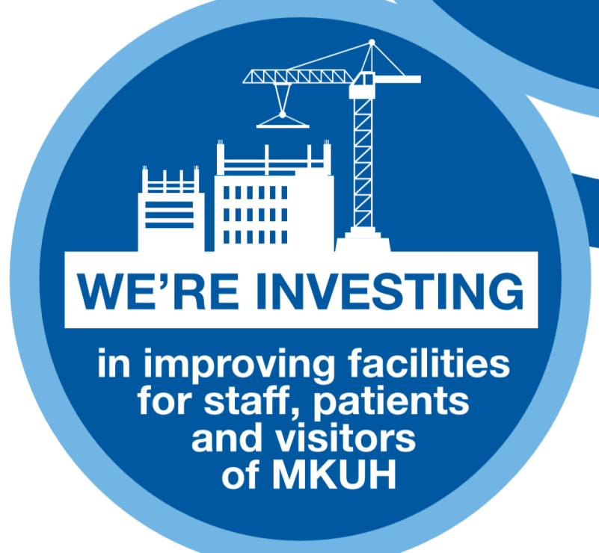
Investing in the future
£24.8m invested in capital projects:
  Completion of new cancer centre;
  Continued investment in the Trust’s digital infrastructure as part of the eCARE programme;
  Completion of a new aseptic unit;
  Refurbishment of the pharmacy department, including a new pharmacy robot; and
  Replacement and upgrade of the Trust’s facilities and equipment.
The Trust expects to continue to make significant investment in its estate and facilities over the coming years, including as part of the government’s Health Infrastructure Plan, with £200m earmarked for a redevelopment of the hospital site.

Slide 21

Charitable funds
£562k was generated from fundraising activities in year, of which £390k related to the Cancer Centre Appeal.
In addition to the Cancer Centre Appeal, the charity continues to use its unrestricted funds in order to support a range of charitable and health related activities for the benefit of patients, their families and staff.
Charitable funds:
 | 2019/20
 | £k
Total income | 562
Total expenditure | (867)
Net movement in funds | (305)
Fund balance brought forward | 628
Fund balance carried forward | 323
DRAFT: subject to audit

Slide 22
Outlook for 2020/21 and beyond
The Trust, and the NHS more generally, face operational and financial challenges as a result of the COVID-19 global pandemic. In particular:
  Operational efficiency has been adversely affected by measures put in place to keep staff and patients safe;
  The size of waiting lists across the NHS has increased significantly;
  Additional costs are being incurred as a result of COVID-19;
  There remains uncertainty about the financial regime in 2020/21 and beyond.
Despite these challenges, the Trust will continue to prioritise improving patient safety, patient experience and clinical effectiveness, whilst making further investments in improving the health and well-being of staff and the hospital’s facilities.

Slide 23
Council of Governors and Membership update
September 2020
Alan Hastings
Lead Governor

Slide 24
Covid-19 pandemic
Unfortunately the activities of the Governors have been somewhat restricted towards the end of the 2019/20 year by the beginning of the Covid-19 pandemic.
Whilst this AMM is focused largely on 2019/20, the Governors recognise and applaud every Member of Staff for their excellent service during the ongoing pandemic. Their work has been exemplary, for which we must all offer them our sincere thanks and gratitude.

Slide 25
Our Governors
27 Governors in total, comprising:
15 public governors - 8 constituencies (they must always be in the majority).
7 staff governors.
5 appointed governors, including:
    Milton Keynes Clinical Commissioning Group
    Healthwatch Milton Keynes
    Community Volunteer representation
    Milton Keynes Business representation
    Milton Keynes Council

Slide 26
New Governors
We welcome our new Governors.
All of our Governors are volunteers and unpaid, thus ensuring our independence.

Slide 27
Statutory Duties
The Council of Governors has a number of statutory duties required by law.
Perhaps the most important of these throughout the year are to:
  Hold Non-Executive Directors to account for the performance of the Executive Board.
  Represent the interests of patients, members of the Trust as a whole and the public in general (we use the legal term Trust, but most of us know it as our hospital).
  I stress the word ‘OUR’ as every member of staff I meet and our Governors think of it that way..

Slide 28
Statutory Duties cont’d
As Governors we must:
  Be independent of the Board of Directors
  Represent the interests of patients, members and the people of Milton Keynes
  Abide by the Code of Practice - 7 Nolan Principles of Public Life :
    Selflessness
    Integrity
    Objectivity
    Accountability
    Openness
    Honesty
    Leadership

Slide 29
Activities 2019/20
The Council formally meet 4 times during the year.
We also have regular Informal meetings with the Chairman. The Chairman and Lead Governor also have one-to-one meetings.
The Council of Governors is responsible for appointment of the Chairperson of the Board and the Non-Executive Directors.
The Appointments Committee, which as Lead Governor I chair, is currently in the final stage of interviews for a new Chairperson.
Monitored Trust-wide governance issues on an on-going basis and received a wide range of reports including, finance, performance, quality and workforce with the opportunity to provide scrutiny and challenge.

Slide 30
Other Activities
The Council of Governors:
  Received and approved formal reports including the Annual Report and Accounts.
  Represent the Council of Governors on various Committees such as the Charitable Funds Committee and the Quality and Clinical Risk Committee, by attending as and when appropriate.
  Participate in the 15 Steps Programme.
  Participate in the annual PLACE (Patient Led Assessment: Clinical and Environment) inspections and Clinical Excellence and Staff Awards.
  On-going drive to increase membership and enable patients and the public to have their say in the future development of the hospital.
  Lead Governors Network for the East of England area.
  An important current activity is our involvement in the process to appoint a new food supplier to the Hospital.

Slide 31
Membership
The total membership including public members and staff members is 8,186 at the end of the year.
The Membership and Engagement Strategy was revised and refreshed to encourage members to get more involved, but due to Covid-19 restrictions has yet to be implemented.

Slide 32
Membership:
Future Planned Activities
    These are subject to restrictions and will probably be virtual:
      More Meet the Members events.
      Local community recruitment campaigns.
      Members’ Newsletter.
      More easily accessible information on the hospital website to keep everyone up-to-date.

Slide 33
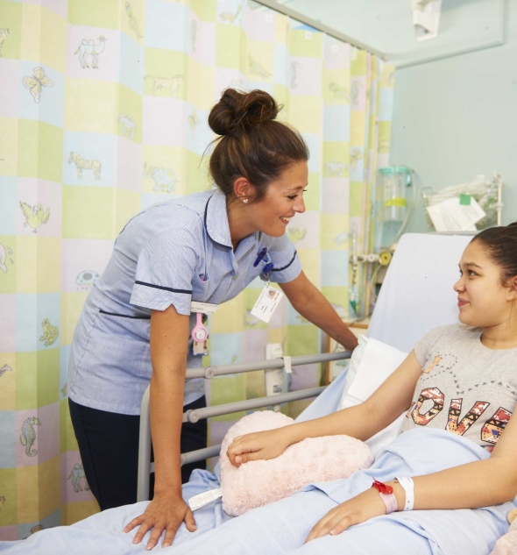
Membership
As Governors we represent patients, members and the public.
COME AND JOIN US!
OUR hospital is here FOR YOU

Slide 34
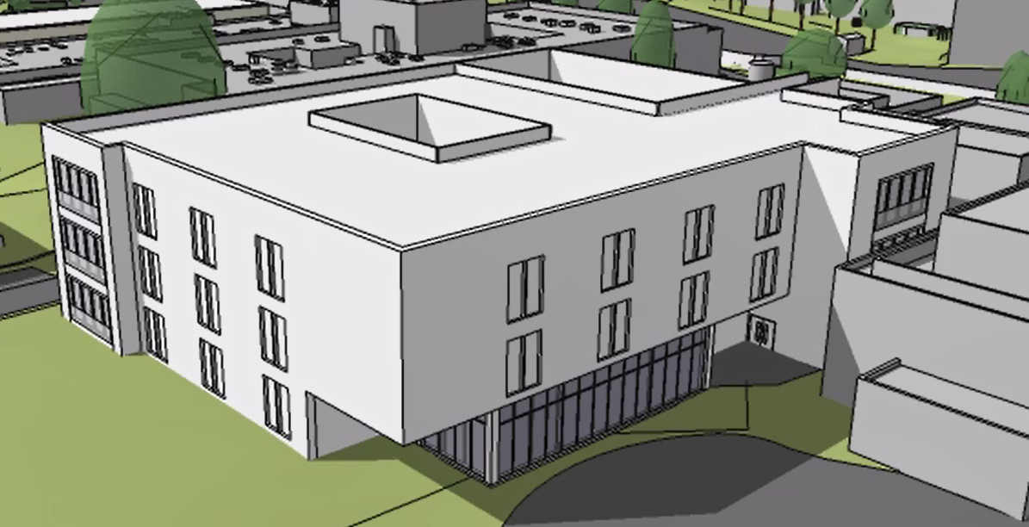
Looking ahead to next year - Estates
The future is uncertain for health and care organisations during the ongoing pandemic so we must be agile…
Work is ongoing in preparation for building the new Pathway Unit:
  Detailed design almost complete.
  Planning permission accepted.
Planning also continues for:
  New Women and Children’s Hospital.
  Surgical block including ITU / Theatres.
  Imaging Centre.
  Radiotherapy.
  And other developments.

Slide 35
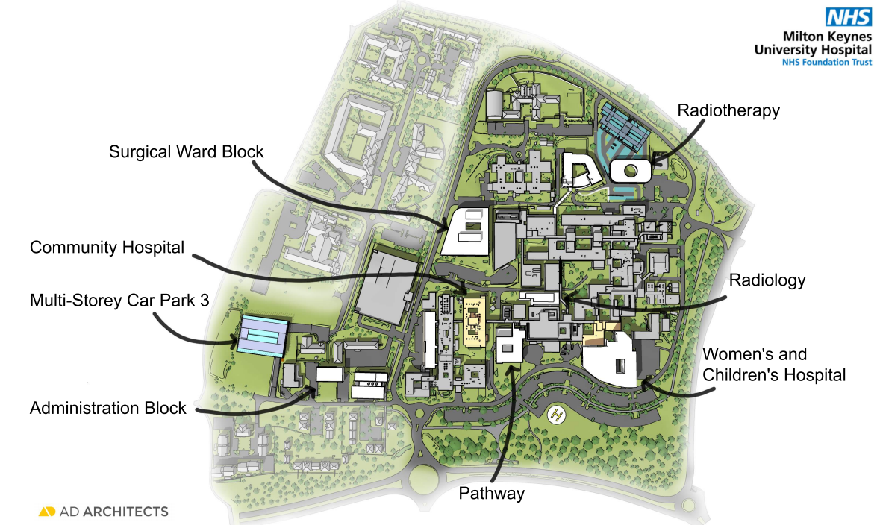
Site Development Control Plan

Slide 36
Looking ahead to next year – Digital developments
The expansion of the use of eCARE this year will encompass Paediatrics, Theatres and Anaesthetics and Intensive Care.
Existing use of eCARE will be improved greatly across the Organisation, and especially across outpatients.
MyCare – Better patient experience with digital documents at patients’ fingertips, including clinical letters, discharge summaries and test results – all part of going paperless.
Virtual library of patient information leaflets to be built on the Trust website.

Slide 37
Last, but not least – Thank you...
To our staff, who provide good, safe care every day for every patient…
To our volunteers…
To those who support our charity…
And to our community.

