Slide 1


Slide 2


Welcome and Opening Address
Alison Davis
Chair
Milton Keynes University Hospital
NHS Foundation Trust

Slide 3
Review of 2020/21
Professor Joe Harrison
Chief Executive Officer
Milton Keynes University Hospital
NHS Foundation Trust

Slide 4
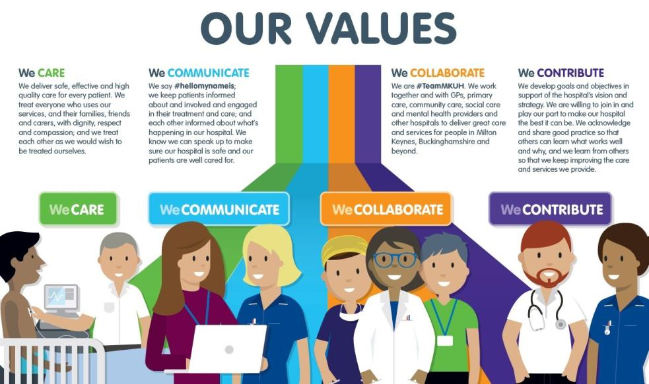

Slide 5
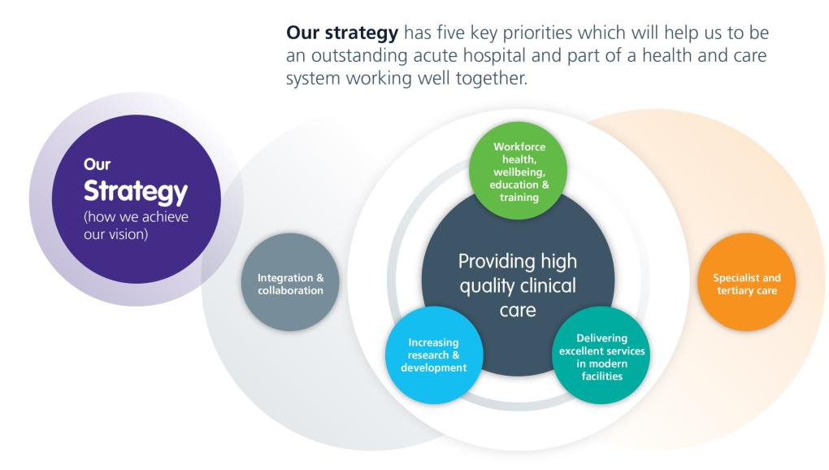

Slide 6
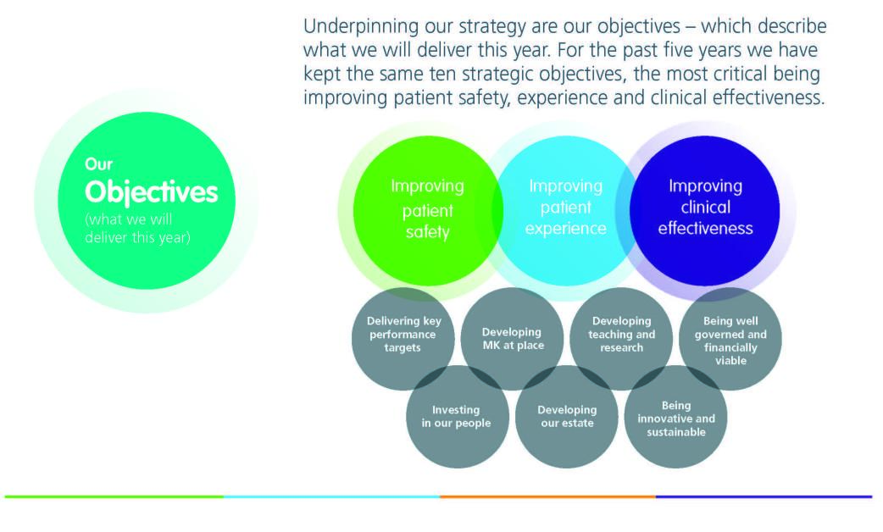

Slide 7
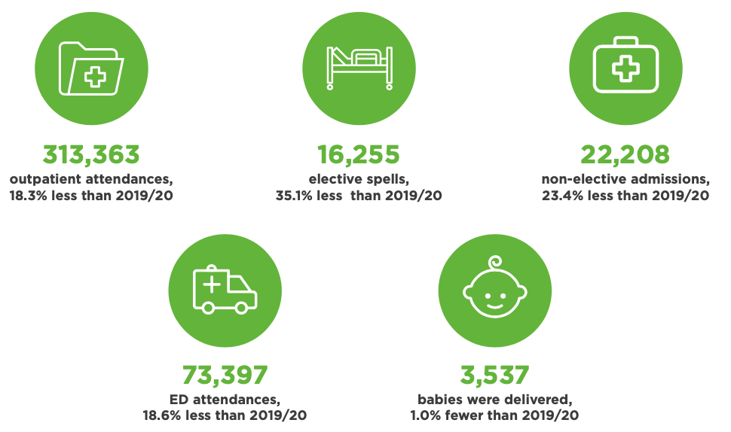
Our year in numbers
Notes:
Pandemic impact meant the national standard for consultant-led Referral to Treatment waiting times of 92% was not viable for the Trust to achieve
The Trust did not achieve the target of treating 95% of patients attending the ED within 4 hours, although our overall performance of 93.1% (all types) for the year placed us among the top performing trusts with a Type 1 department nationally

Slide 8
The impact of COVID-19 on activity
The COVID-19 pandemic had a significant impact on Trust operations, elective procedures and some outpatient appointments.
During the peaks of the virus, over half of our available beds were occupied by patients with COVID-19.
We worked hard to maintain urgent and cancer treatments.
Through the use of alternative technologies and virtual appointments (video and telephone) we were able to maintain many of our outpatient services.
Like all other providers, we had to suspend all but very urgent elective work at certain points in the 12 months, and this has created a large waiting list for patients.
The volume of planned care, including surgery, dramatically increase from March 2021, and we have continued to increase this in 2021.

Slide 9
The impact of COVID-19 on our community
We took the difficult decision to restrict visiting, with a few exceptions.
To help families stay in touch with their loved ones at hospital, we set up a dedicated relatives line, a Letters to Loved Ones service and a bag drop off, to allow people to safely deliver items to patients.
We quickly introduced virtual visitors, utilising devices to enable video calling.
The community rallied round staff, delivering gifts and cooked meals at every opportunity.
Face masks became mandatory on the hospital site at June 2020, and for the most part, local people adhered to these rules.
Thank you to the community of Milton Keynes for your continued support.

Slide 10
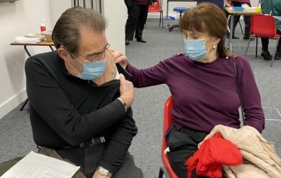
Vaccination Centre
In December 2020, MKUH opened one of the region’s first vaccination centre in the Academic Centre.
Over 35,000 doses of the Pfizer/BioNTech vaccine were administered to members of the public, MKUH and other local health and care staff.
Arthur Simper, 86, and wife Barbara, 82, were the first people in the East of England and some of the first in the country to receive the first dose of the COVID-19 vaccination centre.

Slide 11
The impact of COVID-19 on our staff
Our staff have worked incredibly hard throughout the year to respond to all the challenges of the pandemic.
Many worked longer hours, in full PPE and exhausting conditions, to deliver safe and effective care to local people.
Some staff have had to shield from their families for long periods, whilst others have had to work remotely as they were required to shield themselves.
Increased instances of sickness absence and COVID-19 isolation periods have put wards and departments under additional pressure.
We redeployed staff to bolster areas where there was critical need and utilised brilliant student nurses to help us too.
Thank you to all of #TeamMKUH for their professionalism, compassion and determination in difficult circumstances throughout the year.

Slide 12
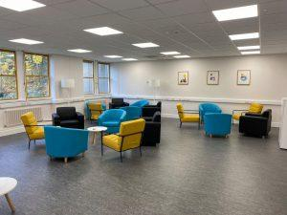

Staff support
We introduced a new staff hub (pictured), to give colleagues additional space to relax and decompress.
Free hotel accommodation and complimentary hot evening meals were organised for staff shielding from their families.
A COVID-19 helpline continued to support staff with any questions they may have, and daily welfare calls were set up with those in isolation.
We ran 12 Weeks of Wellbeing from January to March and focused on all the support available to staff, as well as introducing £2 healthy meals from our restaurant, virtual staff social groups (Click and Connect) and a work place activity app, where teams could track steps and exercise.
Notes:
Also mention our P2P listening service, mental health first aiders and Vivup employee assistance programme

Slide 13

Staff engagement
The NHS Staff Survey in November 2020 highlighted significant improvements in our scores from staff on health and wellbeing and staff engagement.
We held our annual staff event, Event in the Tent, as a virtual conference for the first time in September 2020. The themes were rest, resilience and recovery.
Live virtual Q&As take place each week, with hundreds of staff attending to see a presentation and ask the exec team any questions.

Slide 14
Digital advances
A large proportion of outpatient activity was maintained throughout pandemic by deploying alternative technologies and delivering a number of virtual clinics either by video or telephone to our patients.
Apple Health partnership increased access to information for patients and staff.
More MyCare app development.
The next phase of our electronic eCARE patient records system went live in theatres, anaesthetics, paediatrics and the Intensive Care Unit.
Technological advances facilitated a change in culture towards virtual meetings via MS Teams, enabling greater flexibility.
Virtual library of all patient information leaflets live on Trust website, enabling better accessibility to information with translation and screen reading services available.

Slide 15
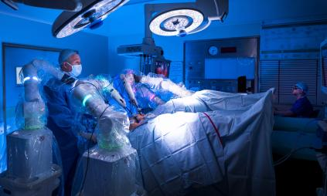
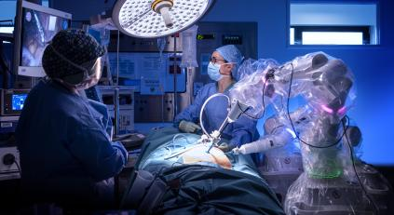
Advances in our services
We became the first hospital in Europe to use robotic surgery for major gynaecological surgery
The Advanced Recovery Programme continued to deliver safer surgery and reduced stay for patients
MKUH also became the first hospital in Europe to trial an app to assist hip and knee replacement patients in June 2020. It aides recovery and allows clinicians to remotely monitor patient progress.

Slide 16
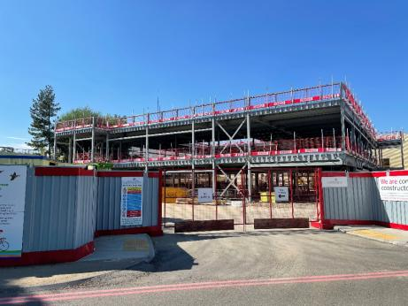
Estate development
Groundwork for Maple Centre construction started in February 2021 next to ED.
The centre is designed to provide improved integrated access to primary care, community and mental health services and social care for patients with complex or multiple needs who attend A&E. With 26 beds and 16 assessment rooms, the unit will provide support to patients, returning them home at the earliest opportunity and lessening demand on the main A&E services.
The Maple Centre is currently scheduled to be open at the end of 2022.

Slide 17
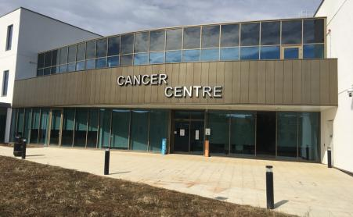
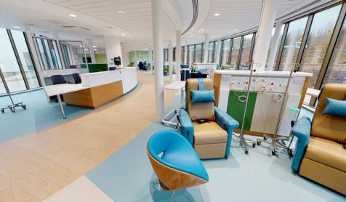
Cancer Centre – A year on
Cancer Centre celebrated its first birthday in March 2021.
Facilities include chemotherapy suite, 24-bed ward, family visiting areas and an information and wellbeing area.
Feedback from patients, visitors and staff very positive through year.
Centre has met the needs of patients and visitors during challenges of the pandemic.

Slide 18

Research & Development
In 2020/21, the Trust:
Was the top recruiting small acute trust in the country for the third year running, with almost 4,000 participants recruited to 21 clinical research studies and 1,580 staff members recruited to the COVID-19 antibody testing programme;
Received £754,000 to deliver National Institute of Health Research (NIHR) portfolio research;
Recruited patients to 19 speciality areas;
Contributed to various therapeutic and mechanistic studies in
COVID-19 research in the past year;
Maintained a high level of recruitment of participants to COVID19 and other research studies with a total recruitment of
5,533 participants.

Slide 19
Financial Review of 2020/21
Terry Whittle
Director of Finance
Milton Keynes University Hospital
NHS Foundation Trust

Slide 20
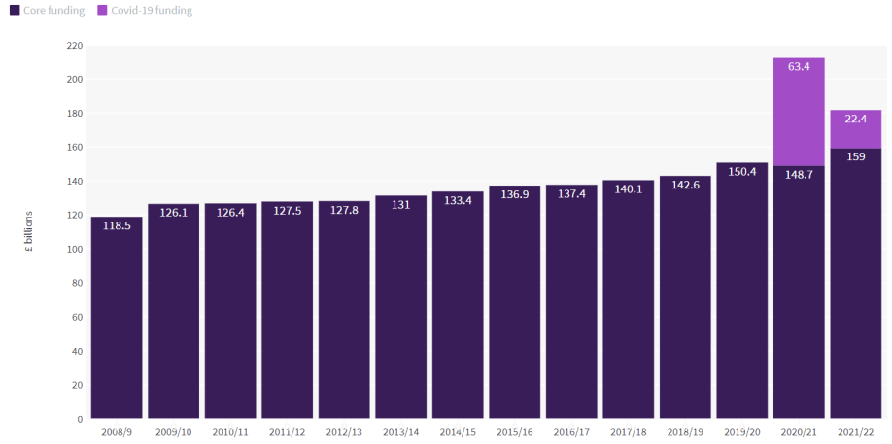
A year defined by COVID-19

Slide 21
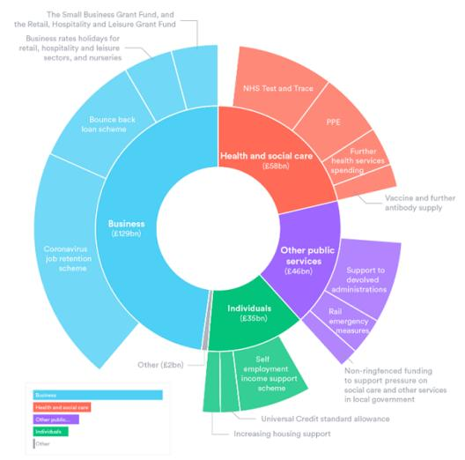
Additional government funding for
COVID-19
Source: The Nuffield Trust analysis of data from the National Audit Office

Slide 22
Changes made to NHS finance regime in response to Covid-19
Suspension of contracts between NHS organisations, replaced with
Heavily centralised block funding arrangement (six month basis)
Top-up payments for direct pandemic related costs (e.g., enhanced cleaning)
Front loading of cash payment to ensure rapid cashflow to suppliers
Independent Sector Providers nationally and then regionally contracted
Funding available to support reconfiguration of space and capacity
Funding regime designed to support cost of provision and deliver breakeven financial performance
Cabinet Office Procurement Policy Notices to support key suppliers
Source: NHSE/I ‘Revised arrangements for NHS contracting and payment during the COVID-19 pandemic’

Slide 23
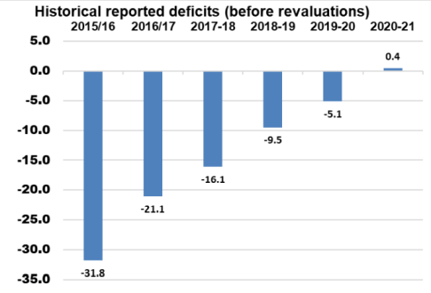
MKUH Financial performance
Surplus of £0.4m vs. planned deficit of £3.6m
Operating income increased by £18.6m (7.9%)
Operating expenditure increased by £12.1m (4.2%) over same period
Exceptional funding regime in place throughout 2020/21 prevents meaningful comparison to historical financial performance

Slide 24
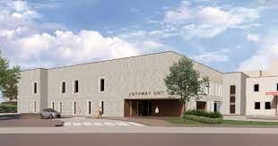
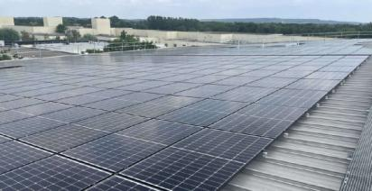
Investing in the future
The Trust invested nearly £41m in capital programmes during 2020/21.
Key areas of investment focus were;
MRI equipment
New Hospitals Programme infrastructure development
Commencement of Maple Centre Development
Endoscopy equipment
Investment in solar panels

Slide 25

Milton Keynes Hospital Charity
Fundraising appeals and activities included:
BabyLeo Neonatal Incubator x 3
Covid-19 Emergency Appeal raised £190k for new Staff Hub and garden
Artwork across the Hospital
Technology to support mobile visiting during Covid-19
Courtyard Garden maintenance for staff and patients
Use of unrestricted funds to support a range of health related activities for the benefit of patients, their families and staff.

Slide 26
Focus for 2021/22 and beyond
As the NHS transitions to the next stage of managing and responding to the COVID-19 pandemic we see a mix of familiar and new challenges:
Continuing to resource the Hospital to ensure we are providing safe services for patients suffering from Covid-19.
Transforming services to safely provide routine acute hospital care whilst the virus is prevalent in society.
Investing in acute care and diagnostic capacity to provide a robust recovery of the accumulated waiting list backlog.
Transitioning from the emergency pandemic NHS funding regime to a new payment model which is likely to be a mix of fixed and variable funding.
Working with Integrated Care System Partners across Bedford, Luton and Milton Keynes to carefully manage our resources to meet the needs of the population we serve.

Slide 27
Council of Governors and Membership Update
02 November 2021
Alan Hastings
Lead Governor
Milton Keynes University Hospital
NHS Foundation Trust

Slide 28
COVID-19 pandemic
Unfortunately, as with last year, the activities of the Governors have been somewhat restricted towards the end of the 2020/21 year by the restrictions of visiting the Hospital due to the COVID-19 pandemic.
Whilst this AMM is focused largely on 2020/21, the Governors recognise, warmly applaud and thank every Member of Staff for their excellent service during the ongoing pandemic. Their work has been exemplary, for which we must all offer them our sincere thanks and gratitude.

Slide 29
Our Governors
26 Governors in total, comprising:
  15 public governors - 8 constituencies (they must always be in the majority)
  7 staff governors
  4 appointed governors, including:-
    Healthwatch Milton Keynes
    Community Volunteer representation
    Milton Keynes Business representation
    Milton Keynes Council

Slide 30
New Governors
We welcome our new Governors
All of our Governors are volunteers and unpaid, thus ensuring our independence.

Slide 31
Statutory Duties
The Council of Governors has a number of statutory duties required by law.
Perhaps the most important of these throughout the year are to:
Hold Non-Executive Directors to account for the performance of the Board of Directors.
Represent the interests of patients, the Members of the Trust as a whole and the public in general (we use the legal term Trust, but most of us know it as our Hospital).
I stress the word ‘OUR’ as every member of the staff I have met and our Governors think of it that way.

Slide 32
Statutory Duties cont’d
As Governors we must:
Be independent of the Board of Directors
Represent the interests of Patients and families, Members and the Citizens of Milton Keynes
Abide by the Code of Practice - 7 Nolan Principles of Public Life :
    Selflessness
    Integrity
    Objectivity
    Accountability
    Openness
    Honesty
    Leadership

Slide 33
Activities 2020-2021
The Council formally meet 4 times during the year.
We also have regular Informal meetings with the Chair. The Chair and Lead Governor also have one-to-one meetings.
The Council of Governors is responsible for appointment of the Chair of the Board and the Non-Executive Directors.
The Appointments Committee, which I chair as Lead Governor, earlier in the year appointed our new Chair, Alison Davis.
The Council of Governors monitored Trust governance issues, received a range of reports on finance, performance, quality and workforce and are empowered to provide scrutiny and challenge.

Slide 34
Other activities
The Council of Governors:
Received and reviewed formal reports, including the 2020/21 Annual Report and Accounts.
Participated in meetings of the Charitable Funds Committee and the Quality and Clinical Risk Committee.
Participated in the Clinical Excellence and Staff Awards.
Participated in the hospital’s infrastructure meetings and cancer experience group meetings
Have an ongoing drive to increase membership and enable patients and the public to have their say in the future development of the Hospital. We have a Membership Engagement Group.
Participated in meetings of the Lead Governors Network for the East of England area.
Were involved in the appointment of the Hospital’s food supplier.

Slide 35
Membership
The total membership, including public members and staff members, was 8,426 at the end of the year.
The Membership and Engagement Strategy was revised and refreshed to encourage members to get more involved but, due to Covid-19 restrictions, this has yet to be implemented.
We requested the Hospital to add to the front page of the Hospital website an easy access to the Members page. Hopefully, you have tried it.

Slide 36
Membership:
Planned activities
    These are subject to restrictions and will
    probably be virtual:
    More Meet the Members events.
    Local community recruitment campaigns.
    Newsletter which is issued biannually.
    Encourage use of the more easily accessible information on the hospital website to keep everyone up-to-date.

Slide 37
Membership
As Governors we represent Patients, Members and the Public
We would love to hear from you so if you have any comments or would like to share your experience of the services at the Hospital do please contact your governor. Their email addresses are listed on the Hospital website

Slide 38
Our governors
 | Governors | Constituency
PUBLIC | Babs Lisgarten | Bletchley & Fenny Stratford, Denbigh, Eaton Manor & Whaddon
 | Alan Hastings (Lead Governor)
 | William Butler | Emerson Valley, Furzton, Loughton Park
 | Jordan Coventry
 | Akin Soetan | Linford South, Bradwell, Campbell Park
 | Brian Lintern | Hanslope Park, Olney, Sherington, Newport Pagnell
 | Alan Hancock
 | Niran Seriki | Walton Park, Danesborough, Middleton, Woughton
 | Clare Hill
 | Ann Thomas | Stantonbury, Stony Stratford, Wolverton
 | Robert Johnson-Taylor
 | Lucinda Mobaraki | Outer catchment area
 | VACANT
 | VACANT | Extended area
STAFF | Raju Thomas Kuzhively | Doctors and Dentists
 | Elizabeth Maushe | Nurses and Midwives
 | Tracy Rea
 | Yolanda Potter | Scientists, technicians and allied health professionals
 | Emma Isted | Non-clinical staff groups e.g. admin & clerical, estates, finance, HR, management
 | VACANT
 | Pirran Salter
APPOINTED | Andrew Buckley | Milton Keynes Business Leaders
 | Maxine Taffetani | Healthwatch Milton Keynes
 | Clare Walton | Community Action:MK
 | Andy Reilly | Milton Keynes Council
Notes:
You will probably recognise Clare Hill and Ann Thomas from their support in the Friends Shop. Robert Johnson-Taylor is also active on the southsite infrastructure group.
As you will see from the bottom of the table we also have four appointed governors from the community who support and promote the hospital.

Slide 39
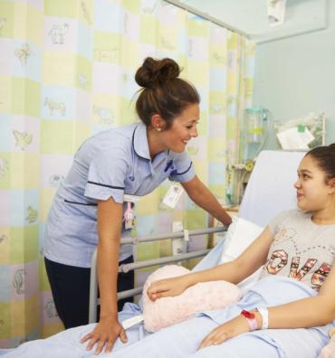
COME AND JOIN US!
OUR hospital is here FOR YOU.

Slide 40
Looking ahead
Professor Joe Harrison
Chief Executive Officer
Milton Keynes University Hospital
NHS Foundation Trust

Slide 41
Looking ahead…
Accelerating activity – since March 2021 we have been increasing activity to deliver above pre-pandemic levels.
We know we have to do more to cut down waiting times and improve access to services – our work in the year ahead includes using technology to offer more virtual appointments where appropriate, delivering more of our services in the community and using different models to give patients more control.
Pushing forward with our digital strategy, which sets out ambitious priorities to utilise Artificial Intelligence, Virtual Reality and better data to help improve patient care and experience.

Slide 42
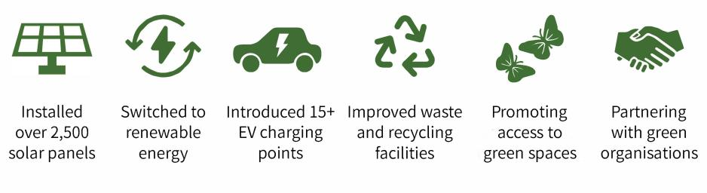
#MKUHGreenerFuture
Green is the colour – the Trust will continue progressing its green agenda.
Our ambition is to be Net Carbon Zero by 2030. This is 10 years ahead of the national target for the NHS.

Slide 43
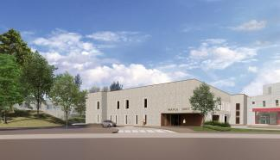
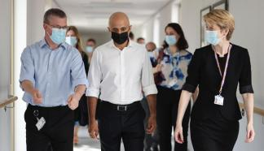
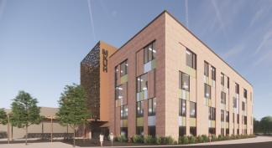
Estates developments
The Maple Centre is currently scheduled to be open late next year, reducing pressure on our Emergency Department
Plans continue to build a new Women’s & Children’s Hospital, Elective Surgery Centre and Imaging Centre as part of The New Hospital Programme (NHP). We are receiving seed funding from the DHSC for the development of these plans.
We welcomed the then-new Health Secretary, Sajid Javid, and NHS England and Improvement Chief Executive, Amanda Pritchard to our hospital to see our plans to increase capacity and improve services for local people.

Slide 44
Thank you...
To our staff, who provide good, safe care every day for every patient…
To Lead Governor Alan Hastings, who is stepping down from his role…
To our volunteers…
To those who support our charity…
And to our community.

Slide 45
Any questions?

