Slide 1
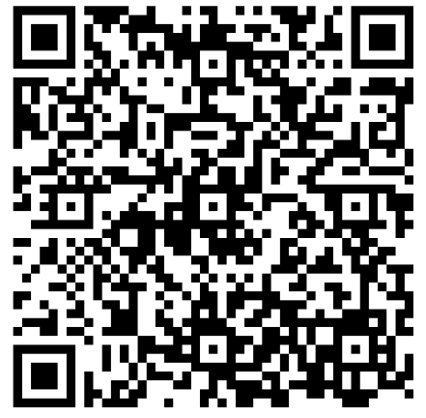
Food First Training for Care Homes
Katy Savage
Lead Dietitian for Food First & Prescribing Support
Before we start, please complete this quiz:

Slide 2
Aim
To improve the knowledge, attitudes and confidence of care home staff on managing malnutrition in their residents and promoting best practice.

Slide 3
Learning objectives
Understanding malnutrition
The definition of malnutrition
Causes of malnutrition and groups particularly at risk
The consequences of malnutrition
How to identify malnutrition risk using the ‘MUST’ tool
How and when to take a weight/height (including use of alternative measures)
How to set an appropriate nutritional aim
A food-based approach
‘MUST’ management guidelines
Food-based management principles
Nutrient dense snacks
Nourishing drinks and oral nutritional supplements
How and when to complete a nutritional care plan
How and when to complete food and fluids charts
Specific nutritional considerations in the following areas: dysphagia, dementia, diabetes, end of life care

Slide 4
CQC Regulation 14 Meeting Nutritional and Hydration Needs
‘The intention of this regulation is to make sure that people who use services have adequate nutrition and hydration to sustain life and good health and reduce the risks of malnutrition and dehydration while they receive care and treatment.’
‘To meet this regulation, where it is part of their role, providers must make sure that people have enough to eat and drink to meet their nutrition and hydration needs and receive the support they need to do so.’
‘People must have their nutritional needs assessed and food must be provided to meet those needs. This includes where people are prescribed nutritional supplements and/or parenteral nutrition. People's preferences, religious and cultural backgrounds must be taken into account when providing food and drink.’
Notes:
Regulation 14: Meeting nutritional and hydration needs - Care Quality Commission

Slide 5
How would you describe someone who is at risk of malnutrition?

Slide 6
What is malnutrition?
‘Malnutrition is defined as a state in which a deficiency of nutrients such as energy, protein, vitamins or minerals results in measurable adverse effects on body composition, function or clinical outcome’.
(NICE, 2006)

Slide 7
How many people in the U.K. are malnourished?
^{A} 1.5 million
^{B} 3 million
^{C} 5 million
^{D} 10 million

Slide 8
How many people in the UK are malnourished?
^{A} 1.5 million
^{B} 3 million
^{C} 5 million
^{D} 10 million

Slide 9
How many people admitted to hospital are at risk of malnutrition?
^{A} 10-18%
^{B} 18-25%
^{C} 25-34%
^{D} 42-56%

Slide 10
How many people admitted to hospital are at risk of malnutrition?
^{A} 10-18%
^{B} 18-25%
^{C} 25-34%
^{D} 42-56%

Slide 11
How many people admitted to care homes are at risk of malnutrition?
^{A} 30-42%
^{B} 15-29%
^{C} 50-68%
^{D} 5-14%

Slide 12
How many people admitted to care homes are at risk of malnutrition?
^{A} 30-42%
^{B} 15-29%
^{C} 50-68%
^{D} 5-14%

Slide 13
What is the annual health cost of malnutrition in England?
^{A} £572 million
^{B} £10.45 billion
^{C} £19.6 billion
^{D} £5.32 billion

Slide 14
What is the annual health cost of malnutrition in England?
^{A} £572 million
^{B} £10.45 billion
^{C} £19.6 billion
^{D} £5.32 billion

Slide 15
What do you think causes malnutrition?

Slide 16
Causes of Malnutrition
Dysphagia
Constipation
Poor mental health
Dysphagia
Drowsiness
Nausea/Vomiting
Dementia
Poor dentition

Slide 17
Do you think there are any groups of people that are at higher risk of malnutrition?

Slide 18
Groups at Risk of Malnutrition
Acutely unwell
Chronic illness e.g. COPD, cancer
Progressive diseases e.g. dementia
Disability e.g. immobility

Slide 19
What are the consequences of malnutrition?

Slide 20
Consequences of Malnutrition
Increased falls
Pressure ulcers
Bone fractures
Infections
Greater reliance on carers
Hospital admissions

Slide 21
What does ‘MUST’ stand for? Has anyone used it?

Slide 22
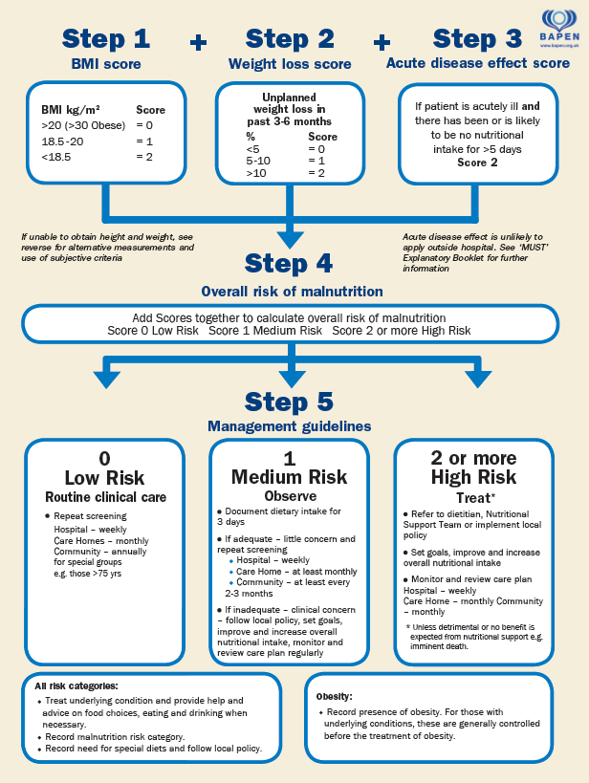
‘MUST’
‘MUST’ stands for Malnutrition Universal screening Tool.
It is the only validated nutritional screening tool.
It is not a diagnostic tool but determines someone’s risk of becoming malnourished.
Notes:
‘MUST’ stands for Malnutrition Universal screening Tool.
It is designed to help us identify those at risk of malnutrition as well as those who are obese.
‘MUST’ is the only nutritional screening tool that is validated.
‘MUST’ is not a diagnostic tool.
‘MUST’ can be completed using Systm1when you’re reviewing your service users.

Slide 23
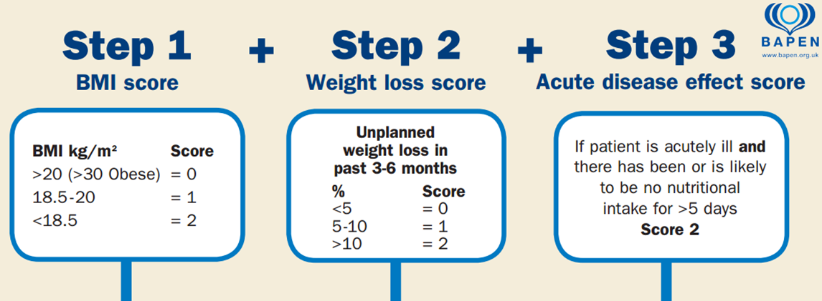
Notes:
Step 1: BMI score:
BMI stands for body mass index.
It uses height in metres and weight in kilograms to work out if your weight is healthy.
The lower the BMI is, the higher the risk of malnutrition.
Scored between 0-2.
Step 2: Weight loss score:
This is looking at unexplained/unplanned weight loss within the last 3- 6 months.
We find the difference between current weight and the weight from 3-6 months ago.
We convert the amount lost into a percent. The higher the percentage (the more someone has lost); the higher the risk of malnutrition.
Scored between 0-2.
Step 3: Acute disease effect score:
This is where a person has had no nutritional intake for at least 5 days or more.
We do not count this step within the community.

Slide 24
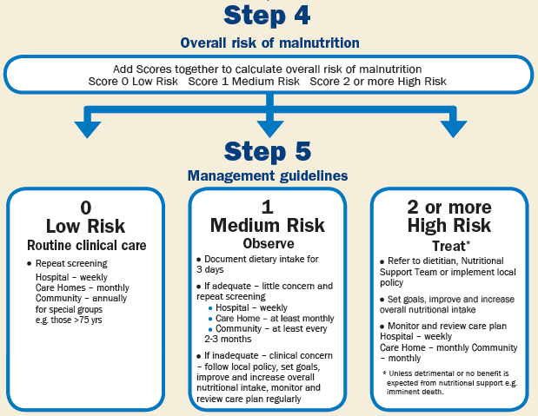
Notes:
Step 4: Total ‘MUST’ score:
Adding scores calculated from step 1 and 2.
Can get a score between 0-4.
The higher the ‘MUST’ score, the higher the risk of malnutrition.
Step 5: Management guidelines:
0 = Low risk.
1 = Medium risk.
2 = High risk.

Slide 25
Step 1: Body Mass Index (BMI)
It uses height (metres) and weight (kilograms) to work out if weight is in the healthy range. The lower the BMI, the higher the risk of malnutrition
Calculation: BMI calculation = weight (kg) ÷ height (m) ÷ height (m)
>20kg/m² = 0 18.5-20kg/m² = 1 18.5kg/m² = 2

Slide 26
Step 2: Weight Loss Score
Uses current weight and weight from 3 months* ago
*Some electronic care systems take weight from 6 months ago/highest weight from past 3-6 months
Calculation: (Weight from 3 months* ago – Current weight) x 100
Weight from 3 months ago
<5% = 0 5-10% = 1 >10% = 2

Slide 27
Total ‘MUST’ Score
BMI Score
>20kg/m² = 0
18.5-20kg/m² = 1
<18.5kg/m² = 2
Weight Loss
<5% = 0
5-10% = 1
>10% = 2
Total MUST score will always be between 0-4
Most electronic care systems do the maths for you!

Slide 28
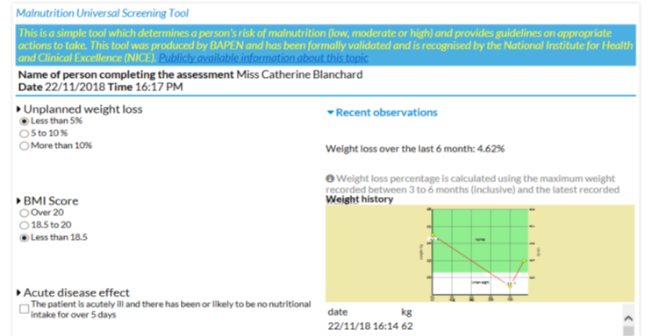
Electronic care plans - PCS
Most care plan software calculates BMI, percentage weight loss, and MUST for you when you input current weight
Take care if you need to input the BMI and weight loss score
Notes:
This is an example from PCS – there are several other types of care plan software used
If BMI & WL score are input incorrectly then the total MUST score recorded will be wrong

Slide 29
Electronic care plans - CMS

Slide 30
How often do you weigh your residents? Is there anyone you can’t weigh? How do you monitor them? How would you obtain someone’s height?

Slide 31
Collecting anthropometrics
Residents should be weighed:
On admission (within 48 hours),
On return from hospital (within 48 hours)
Monthly (same date +/- 2 days)
Record if resident is unable to be weighed e.g. declined / unwell
MUAC is an alternative for weight.
Only to be used if unable / inappropriate to hoist.
Gives you estimated BMI category, NOT a weight.
Look for changes each month.
Height should be recorded on admission.
Can be estimated by ulna length.
Source of height should be recorded.

Slide 32
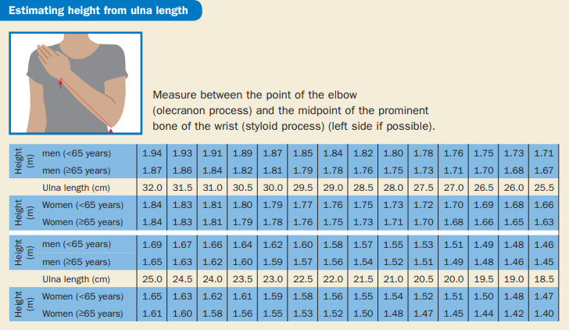

Slide 33
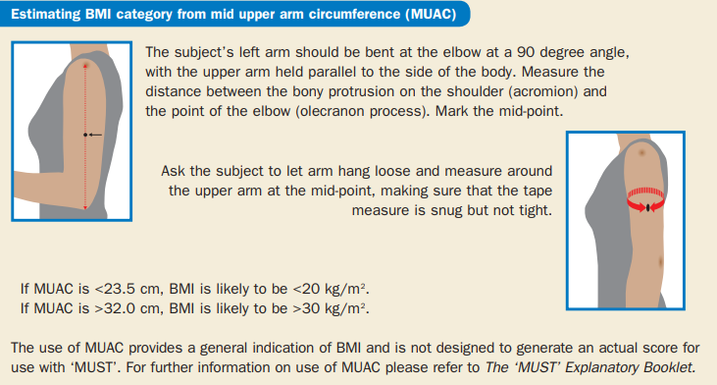

Slide 34
Who would you talk to about setting a nutritional aim? Do you encourage weight loss?

Slide 35
Setting an Appropriate Aim
Speak to resident, family, maybe Dietitian
Gaining weight not always realistic.
Maintaining weight is important.
Some residents may not be able to maintain, so minimising maybe appropriate.
There may be other individual aims or considerations
Weight management:
Weight loss may not be appropriate.
Often ineffective in care homes as needs to be paired with physical activity.
Resident may be losing muscle mass rather than fat mass.
Healthier BMI range in older adults is up to 30.

Slide 36
Break

Slide 37
Can you describe what the food-based approach is? What would you do if someone is low, medium, or high risk?

Slide 38
Food-based Approach
Food fortification​
Adding extra energy and protein to foods/meals without increasing the portion size​.
Nourishing drinks​
Additional 300kcal and 12g protein (approx.) per serving. Have in between meals​.
100kcal boosters​
For a little and often approach, for those with a small appetite.

Slide 39
MUST Management Guidelines
Score 0 = LOW RISK:
Aim to maintain a healthy weight and follow a balanced diet.
If overweight (BMI >30kg/m²), encourage healthier alternatives for meals and snacks and inspire to take part in physical activity.

Slide 40
MUST Management Guidelines
Score 1 = MEDIUM RISK:
Aim to increase oral intake by an extra 500kcal per day to prevent further weight loss or to achieve and maintain a healthy BMI (>20kg/m2).
At least 2 nourishing drinks, snacks or a fortified diet are offered as per the service user’s preference.
Record food and fluid intake for at least 3 days to highlight problem areas; be specific when recording quantities consumed.
Follow fortified diet plan for at least one month to encourage weight gain or maintenance.

Slide 41
MUST Management Guidelines
Score 2+ = HIGH RISK:
Aim to increase oral intake by an extra 500-1000kcal per day to prevent further weight loss and to achieve and maintain a healthy BMI (>20kg/m2).
At least 2 nourishing drinks, snacks and a fortified diet are offered as per the service user’s preference.
Record food and fluid intake for at least 3 days to highlight problem areas; be specific when recording quantities consumed.

Slide 42
When would you refer to a Dietitian? How do referrals work here?

Slide 43
Dietetic referrals
When is a referral to a Dietitian appropriate?
MUST score of 2 or more and continue to lose weight after one month of following the MUST Management Guidelines
A stable BMI of <18.5kg/m2 and resident is keen to gain weight
A Grade 3 or 4 pressure wound/non-healing wound
Frequent falls
Weight loss of >2kg in any one month after confirmation of at least two readings
Have complex nutritional needs such as uncontrolled diabetes, renal failure, CKD 3 with high potassium, heart failure with volume restrictions, gastrointestinal disorders.
Are at risk of developing refeeding syndrome (BMI <16kg/m², or who have had little or no nutritional intake for the last 10 days, or who have lost >15% body weight in the last 3-6 months but excluding those at the end of life).
Are reliant on fluid as the sole source of nutrition.
Are admitted to a Care Home already on a prescription of ONS.
When is a referral to a Dietitian not appropriate?
Overweight residents wishing to lose weight
MUST score 1 without other reason
Resident/LPA who does not consent to referral
What to do if you’re unsure:
Email food.first@mkuh.nhs.uk or phone 01908 995416
Who can refer and how?
Care home teams – please email the new form to food.first@mkuh.nhs.uk

Slide 44
What is food enrichment? What do you do already?

Slide 45
Food enrichment
Using everyday food items to enrich the diet with energy and protein
Adding extra calories and nutrients without increasing the portion size of foods​
Always choose the full-fat and full sugar products!​
Food Enricher | Energy | Protein
Butter / ghee | ✔ | ✖
Cream | ✔ | ✖
Full fat milk | ✔ | ✔
Milk alternatives (soya/oat etc) | ✔ | ✔
Skimmed milk powder | ✔ | ✔
Oil / mayonnaise / sauces | ✔ | ✖
Yoghurt | ✔ | ✔
Cheese | ✔ | ✔
Ground nuts / nut butters | ✔ | ✔
Cream cheese | ✔ | ✔ Low
Sugar / honey / jam | ✔ | ✖
Notes:
Food First/Food Enrichment | BAPEN

Slide 46
Pots of goodness

Slide 47
100kcal boosters
Foods which are 100kcal in a small volume
Useful for people who struggle with fixed mealtimes
Snacks and/or fortification
Savoury additions: Butter - 2 cubes Dried milk powder - 2 tbsp Full fat mayonnaise - 1 tbsp Full fat salad cream - 2 tbsp Ghee -1 tbsp Grated cheese - 3 tbsp Hummus - 2 tbsp Olive oil - 1 tbsp Peanut butter - 1 tbsp Pesto - 1 heaped tbsp Linseed/chia seeds - 2 tbsp | Sweet additions: Chocolate hazelnut spread - 1 tbsp Condensed milk - 2 tbsp Double cream - 2 tbsp Dried milk powder/soy protein - 2 tbsp Golden syrup - 2 tbsp Ground almonds - 2 tbsp Honey - 2 tbsp Lemon curd/jam - 2 tbsp Plain yoghurt - 3 tbsp Sugar - 2 tbsp Coconut milk - 2tbsp

Slide 48
Food enrichment game

Slide 49
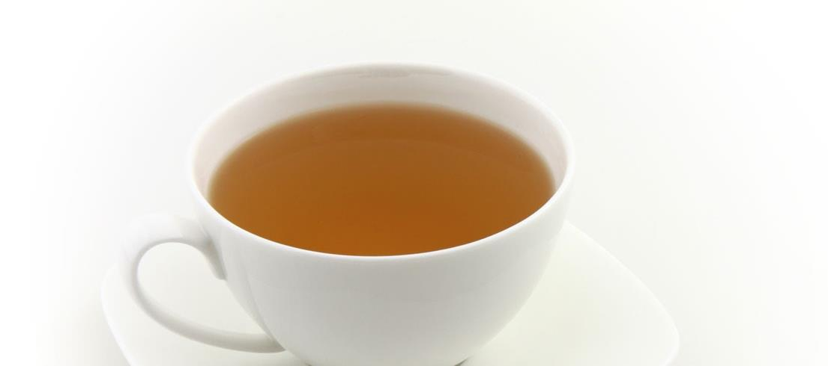
Cup of tea

Slide 50
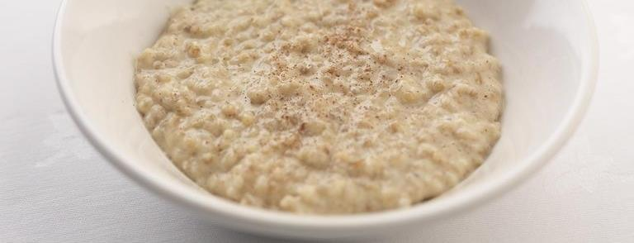
Bowl of porridge

Slide 51
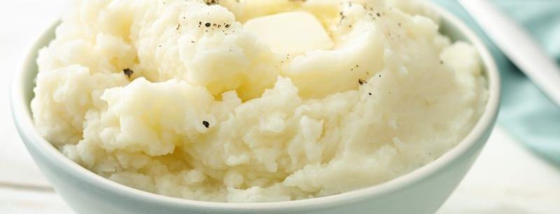
Mashed potato

Slide 52
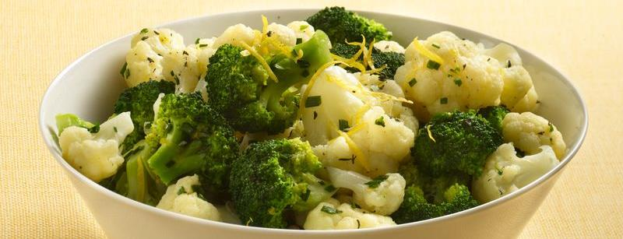
Vegetables

Slide 53
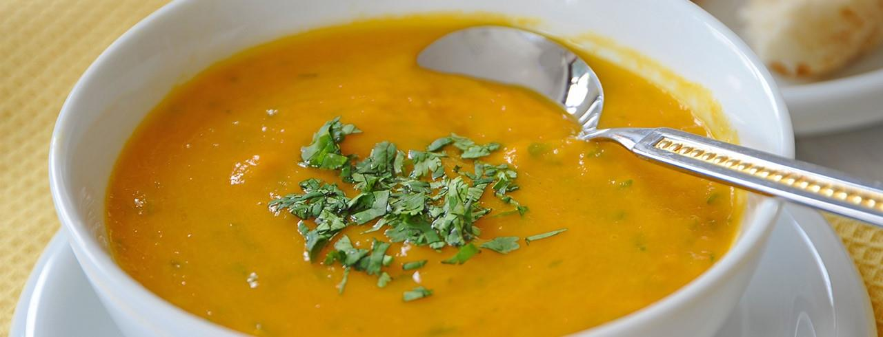
Soup

Slide 54
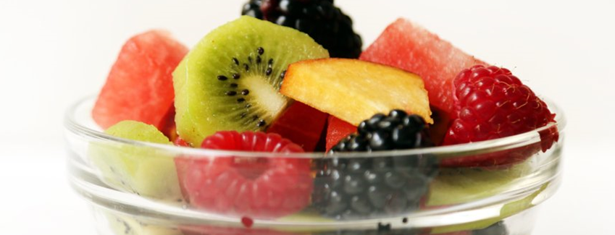
Fruit salad

Slide 55
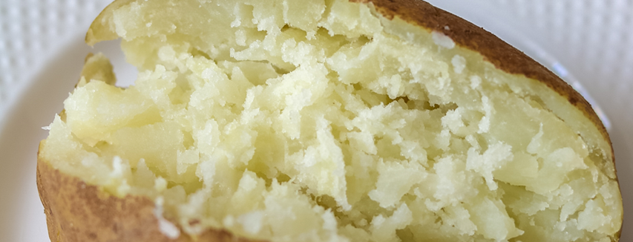
Baked potato

Slide 56
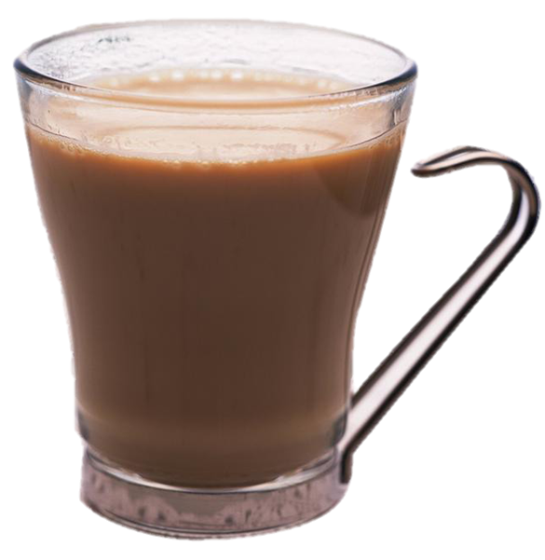
Cup of coffee

Slide 57
Before and after

Slide 58
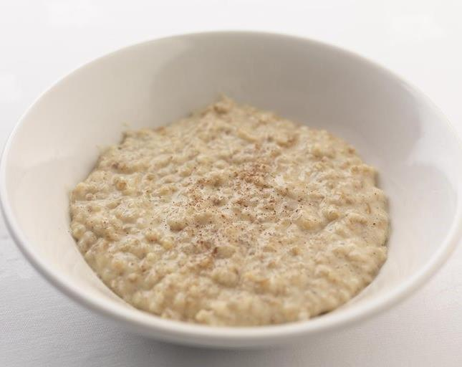
Porridge
Before
50g oats + 300ml whole milk
386kcal, 16g protein
After:
Add 2tbsp skimmed milk powder, 1 tbsp butter, 2 tbsp ground almonds
787kcal, 33g protein
+ 401kcal, 17g protein

Slide 59
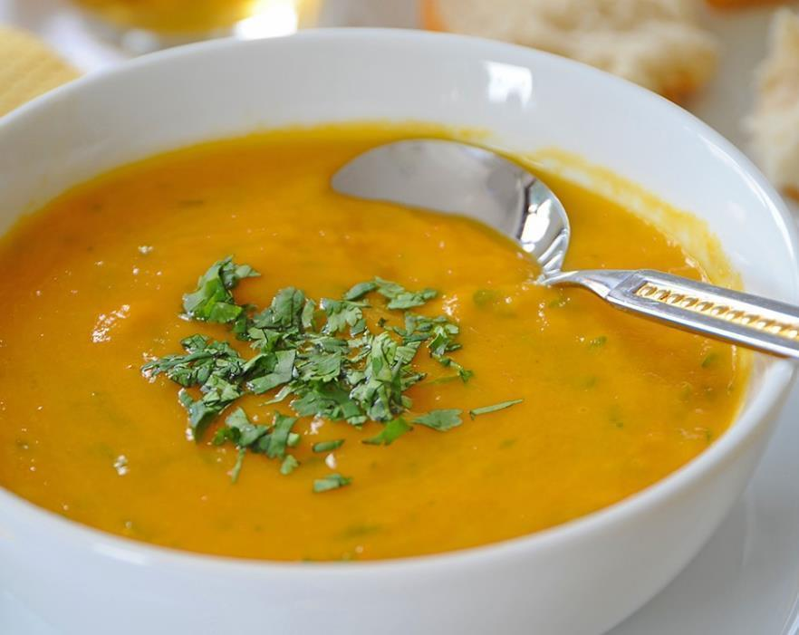
Soup
Before
300ml fresh cream of tomato soup
217kcal, 5.4g protein
After:
Add 2tbsp skimmed milk powder, 30g grated cheese, 3tbsp yoghurt (heaped)
525kcal, 28.8g protein
+ 308kcal, 23.4g protein

Slide 60
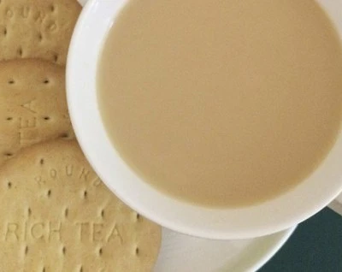
Coffee and biscuits
Before
Coffee granules, hot water, 30ml whole milk, 2 rich tea biscuits
106kcal, 2.5g protein
After:
Add 2tbsp skimmed milk powder, 170ml whole milk (hot), 2 chocolate digestive biscuits
486kcal, 21.4g protein
+ 380kcal, 18.9g protein

Slide 61
Can you think of any snacks that are particularly nutrient dense? What might you give someone who has to have a texture modified diet?

Slide 62
Nutrient dense snacks
Savoury snacks: Beef jerky - 1 large piece Brazil nuts – 5 nuts Cheese - 1 matchbox size piece (25g) Cream crackers - 3 Crisps - small bag Dolma – 2 pieces Falafel - 2 Peanuts/cashew/pistachio nuts - small handful/20g Pretzel – small handful/30g Rice cakes - 3 Samosa - 1 small Sourdough /rye bread - 1 slice | Sweet snacks: Banana – 1 small Chocolate – 3 cubes Chocolate digestives - 1 biscuit Dates - 6 or 2 medjool dates Dried apricots/prunes - 7 Ice cream - 1 scoop Jaffa cakes - 2 Malt loaf - 1 slice Mathri – 1 biscuit Rich tea biscuits - 3 Sultanas - 2 tbsp Sweets – small handful/20g Yoghurt - 1 small pot

Slide 63
What are the benefits of the food-based approach over prescribed products?

Slide 64
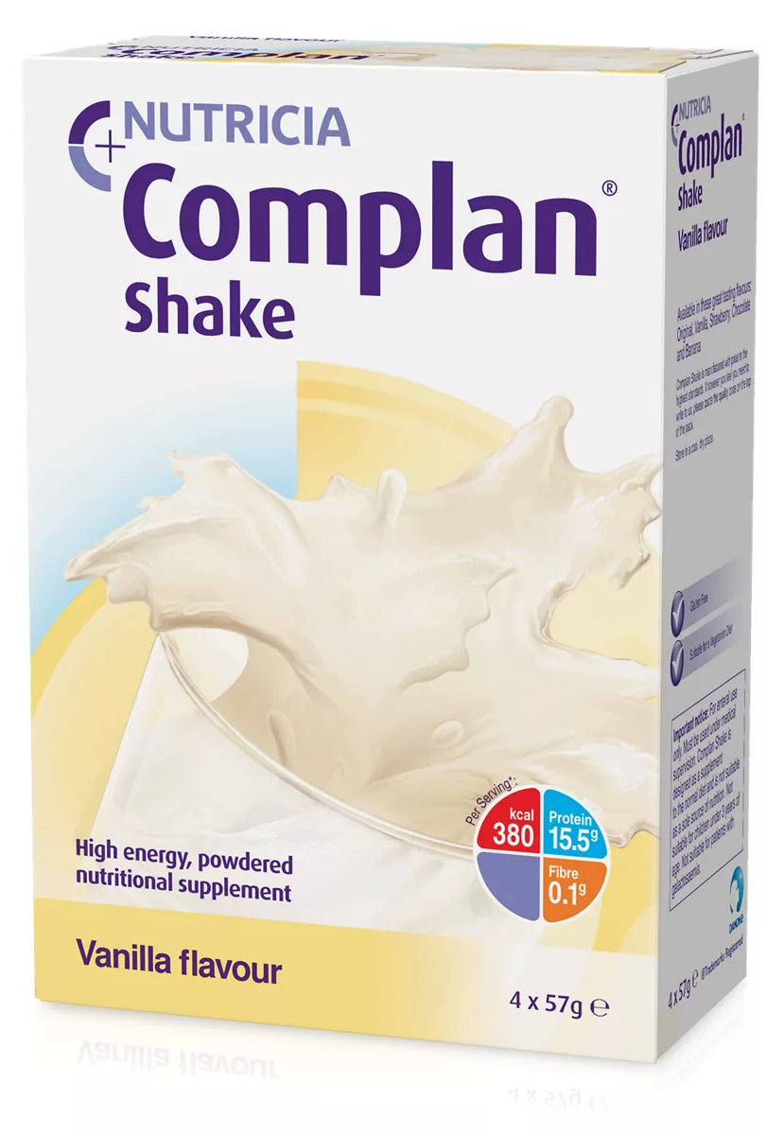
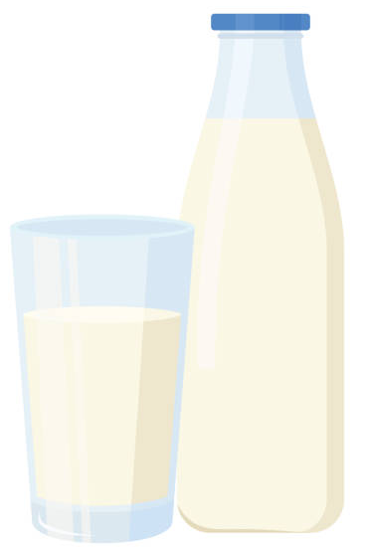
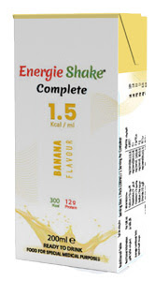
Higher or lower

Slide 65
Highest to lowest
Per 200ml | Calories | Protein
Homemade booster | 440 | 17
Powder-style ONS | 380 | 16
Milkshake-style ONS | 300 | 12
Fortified milk | 175 | 11
Whole milk | 132 | 7
Shop bought latte | 108 | 6
Orange juice | 94 | 1
Cola | 84 | 0
(Premium) squash | (36) 10 | 0

Slide 66
Nourishing Drinks
Aim to have 2 every day to prevent weight loss
Consume in between meals and not as a meal replacement
Base drinks on milk or fruit juice, rather than water
Homemade milkshake
⅓ pint (180ml) full fat milk
2 generous tablespoons (30g) skimmed milk powder
2 tablespoons (30ml) double cream
4 heaped teaspoons (20g) vitamin fortified milkshake powder

Slide 67
Video (2m 40s)
https://vimeo.com/497349699/188da47aee

Slide 68
What makes an enjoyable eating environment for you?

Slide 69
The eating environment
Presentation of food and drinks
Pleasant environment, reducing distraction
Appropriate cutlery and crockery
Verbal and visual prompts
Appropriate positioning
Protected mealtimes
Activities to encourage residents

Slide 70
Who might need other nutritional considerations?

Slide 71
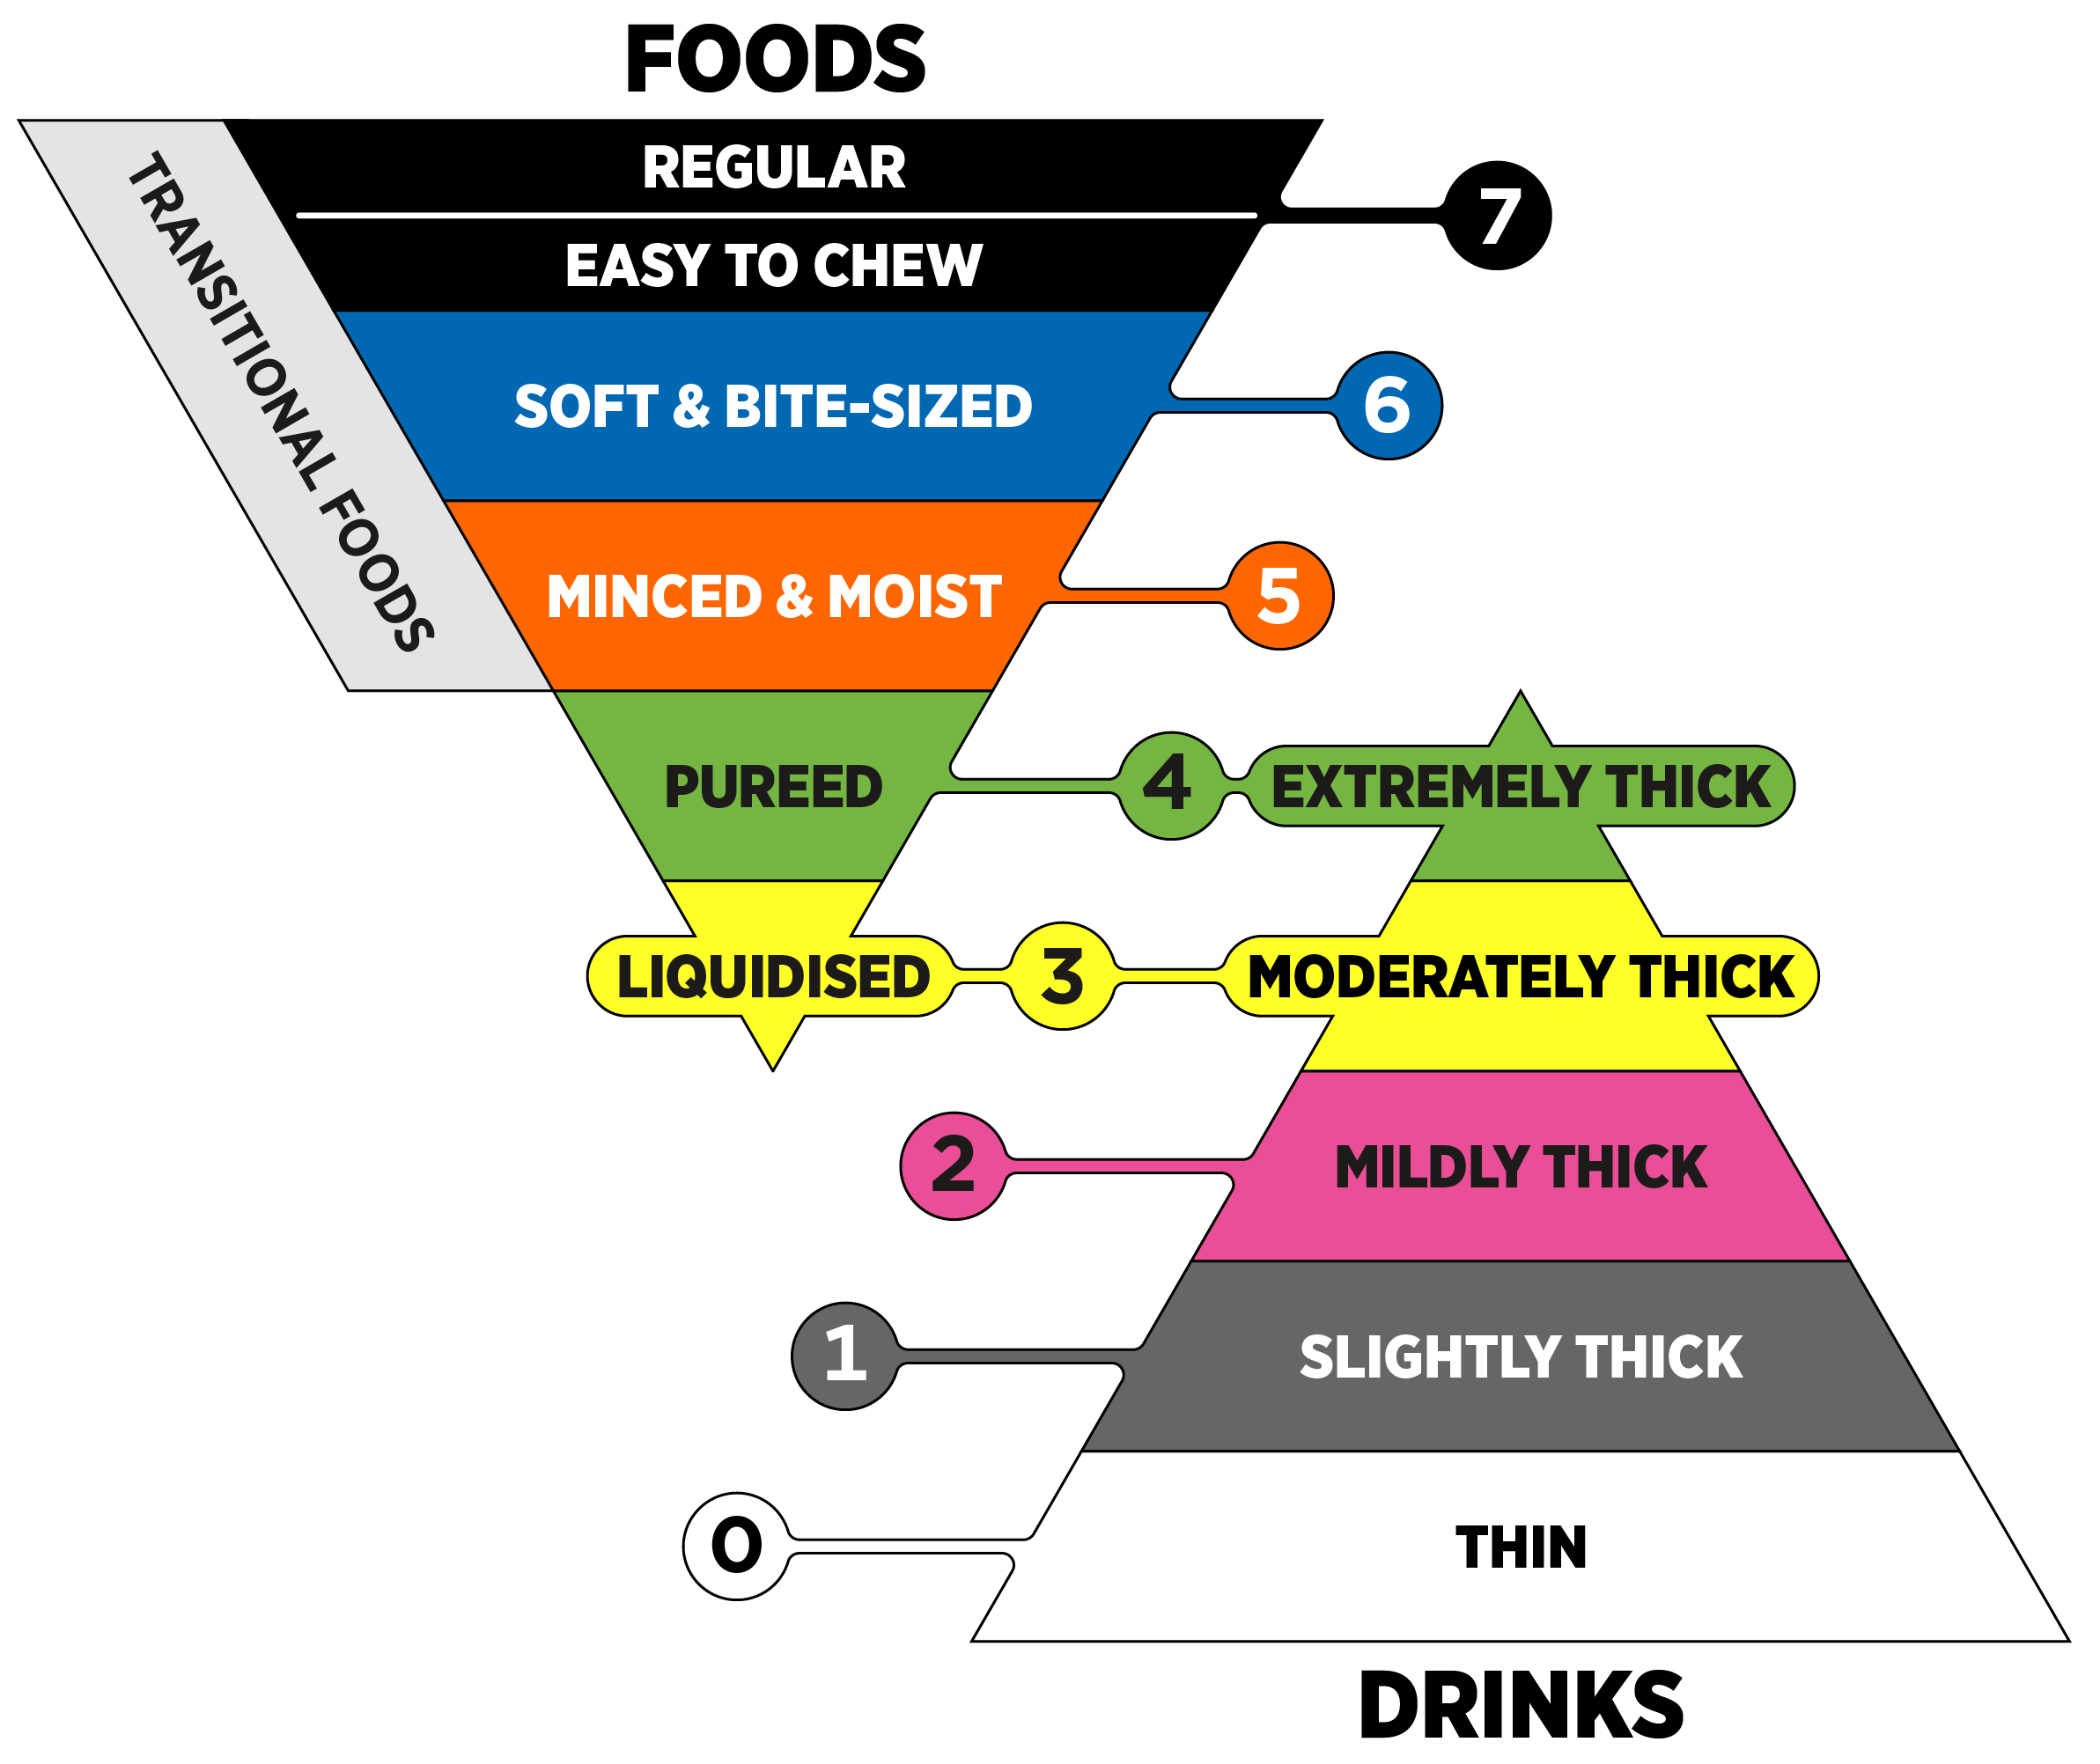
Dysphagia
Presentation – moulds, piping, divided plates
Nutrient content – nutrient density
Responsibility – catering, server, unit staff
IDDSI levels
Eating and drinking with acknowledged risk
Consult Speech & Language Therapy

Slide 72
Dementia
Taste changes
Decreased appetite and thirst
Thinking already eaten
Forgetting how to eat
Walking
Night and day reversal
Sight changes
Communication and choices
Mood changes
Co-ordination changes

Slide 73
Diabetes
No place for diabetic foods
No food exclusions – balanced diet
Medical management of diabetes
Discuss with health care professional about adjusting medication if needed
Acute risk of malnutrition > chronic risk of poor glycaemic control

Slide 74
End of Life
Define the last few weeks of life.
Quality of life vs intensive intervention - Food and fluid for comfort.
ONS are not indicated on ACBS.
People stop eating and drinking because they are dying; they are not dying because they have stopped eating and drinking.
Notes:
supporting-people-who-have-eating-and-drinking-difficulties_3_0.pdf

Slide 75
When do you complete food and fluid charts?

Slide 76
Food and Fluid Charts
When staff are concerned / 3 days before dietetic review
Quality is more important that number of entries
Document what’s offered (including quantities), declined and taken
Care planning software can be preset/offer prompts if helpful

Slide 77
When do you complete and review nutritional care plans?

Slide 78
Nutritional Care Plans
Should contain:
Specific needs e.g. allergies
SLT recommendations – e.g. IDDSI levels
Support required
Preferences – likes and dislikes
Specific aims and the plan of how to achieve these
Should be reviewed and updated:
monthly, or sooner if there are changes

Slide 79
Any questions?

Slide 80
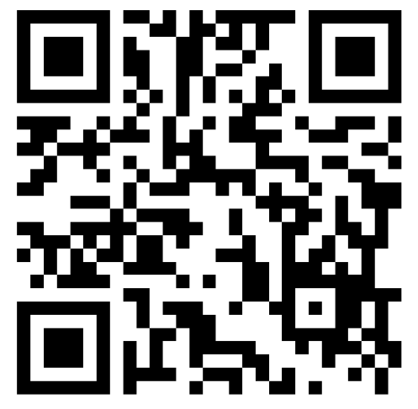
Please complete the questionnaire to register your attendance and generate your certificate

