Slide 1
Trust Board – Maternity Update
Presented by Ian Reckless, Medical Director & Maternity Safety Champion
Prepared by Melissa Davis, Head of Midwifery, Gynaecology and Paediatric Nursing
Trust Board, 07 July 2022

Slide 2
Maternity Reporting to Trust Board
Regular reporting of information on safety and quality in maternity / neonatal services is required to comply with:
  CNST (Clinical Negligence Scheme for Trusts) operated by NHSR
  Ockenden
  Perinatal Quality Surveillance Model
As previously discussed, a Maternity Assurance Group (MAG) is being set up to facilitate in depth scrutiny and will report through to Board. MAG will be chaired by the NED Maternity Safety Champion.

Slide 3
Perinatal Quality Surveillance Model
The Perinatal Quality Surveillance Model incorporates 5 principles for increasing oversight of perinatal clinical quality, integrating perinatal clinical quality into ICS structures and providing clear lines for responsibility and accountability in addressing quality concerns at each level of the system

Slide 4
Perinatal Quality Surveillance Model
The Perinatal Quality Surveillance Model incorporates 5 principles for increasing oversight of perinatal clinical quality, integrating perinatal clinical quality into ICS structures and providing clear lines for responsibility and accountability in addressing quality concerns at each level of the system
CNST expectation – quarterly dashboard with minimum data set presented by the Board Level Maternity & Neonatal Safety Champion to Trust Board
Ockenden expectation – that a monthly review of maternity and neonatal safety and quality is undertaken by the Trust Board

Slide 5
Minimum Data Set for Trust Board
Item | Description
1 | Findings of PMRT reviews
2 | Findings of all HSIB cases
3 | Number of incidents logged (graded moderate or above) and actions taken
4 | Training compliance (all staff groups, competency framework)
5 | Minimum safe staffing in maternity (including obstetrics)
6 | Service User Feedback
7 | Staff feedback from frontline staff engagement by safety champions
8 | CQC / NHSR / HSIB concerns or requests for action of the Trust
9 | Regulation 28 report (HM Coroner)
10 | Progress in achievement of the CNST 10

Slide 6
PMRT – Perinatal Mortality Review Tool
Supports standardised review of cases meeting inclusion criteria
Enables identification of themes and trends
Live action plan to support continuous service improvement
Adoption a requirement of NHSR (CNST)
Quarterly reports are submitted to Trust Board and include details of reviews undertaken and consequent actions
Detailed reports are seen by Maternity Safety Champions (three of whom are members of the Trust Board), and once established, will be reviewed at MAG

Slide 7
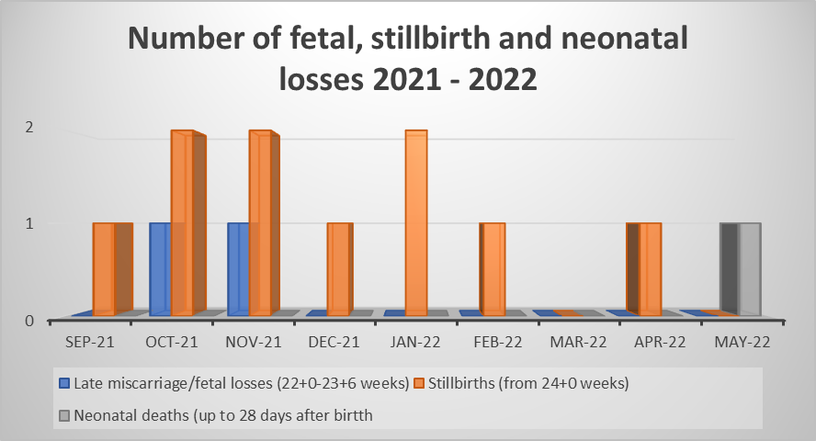
PMRT
All eligible perinatal deaths notified to MBRRACE-UK within 7 working days | A review using the PMRT of 95% of all deaths of babies (suitable for the review), by an MDT and started within 2 months of each death. | At least 50% of all deaths of babies (suitable for the review) will have been reviewed using the PMRT, by an MDT. Each review will have a draft reports should be generated within 4 months and closed within 6 months | At least 95% of all deaths of babies who died at the Trust, the parents have been told about the review and that the parents perspective, questions and concerns have been sought.
16 | 100% | 100% | 100%
Themes within PMRT
CO monitoring not always being offered, even in well ventilated areas
  Community matron reiterates to community team leaders every month the importance of checking CO readings and reviews the barriers to universal uptake
Risk factors not always being calculated accurately (re: aspirin)
  Community matron to review the templates used for risk assessment and ensure they align with the guideline, and reduce duplication in documentation
MSUs (urine specimens) are not always being sent
  Community matron reiterates to community team leaders every month the importance of sending MSUs at booking
13 cases were considered through PMRT (and reported to MBRRACE)
3 cases were terminations of pregnancy due to fetal abnormalities

Slide 8
ATAIN (Avoiding Term Admissions Into Neonatal Units)
Weekly audit of admissions to NNU following birth at term
Enables identification of themes and trends in neonatal morbidity and death
Live action plan to support continuous service improvement
Adoption a requirement of NHSR (CNST)
Findings of ATAIN reviews are shared quarterly with the Board Level Safety Champion
An action plan – to address local findings from pathway audit and ATAIN reviews – must be agreed with the maternity and neonatal safety champions, including Board-level champions (by 29 July)

Slide 9
ATAIN update
Though the admission rate is higher than previous months, the avoidable admissions reduced. This reflects the team effort to keep Mums/babies together.
Babies are getting cold in theatre. While we review the theatre temperature control mechanisms and SOP, we have reintroduced the ‘Hot cot’ to theatre.
There has been prompt recognition of CTG abnormalities and abnormal baby observations, these have been acted on quickly. Well done team!
Admission rate for March 2022 = 6.3%
(Previous month 5.6%)
New CNST recommendation is to review every baby admitted to NNU through ATAIN regardless of length of stay (accounts for slightly higher figure this month on previous)
Avoidable admissions – 4 Unavoidable admissions – 16

Slide 10
Transitional Care (TC) Audits
Agreed pathway for TC between maternity and neonatal services
Business case under development to support designated TC providing full pathway and reducing separation following birth
Monthly audit of TC admissions to ward 9 (currently runs limited TC pathway)
CNST expectation that the TC pathway has been fully implemented and is audited quarterly: audit findings are shared with the neonatal safety champion, LMNS, commissioner and ICS quality surveillance meeting each quarter

Slide 11
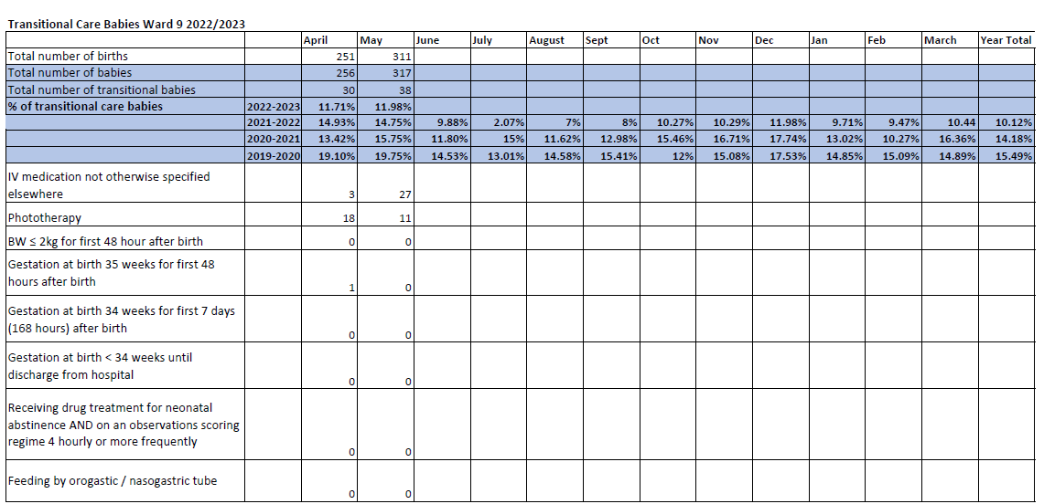

Slide 12
Ockenden Compliance
The initial Ockenden Report was released in December 2020
It consisted of 7 Immediate & Essential Safety Actions (IEA’s) and 1 workforce action
The final Ockenden Report was released in March 2022
It consisted of 15 Immediate & Essential Safety Actions (IEA’s)
Compliance with the Ockenden IEAs is monitored monthly to demonstrate progress and areas of continued focus
Compliance – and progress against gaps – will be monitored in detail via MAG

Slide 13
Assessment against Final Ockenden Immediate and Essential Action (IEA)​ | FullyCompliant ​ | Partially​ Compliant ​ | Non​ Compliant ​
Immediate & Essential Theme 1 – Workforce ​ 4 Actions – 2 for delivery at provider level ​ | 1​ | 1​ | ​
Immediate & Essential Theme 2 - Training​ 7 Actions – 6 for delivery at provider level ​ | 1​ | 2​ | 3​
Immediate & Essential Theme 3 – Safe Staffing​ 10 actions – 10 for delivery at provider level ​ | 7​ | 3​ | ​
Immediate & Essential Theme 4 – Escalation & Accountability ​ 5 actions – 5 for delivery at provider level ​ | 4​ | 1​ | ​
Immediate & Essential Theme 5 – Clinical Governance & Leadership​ 7 actions – 7 for delivery at provider level ​ | 5​ | 1​ | 1​
Immediate & Essential Theme 6 – Clinical Governance Incident Investigations &Complaints ​ 7 actions – 7 for delivery at provider level ​ | 4​ | 2​ | 1​
Immediate & Essential Theme 7 – Learning from Maternal Deaths​ 3 actions – 2 for delivery at provider level ​ | 2​ | ​ | ​
Immediate & Essential Theme 8 – MDT Training ​ 7 actions – 7 for delivery at provider level ​ | 5​ | 2​ | ​
Immediate & Essential Theme 9 – Complex Antenatal Care ​ 5 actions – 4 for delivery at provider level ​ | 1​ | 3​ | ​
Immediate & Essential Theme 10 – Preterm Birth ​ 4 Actions – 4 for delivery at provider level ​ | 3​ | ​ | 1​
Immediate & Essential Theme 11 – Labour & Birth ​ 6 Actions – 6 for delivery at provider level – 2 not relevant to MK (MLU)​ | 1​ | 3​ | ​
Immediate & Essential Safety Theme 12 – Obstetric Anaesthesia ​ 8 Actions – 7 for delivery at provider level ​ | 2​ | 5​ | ​
Immediate & Essential Safety Theme 13 – Postnatal Care ​ 4 actions – 4 for delivery at provider level ​ | 2​ | 1​ | 1​
Immediate & Essential Safety Theme 14 – Bereavement Care ​ 4 actions – 4 for delivery at provider level ​ | 2​ | 2​ | ​
Immediate & Essential Safety Theme 15 – Neonatal Care ​ 8 actions – 8 for delivery at provider level ​ | 8​ | ​ | ​
Immediate & Essential Safety Theme 15 – Neonatal Care ​ 3 actions – 3 for delivery at provider level ​ | 3​ | ​ | ​
Assessment against Ockenden Immediate and Essential Action (IEA)​
Immediate & Essential Action 1 ​ | ​
Immediate & Essential Action 2​ NED oversight of maternity services ​ | ​
Immediate & Essential Action 3​ ​
Immediate & Essential Action 4​ | ​
Immediate & Essential Action 5​ Pathway for care outside of guidelines ​
Immediate & Essential Action 6​
Immediate & Essential Action 7​
Maternity Workforce Planning & NICE​ 6 monthly board reviews for ALL staff, GAP Analysis​

Slide 14
Continuity of Carer (CoC) Model
Following publication of the Final Ockenden report, Trusts were asked to review positions in relation to the CoC model
On 05 May, we agreed to continue ‘as is’ and delay further rollout until the Board was assured around staffing
There have been several developments – including an increase in the vacancy rate.
As a result, a process of staff engagement is underway to ensure that views and ideas are captured prior to significant changes
Plans going forward are likely to evolve quickly over the coming days

