Slide 1
Looking Ahead
Joe Harrison
Chief Executive Officer
Milton Keynes University Hospital
NHS Foundation Trust

Slide 2
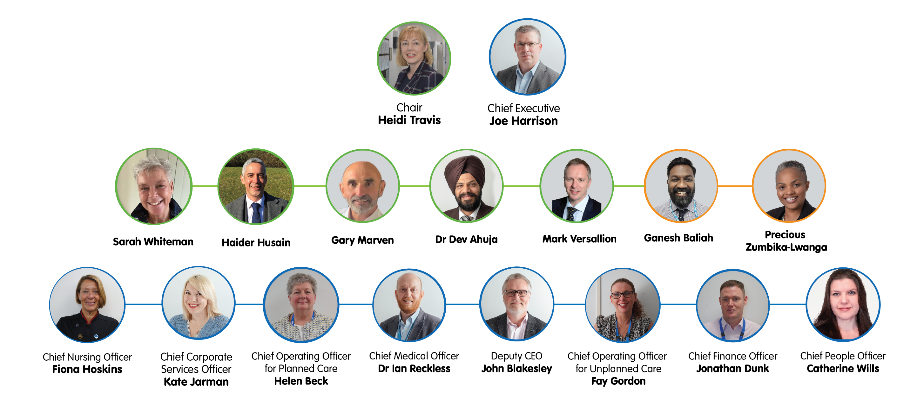
MKUH Board of Directors

Slide 3
Green Ambitions – 2024-27
Some of our ambitions include:
Replacing plastic medication bags with alternative approach.
Reducing paper used for take-home medication.
Running a pilot on return medication to avoid waste and reuse.
Installing more double-glazed windows across site.
More LED lighting investment.
Continuing development of Waste Strategy.
Installing further EV charging facilities.
Continuing energy efficiency drive through smart building management.

Slide 4
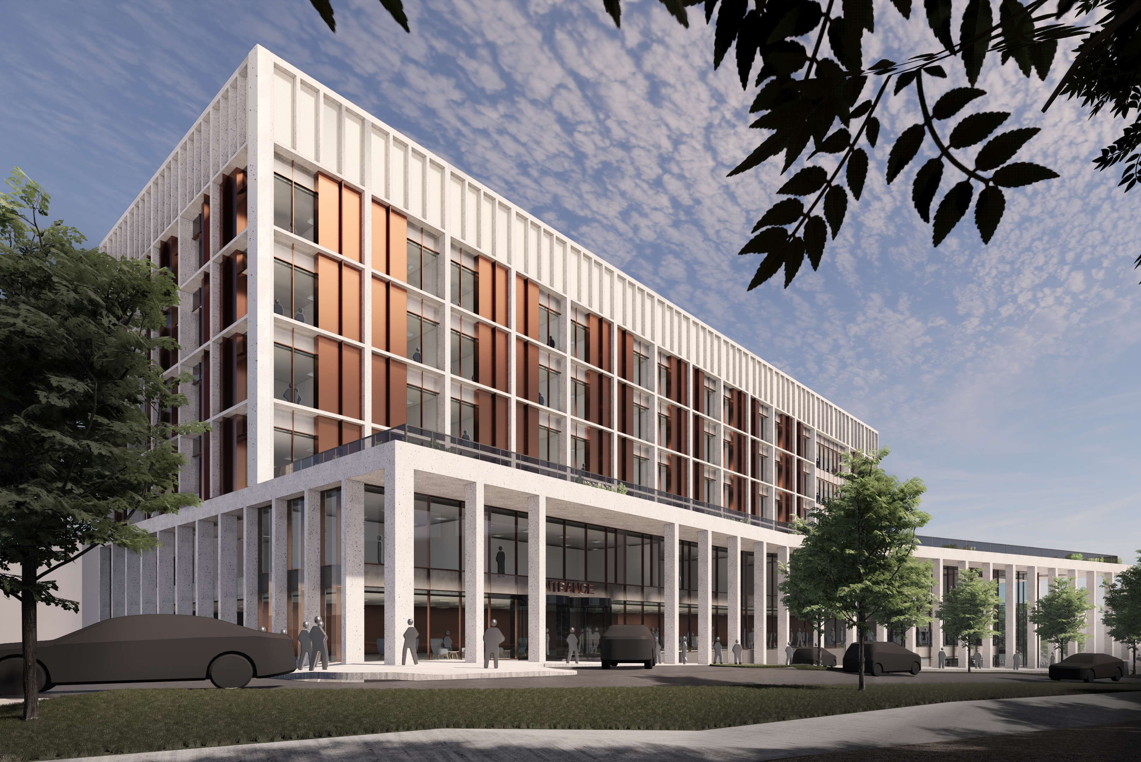
New Hospital Programme (NHP)
Delivering:
A Women’s & Children’s Hospital, with Surgical Capacity
An Imaging Centre
A Multi-Storey Car Park 3 (MSPC 3)
High Voltage Power Enhancements
Two key project drivers:
Currently under construction, ‘Oak Wards’ will provide the hospital with two additional 24-bed wards across two floors. Increasing our medical bed capacity and allowing us to treat more patients.
Located in the car park outside Oak House, will scope with further expansion in the future.
Meet the future demand healthcare demands of our growing local population
Improve the quality of facilities in maternity, neonatal & paediatric services

Slide 5
Equality, diversity and inclusion
The Trust has been working with Roger Kline, a Research Fellow at Middlesex University Hospital and a Workforce Race Equality Standard (WRES) expert and Yvonne Coghill OBE, a leading NHS expert in race equality and equity.
This is to help us to better understand what it can be like to work at MKUH as a Black, Asian or minority ethnic (BAME) member of staff.
Work so far has highlighted several areas of focus, and we are reviewing this feedback, working alongside our BAME staff network and other colleagues across the hospital, to take it forward and identify immediate and long-term actions to improve experiences across the whole of #TeamMKUH.

Slide 6
Digital future
AI in Ophthalmology – Dora:
New conversational AI assistant called Dora trialled to hold follow-up calls with patients and have an automated conversation with them naturally, like they would a doctor or nurse.
Reduces wait times for routine check-ups, and more patients seen, and more focus on more complex care needs.
AI in Imaging – Echo-Robot:
In collaboration with Cranfield University, significant breakthrough in cardiac imaging technology with the successful development of a semi-automated echocardiography prototype, known as Echo-Robot, integrating AI and robotics.
Aidoc’s Incidental Pulmonary Embolism (iPE) detection system analysing all of our CT scans to prioritise positive cases for reporting and next-day conservative treatment.
Emergency Department plain film images of appendicular skeleton analysed by Gleamer Boneview AI system for immediate detection of fractures, dislocations, effusions and bone lesions, improving speed and accuracy of care.

Slide 7
Thank you...
To our staff and volunteers, who provide good, safe care every day for every patient…
To our Governors and members…
To those who support our charity…
And to our community and our partners.

Slide 8
Any questions?

