Slide 1

Financial review of
2022/23
Terry Whittle
Director of Finance

Slide 2
Continued recovery and tapered funding
The COVID-19 pandemic necessitated interim NHS funding allocations to ensure sufficient financial
resources were available to respond to the pandemic. During 2022/23, the national NHS allocations
methodology was reset to move Integrated Care Systems (and by extension partners within the ICS),
back to a fair share distribution of resources at levels afforded by the 2021 Spending Review
settlement. The key deliverables outlined in the national planning guidance were:
• Deliver financial breakeven performance (income = expenditure) at an Integrated Care System level.
Whilst financial performance targets could be agreed locally between partners (organisational
surplus and deficits), the default position was a breakeven requirement for individual organisations.
• Continue to recover (building on 2021/22 performance) elective waiting list performance. Planning
expectation set at achieving 104% elective activity compared to a 2019/20 baseline (pre-pandemic).
Elective activity paid on a cost and volume basis for over/under delivery.
• Payment for non-elective care via a fixed ‘block’ payment transferred from local commissioners
(Integrated Care Board) to local providers.
• Capital funding limits set centrally by NHS England for distribution between local partners to cover
business-as-usual capital requirements. Some exceptions to this for high-profile national schemes
eg Community Diagnostic Centres.

Slide 3
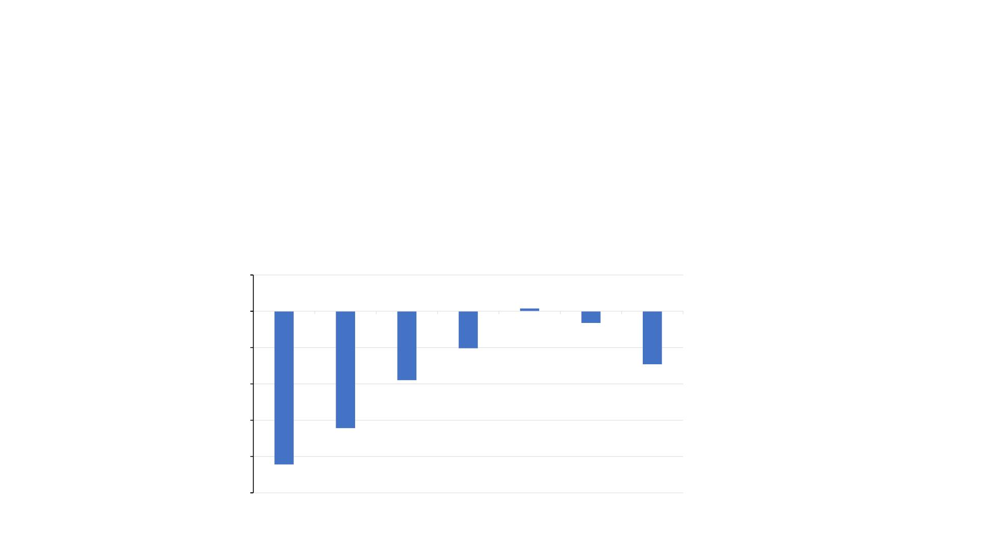
Headline financial performance 2022/23
The Trust agreed a breakeven financial plan (on a Control Total basis) for 2022/23 as part of a balanced
Bedford, Luton and Milton Keynes ICS plan. The Trust ended the financial year with a deficit of £7.3m
(£5m on a Control Total basis) which was agreed with NHS England.
Historical financial performance of the Trust is shown below.
5.0
0.0
2016/17
2017-18
2018-19
2019-20
2020-21
2021-22
2022-23
0.4
-5.0
-1.6
-5.1
-10.0
-15.0
-20.0
-25.0
-7.3
-9.5
-16.1
-21.1

Slide 4
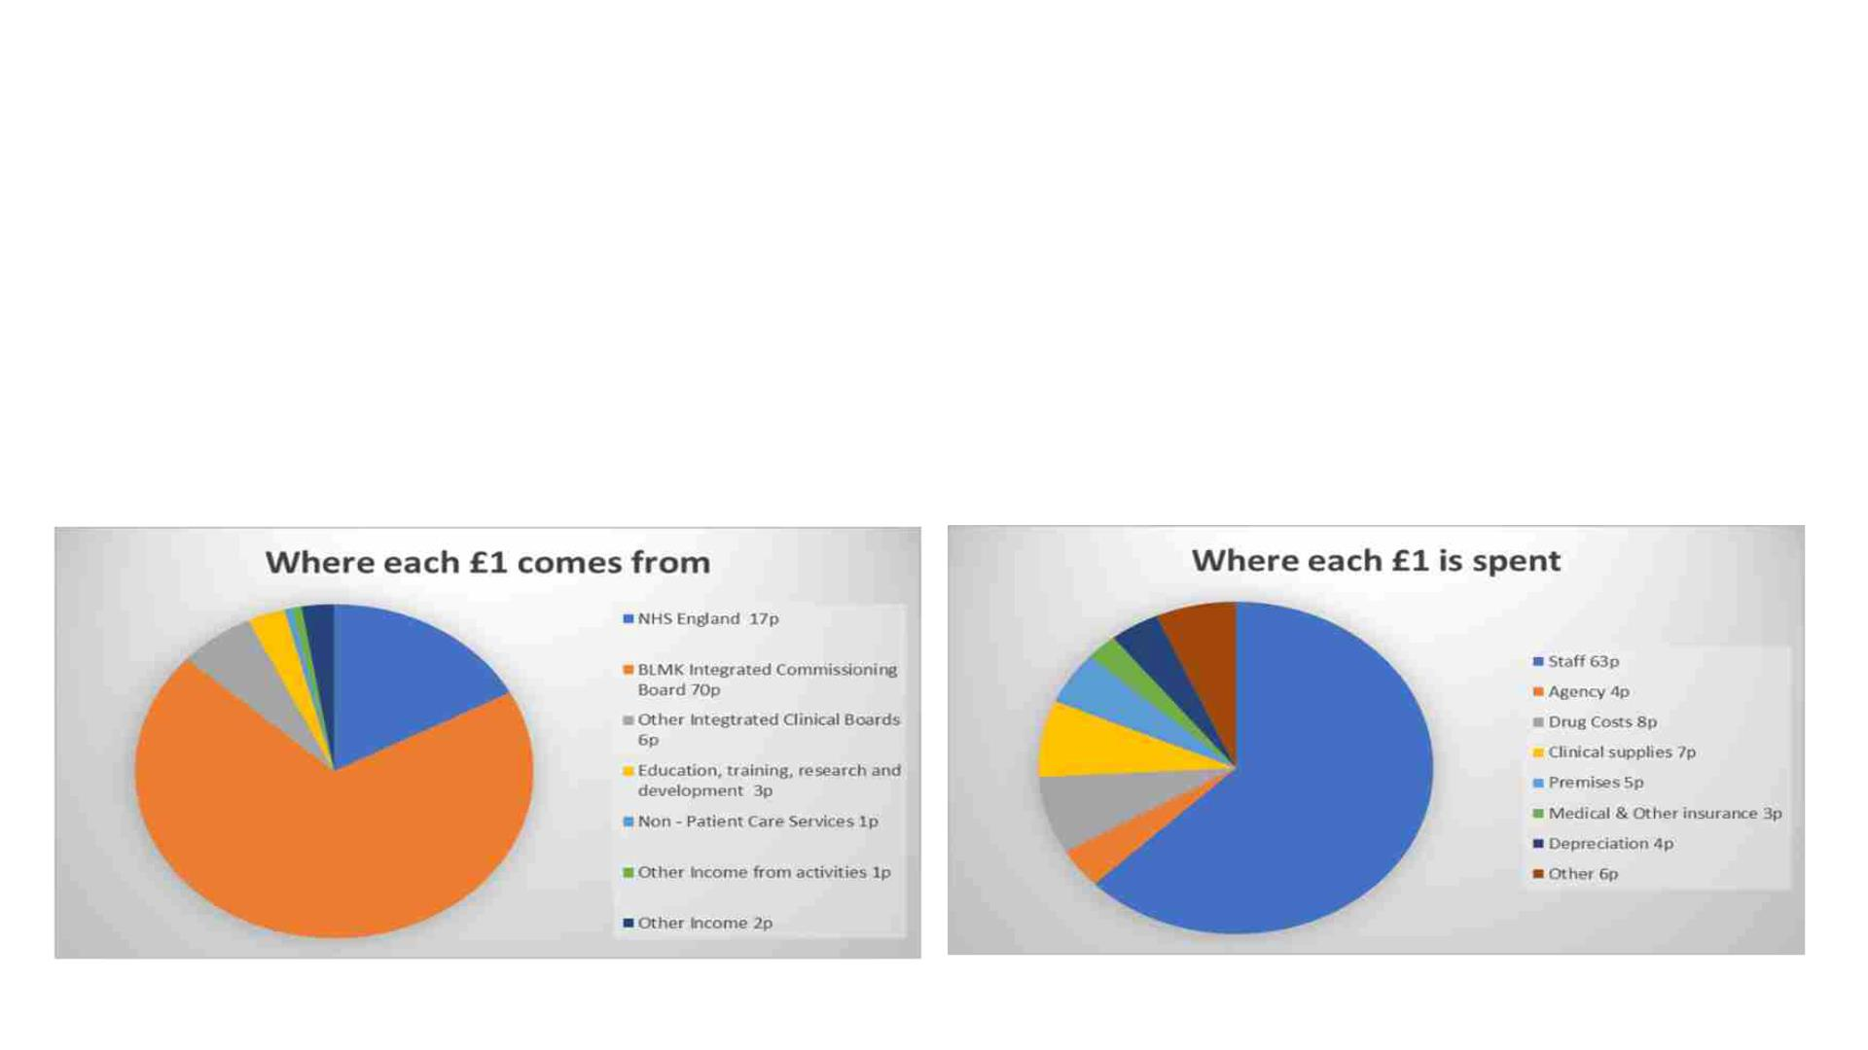
How the money was spent
The Trust receives funding for clinical service provision as income payable under contracts with either
local or regional commissioner organisations. During 2022/23, the Trust received income totalling
£365m, predominantly (c.76%) from local commissioners (Integrated Care Board) for the provision of
core acute services. This was a small increase of 2% compared to the prior year which was due to
inflationary uplift.

Slide 5
Capital spending 2022/23
The Trust continued to invest significantly in new infrastructure and equipment to support the delivery of
quality healthcare. In 2022/23, capital investment totalled £31.0m. This total includes the investment in
the start of the Radiotherapy Centre, which will enable local patients to receive radiotherapy closer to
home, completion of the construction of the Maple Centre, a state-of-the-art short stay care facility, as
well as providing investment for diagnostic equipment to support elective care recovery. There was also
continued investment in areas such as energy infrastructure to accelerate progress in the Trust’s Green
Plan5.
Key capital investments included:
• Completion of the Maple Centre - £6.3m
• Commencement of the Radiotherapy Centre - £6.2m
• Investment in community Endoscopy services - £1.1m
• Infrastructure costs (including car park and access road) - £1.4m
• Investment in diagnostics (including building refurbishment for Breast Screening and IT for Imaging
and Pathology) - £1.8m
• Design work for the New Hospital Programme business case - £1.3m
• Information Technology - £2.0m

Slide 6
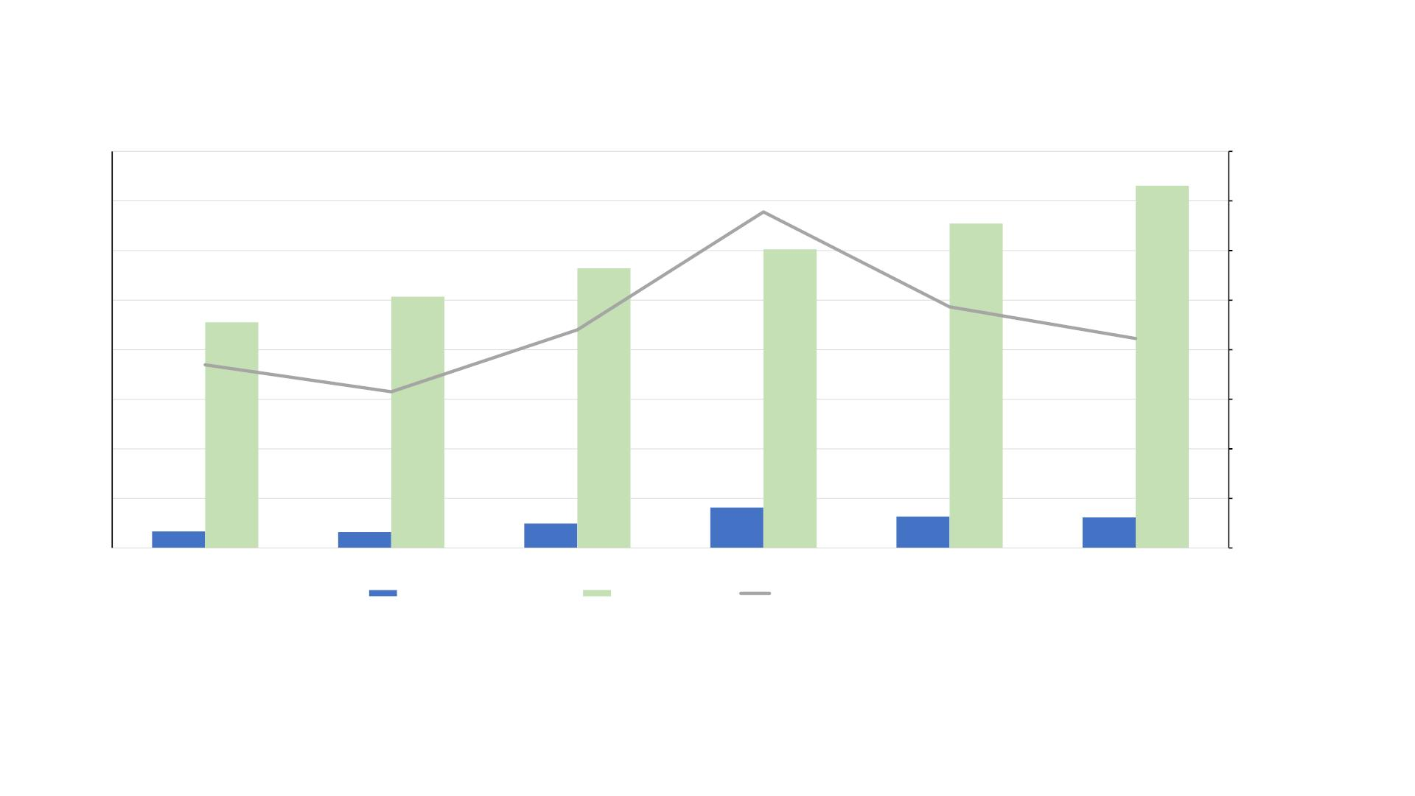
Our growth journey
400
350
300
16%
14%
12%
10%
8%
365
14%
301
327
282
9%
253
250
228
7%
10%
200
150
100
50
8%
6%
6%
4%
25
41
32
31
2%
17
16
-
0%
2017/18
2018/19
2019/20
2020/21
2021/22
2022/23
Capital investment (£ million)
Turnover (£ million)
Capital as a proportion of turnover
• Turnover has increased by 60% since 2017/18
• Capital investment has increased by 82% since 2017/18
• NHS England capital investment is 5.5% as a proportion of day-to-day spending

Slide 7
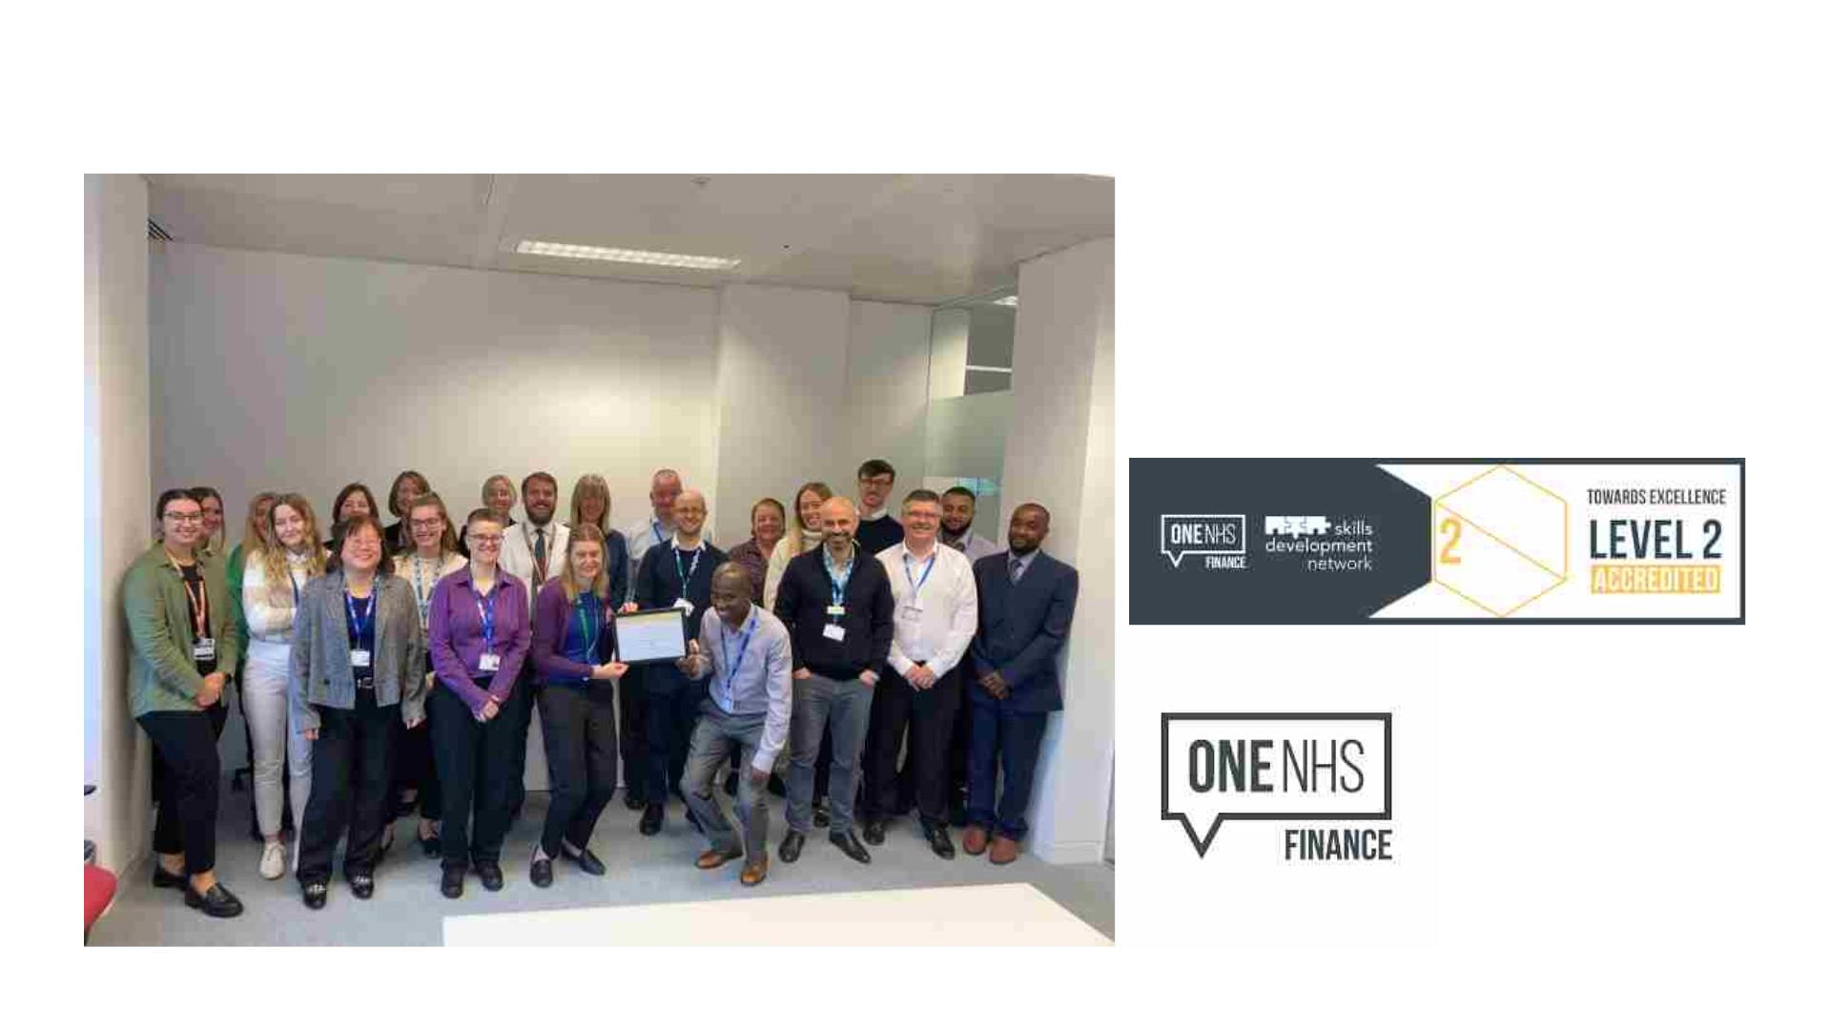
Other notable achievements!
Team achieved Level 1
accreditation in October 2022 and
more recently Level 2 accreditation
from the National Finance
Leadership Council in September
2023

Slide 8
Focus for 2023/24 and beyond
The Trust continues to invest for the future. During the current financial year we are:
• Investment in capacity/productivity to tackle elective care backlog
• Delivering Value for Money in challenging climate (e.g., inflationary pressures)
• Completing construction and handover Radiotherapy Centre
• Investing in green initiatives and facilities on-site
• Completion of community diagnostic care facilities (Whitehouse Park and Lloyds
Court)
• Continuing to progress business case development for the New Hospital
Programme

