Slide 3
Previously referred to as HIP2
48
£4bn

Slide 5
A vision to meet our growing population
The New Hospital Programme provides a fantastic opportunity to deliver improved services and additional capacity for the ever-growing population of MK and surrounding areas.

Slide 7
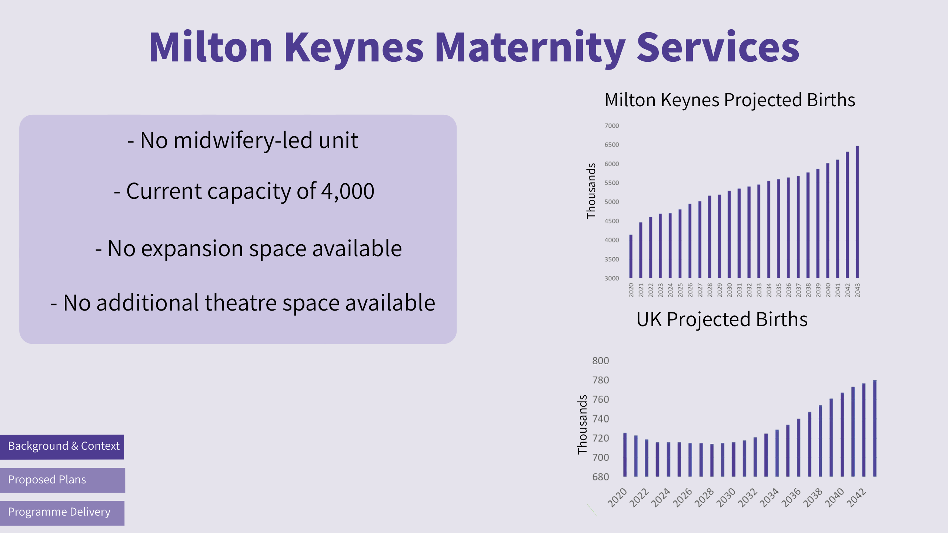

Slide 8
Programme vision
“Working with stakeholders across the local healthcare system to redesign the way we deliver services, creating an environment that enables our staff to deliver an individualised experience to patients where they have enhanced ownership over their care.”

Slide 9
Key messages
Milton Keynes is one of the fastest growing places in the UK and these new facilities will enable us to meet the needs of our population now and in the future
The proposed plans will significantly expand and enhance the clinical services that we are able to deliver to patients in and around Milton Keynes
Creating these new facilities will offer greater choice for patients, improving the experience that they receive while in our care
Dedicated facilities will allow us to deliver a more efficient, patient-focussed service and provide a high-quality, safe environment for new parents

