Slide 1
Review of 2023/24
Joe Harrison
Chief Executive Officer
Milton Keynes University Hospital
NHS Foundation Trust

Slide 5
Some unique challenges
The year of 2023/24 presented some unique challenges for our hospital:
Period of unprecedented demand for urgent and emergency services in January 2024 for which the Trust declared a critical incident.
We opened up 114 escalation beds and temporarily redirected resources to help to manage the situation effectively, enabling the surge in demand to be met.
Several strikes by both junior doctors and consultants represented by the British Medical Association throughout the year.
Appointments and procedures postponed during these periods of industrial action.

Slide 6
2023/24 in numbers
Activity levels during 2023/24:
441,082 outpatient attendances
26,620 elective spells
9,460 non-elective spells
101,045 Emergency Department Attendances
3,787 babies delivered
Notes:
Pandemic impact meant the national standard for consultant-led Referral to Treatment waiting times of 92% was not viable for the Trust to achieve
The Trust did not achieve the target of treating 95% of patients attending the ED within 4 hours, although our overall performance of 93.1% (all types) for the year placed us among the top performing trusts with a Type 1 department nationally

Slide 7
Performance
Indicator | Threshold / Target | Performance
2 week wait (all cancers) | 93% | 77.7%
31-day wait (all cancers) | 96% | 94.9%
62-day wait (all cancers) | 85% | 57.6%
Referral to Treatment (%) | 92%* | 36.2%
28 days to faster diagnosis | 75% | 72.8%
ED 4-hour target | 75% | 74.9%

Slide 8
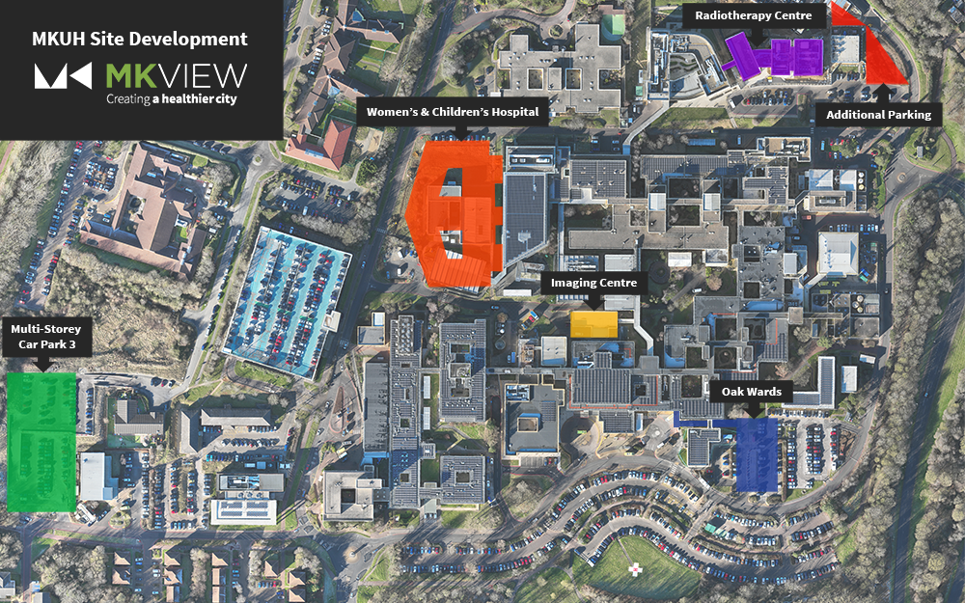
MKUH Estate Developments
Radiotherapy Centre
Completed and opening soon
Lloyds Court, Community Diagnostic Centre
Completed and opening soon
Multi-Story Car Park 3
NHP enabling work, under construction
Imaging Centre
NHP enabling work, under construction
High Voltage Power Enhancements
NHP enabling work, project underway
Oaks Wards
Under construction
New Women’s and Children’s Hospital
and Elective Surgery Capacity
Under government review. It’s anticipated work will start in early 2026

Slide 9
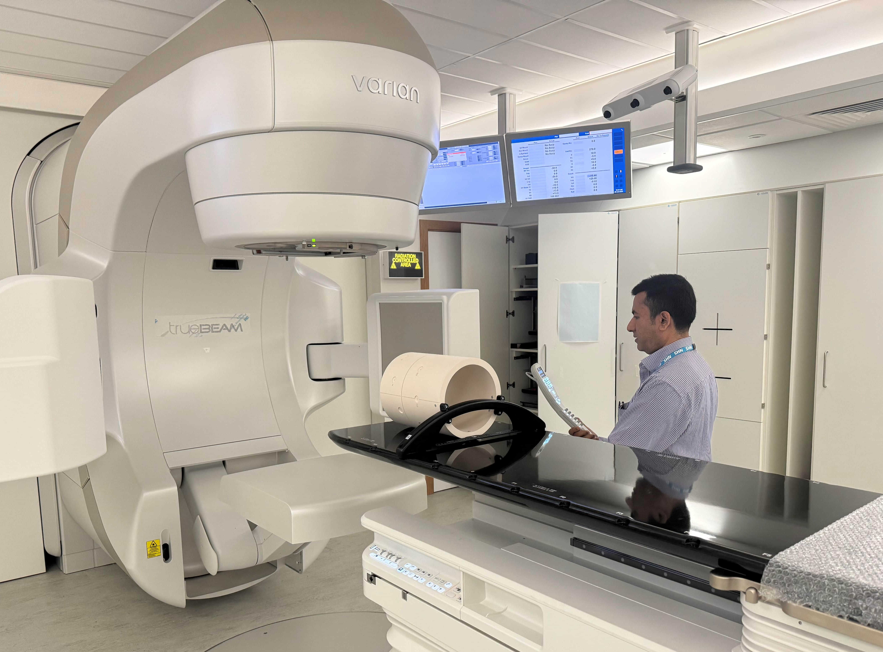
Radiotherapy Centre
Our new modern space for radiotherapy care in Milton Keynes. Bringing access to treatment closer to home for many patients in Milton Keynes.
The centre will include a medical linear accelerator (LINAC) treatment suite, a CT scanning area, and purpose-built consultation spaces.

Slide 10
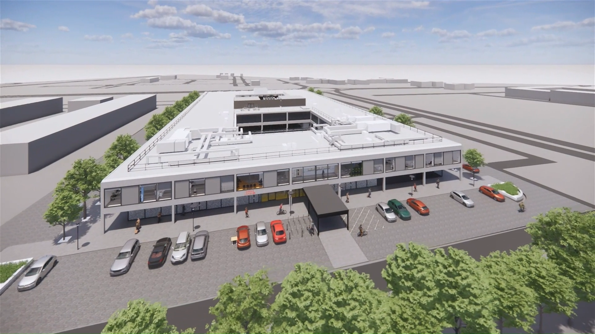
Lloyds Court, Community Diagnostic Centre
A 15,000-square-foot facility providing additional diagnostic services in the community.
Services in operation from October 2024 include:
Bone density scan (DEXA scan)
Ultrasound Scan (non-obstetric)
Echocardiogram (ECHO)
Further services to be available at the new facility in the near future.

Slide 11
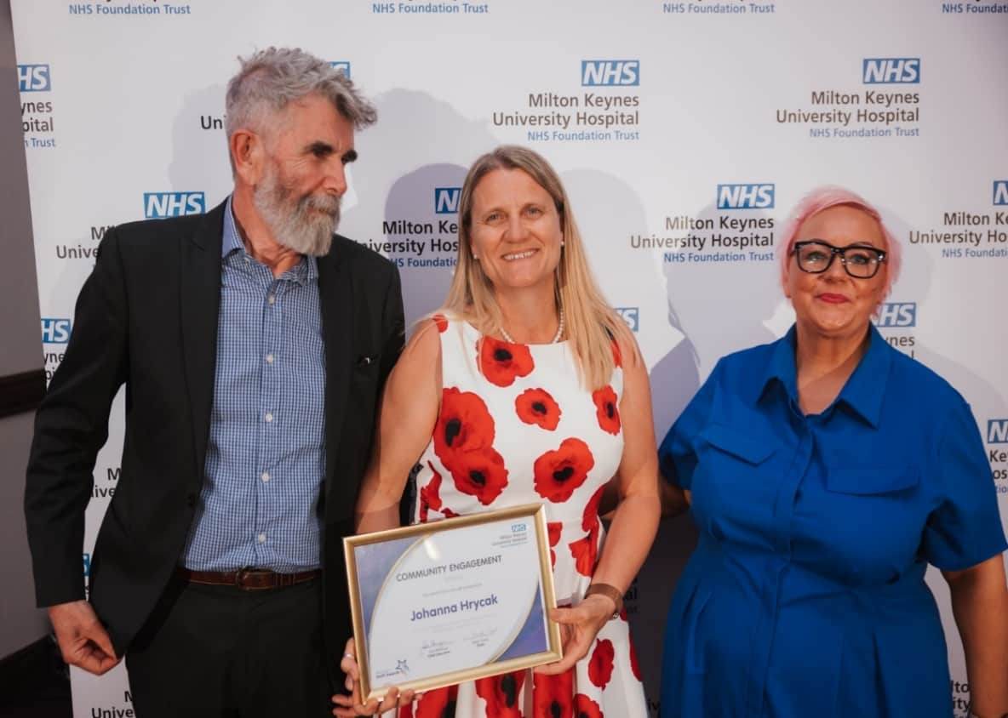
Supporting our staff
Sector-leading staff benefits programme.
In March 2024, results from the 2023 NHS Staff Survey were published (2,000 responses):
MKUH scored above average in all 9 areas - highest in ‘We are inclusive and compassionate’ and ‘We each have a voice that counts’.
Areas for improvement identified, including ensuring all colleagues feel valued, equitable opportunities, tackling racism and discrimination – we have launched a significant programme of work addressing this.
Another record-breaking number of nominations (900) for our Staff Awards.

Slide 12
CQC Adult in-patient survey
In September 2023, the 2022 Care Quality Commission (CQC) Adult in-patient survey results showed:
The Trust improved food offering to patients, with an overall patient rating of 7.3 (up from 7.1) for food quality.
The Trust scored highly in the range of dietary alternatives available - 8.4, up from 8.2 the previous year.
Patients were complementary about the clinical teams involved in their care - 9.0 and 8.9 respectively, for how confident and trusting patients felt about the care they were provided by doctors and nurses.
Improvement needed to reduce noise at night from staff, difficulty sleeping due to lighting, and involving family and carers in discussions about patients leaving the hospital.

Slide 13
Patient Safety and Experience
New ‘Night-Mode’ initiative launched in June 2023 to combat noise at night, and new motion-sensor ‘softer’ LED lighting rolled out across the hospital for better sleep.
Launched the MK Activity Reward Programme, an innovative study launched with support from Apple, EXI and Loughborough University, to encourage physical activity in those with Type 2 diabetes.
Our surgery division launched the High Volume Low Complexity (HVLC) cataract lists for patients awaiting surgery, for treatment and discharge all before midday - Getting It Right First Time.
In October 2023 the Trust received its Gold Armed Forces Covenant, from the Ministry of Defence Employer Recognition Scheme.

Slide 14
Making strides in digital and technology
Trust recognised with awards for its achievements during 2023/24:
Shortlisting for the ‘Empowering Patients Through Digital’ Award at the HSJ Digital Awards 2023 for the ongoing development of our MyCARE patient portal - patients have greater control over their care journey.
The Trust integrated the national Friends and Family Test (FFT) feedback through the MyCARE portal, making it even easier for patients to provide their feedback on the care and experience they received.
These increased responses allow the hospital to understand where we are performing well as well as where the areas for improvement are.
We will continue to work closely in collaboration with our staff, patients and partners to develop the platform further.
Empathic building management systems in our Pines Suite offices to better manage the working environment.

Slide 15
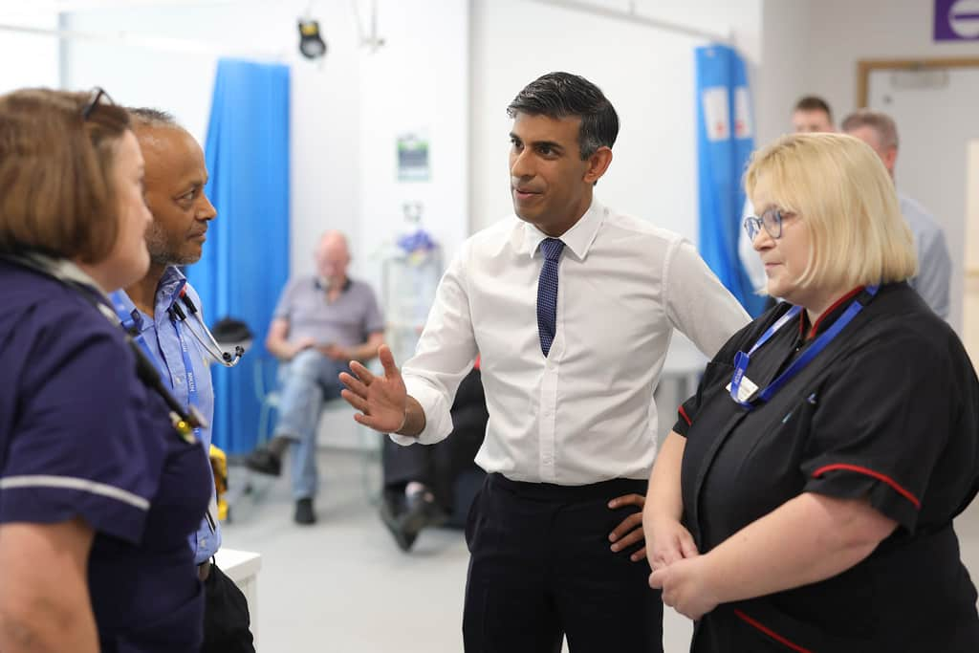
Visit from the Prime Minister
In August 2023, the Trust welcomed then-Prime Minister Rishi Sunak to the hospital to showcase some of the fantastic work that is going on across the hospital.
The Prime Minister visited our new state-of-the-art Maple Centre, which opened in October 2022 as one of the largest facilities of its kind in the country.
The Prime Minister was impressed with how the Trust is progressing its development and we look forward to being able to continue with that in the coming months and years.

Slide 16
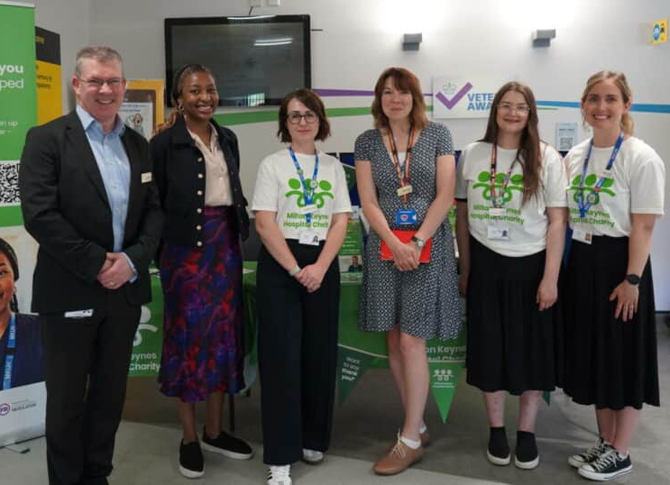
My Thank You Launch – MKH Charity
Patients and visitors can send personal messages of gratitude to members of staff who have made their day.
My Thank You is a way for the community to express their appreciation for dedicated NHS staff and make a charitable donation to support the charity’s mission: enhancing the care and experience of patients, their families and staff at the hospital.
Visitors can send heartfelt messages to any staff member, specific team/department, or volunteer.

Slide 17
Research and Development

