Slide 1
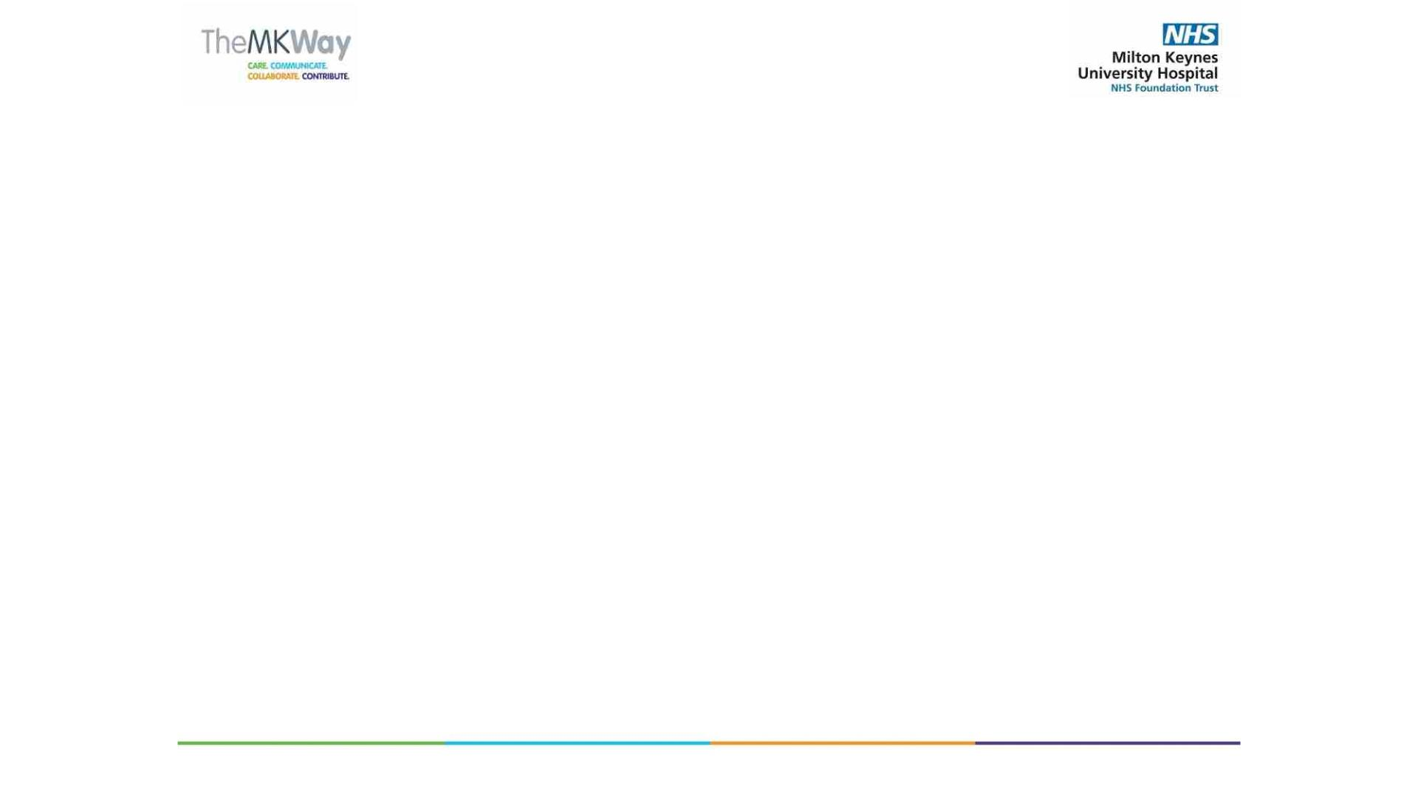
Council of Governors and
Membership Update
9 October 2023
Babs Lisgarten
Lead Governor and Public Governor for
Ashland, Bletchley, Denbigh, Eaton Manor, Fenny Stratford, Mount Farm,
Simpson, Water Eaton, Whaddon
Milton Keynes University Hospital
NHS Foundation Trust

Slide 2
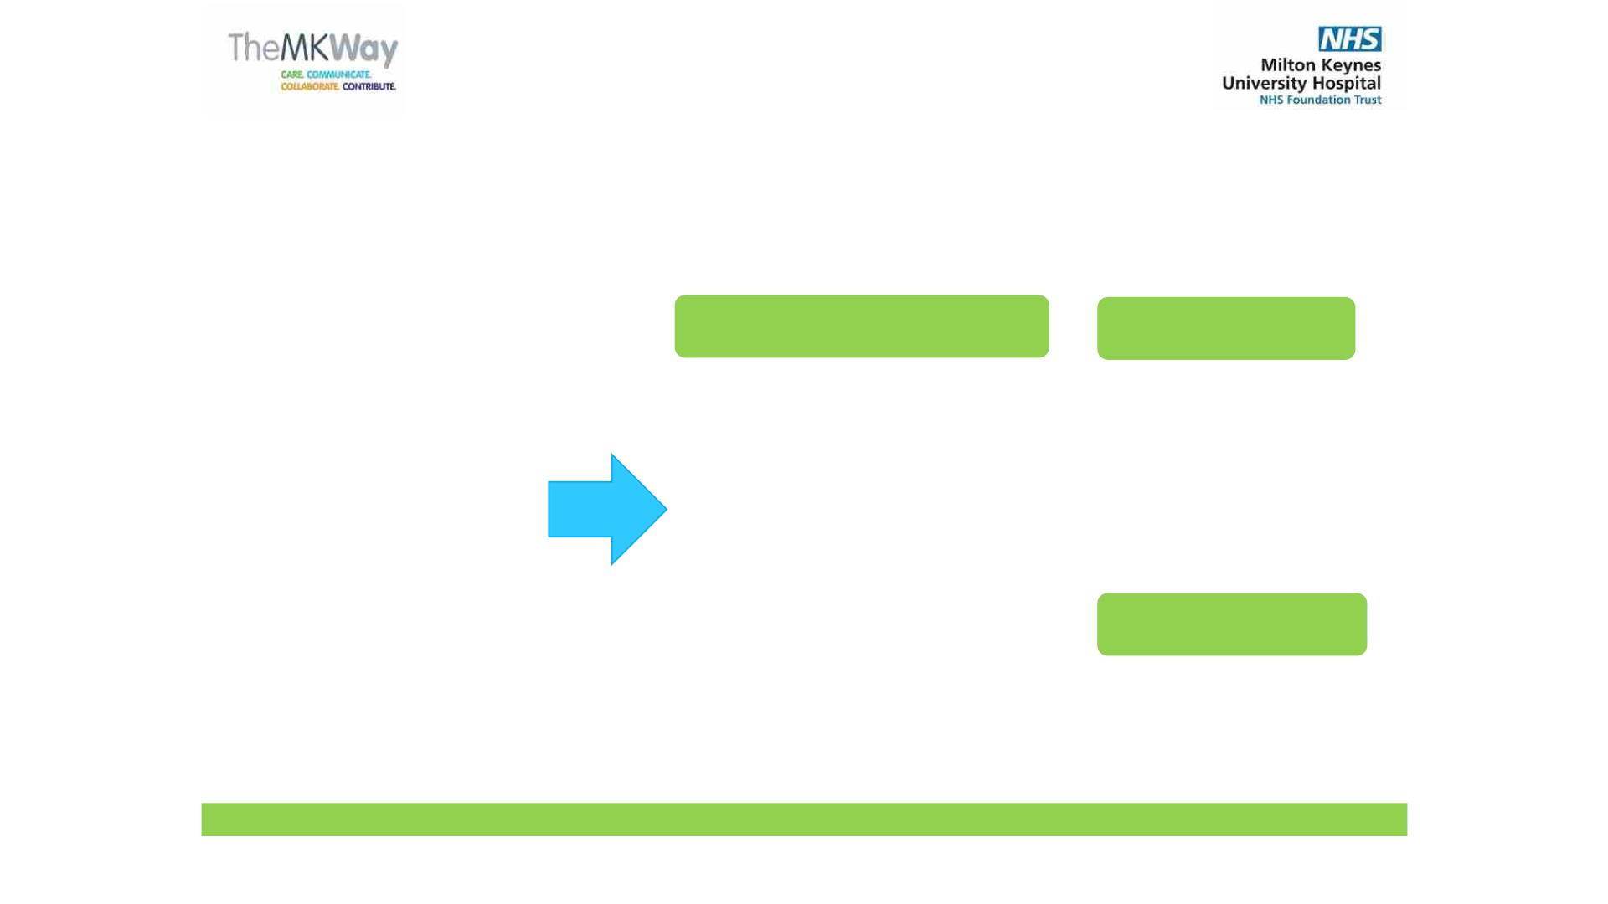
Our Council of Governors
The Council of Governors is made up of different types of governors who are elected by their members and
are direct representatives of our patients, their families, staff, members of the public and local organisations.
We currently have 24 Governors,
comprising:
14 Public Governors
7 Staff Governors
•
•
•
•
•
•
Babs Lisgarten
William Butler
Andrea Vincent
Kathryn Jaitly
Dianna Moylan
Christine
•
Lesley Bell
•
Caroline Kintu
Dr Hany Eldeeb
Tracy Rea
•
14 public governors - 8
constituencies (they must
always be in the majority)
•
•
•
•
•
•
•
•
•
•
•
•
Clare Hill
Andy Forbes
John Garner
Tom Daffurn
Rachel Medill
Ken Rowe
Yolanda Potter
Emma Isted
Pirran Salter
Stevie Jones
•
•
7 staff governors
3 appointed governors,
including:
Thompson
3 Appointed Governors
ü Healthwatch Milton
Keynes
ü Milton Keynes
Business
representation
•
Shirley Moon
•
Maxine
Taffetani
•
•
Nicholas Mann
ü Milton Keynes Council
Councillor Keith
McLean
We welcome our new Governors. All our Governors are volunteers and unpaid, thus ensuring our independence.

Slide 3
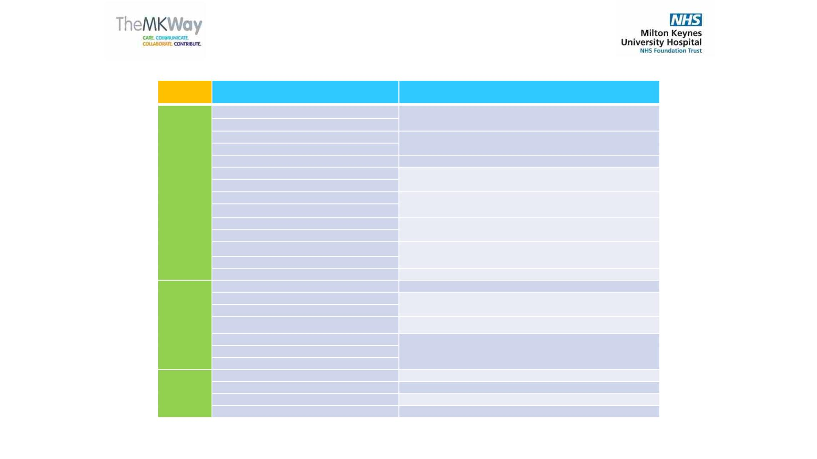
Our Governors by constituency
Governors
Constituency
PUBLIC
Babs Lisgarten (Lead Governor)
Bletchley & Fenny Stratford, Denbigh, Eaton Manor & Whaddon
Ken Rowe
William Butler
Andrea Vincent MBE
Kathryn Jaitly
Christine Thompson
Shirley Moon
Lesley Bell
Emerson Valley, Furzton, Loughton Park
Linford South, Bradwell, Campbell Park
Hanslope Park, Olney, Sherington, Newport Pagnell
Clare Hill
Walton Park, Danesborough, Middleton, Woughton
Stantonbury, Stony Stratford, Wolverton
Outer catchment area
Andy Forbes
VACANT
John Garner OBE
Tom Daffurn
Rachel Medill MBE
Dr Hany Eldeeb
Caroline Kintu
Tracy Rea
Extended area
Doctors and Dentists
STAFF
Nurses and Midwives
Yolanda Potter
Scientists, technicians and allied health professionals
Emma Isted
Stevie Jones
Pirran Salter
Nicholas Mann
Maxine Taffetani
VACANT
Non-clinical staff groups eg admin & clerical, estates, finance, HR,
management
APPOINTED
Milton Keynes Business Leaders
Healthwatch Milton Keynes
Community group
Keith McLean
Milton Keynes Council

Slide 4

The role of the Council of Governors
• The Council of Governors is authorised by statute to discharge these duties:
• Be independent of the Board of Directors.
• To hold the Non-Executive Directors to account for the
performance of the board.
• To represent the interests of the general public including patients
and members.
• To agree/approve certain large transactions.
• To appoint the Trust’s auditors.
• To appoint Non-Executive Directors, including the Chair and agree
remuneration.

Slide 5

Working Together
Governors observe Trust
Board assurance
committee meetings and
have feedback sessions
with Non-Executive
Directors
Non–executive directors
attend every Council of
Governors’ meeting
Governors have an open
invitation to attend all Trust
Board meetings
Non–executive directors
attend every Council of
Governors’ meeting

Slide 6
What have we done in 2022/2023?
•
•
•
•
The Council formally meets 4 times during the year.
We also have regular Informal meetings with the Chair. The Chair and Lead Governor also have one-to-one meetings.
The Council of Governors is responsible for appointment of the Chair of the Board and the Non-Executive Directors.
The Appointments Committee, which I chair as Lead Governor, have appointed our new Non-Executive Directors and
Associate Non-Executive Directors.
•
The Council of Governors monitored Trust governance issues, received a range of reports on finance, performance,
quality and workforce and are empowered to provide scrutiny and challenge.
•
•
•
Appointed new External Auditors.
Reviewed and updated the Constitution.
Received and reviewed formal reports, including the 2022/23 Annual Report and Accounts.

Slide 7
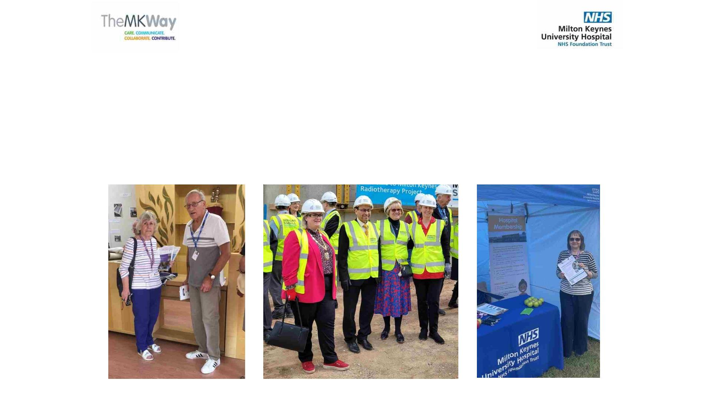
Other Governor activities
• The Council of Governors:
•
Attended well over a dozen public events to engage with the public by signing up members,
listening to people’s feedback and promoting the Governor role (see photos below).
•
•
•
Participated in the MKUH Staff Awards.
Observed Trust Board and Committee meetings.
Continued to increase their engagement activities and further increase the feedback from
nd th es a

Slide 8
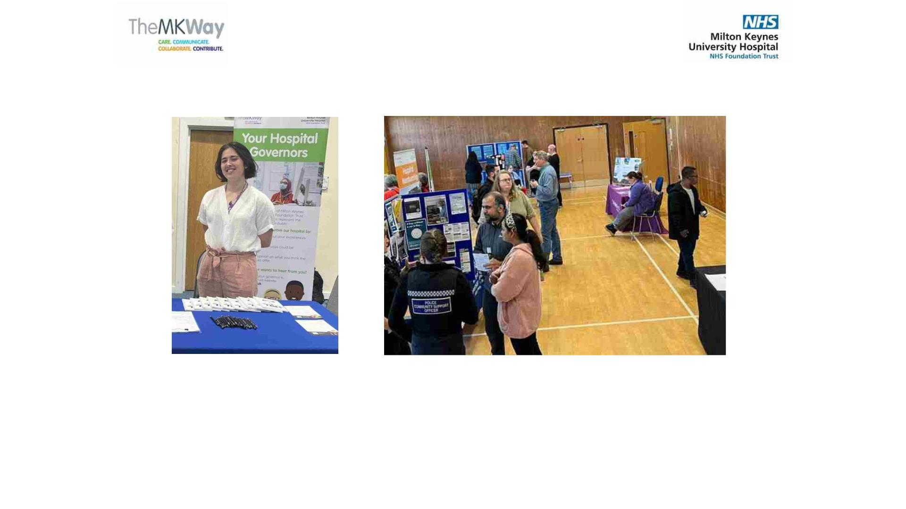
We listen
• We would love to hear from you. If you have any comments or would like to
share your experience of the services at the hospital, do please contact me or
your local Governor via email addresses listed on the Trust website.

Slide 9
Trust membership
• As Governors we represent patients, members and the
public.
• The total membership is now over 4,900, comprising over
1,900 public members and over 3,000 staff.
• We aim to attend more events, increasing visibility and
presence in the community, across diverse areas. We
communicate regularly though regular Membership
newsletters, and we aim to engage more with local groups
and young people.

Slide 10
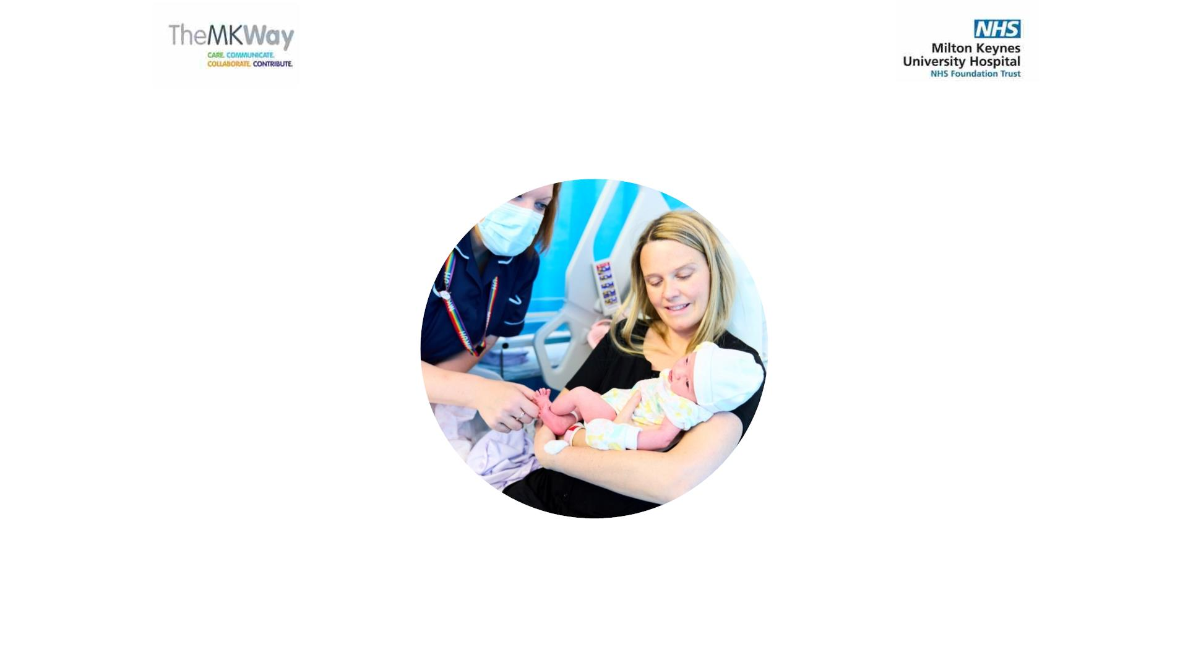
Come and join us!
Our hospital is here for you.

