Slide 1
Review of 2022/23
Joe Harrison
Chief Executive Officer
Milton Keynes University Hospital
NHS Foundation Trust

Slide 5
A uniquely challenging year
Emergency Department attendance records broken. At one stage, the department saw one patient arriving every four minutes - an unprecedented level of demand and a record we have started to see broken each year.
Industrial action – This impacted the nursing, midwifery, allied health professional, ambulance, and medical workforces, and junior doctors were involved in a 72-hour walkout in March 2023.
Extreme heat – Very high temperatures experienced during the heatwave in the summer of 2022 also provided challenges to staff who endeavoured to make life as comfortable as possible for our patients.

Slide 6
2022/23 in numbers
Activity levels during 2022/23 (compared to 2021/22):
413,979 outpatient attendances – 2.28% higher
25,568 elective spells – 7.3% higher
28,118 non-elective spells – 10.8% lower
101,212 Emergency Department Attendances – 0.78% higher
3,514 babies delivered – 7.28% lower
Notes:
Pandemic impact meant the national standard for consultant-led Referral to Treatment waiting times of 92% was not viable for the Trust to achieve
The Trust did not achieve the target of treating 95% of patients attending the ED within 4 hours, although our overall performance of 93.1% (all types) for the year placed us among the top performing trusts with a Type 1 department nationally

Slide 7
Impact of COVID-19 on performance
Staff continued to work exceptionally hard to reduce the waiting times for patients requiring elective (planned) treatment, including operations, following the COVID-19 pandemic.
The post-COVID-19 pandemic influenced backlog continued to impact planned care across the NHS during 2022/23.
As a result, the constitutional standard for consultant-led Referral to Treatment (RTT) waiting times of 92% within 18 weeks was not deemed viable or realistic for the NHS to achieve during this period of recovery. The Trust’s RTT performance as of March 2023 was 47.3%.
In emergency care, the Trust’s performance in relation to the four-hour target was 79.1%, against a target of 95%.
At the end of March 2023, the Trust reported zero patients waiting more than two years for treatment, and twenty patients waiting more than 18 months, reflecting steady and sensitively managed recovery.

Slide 8
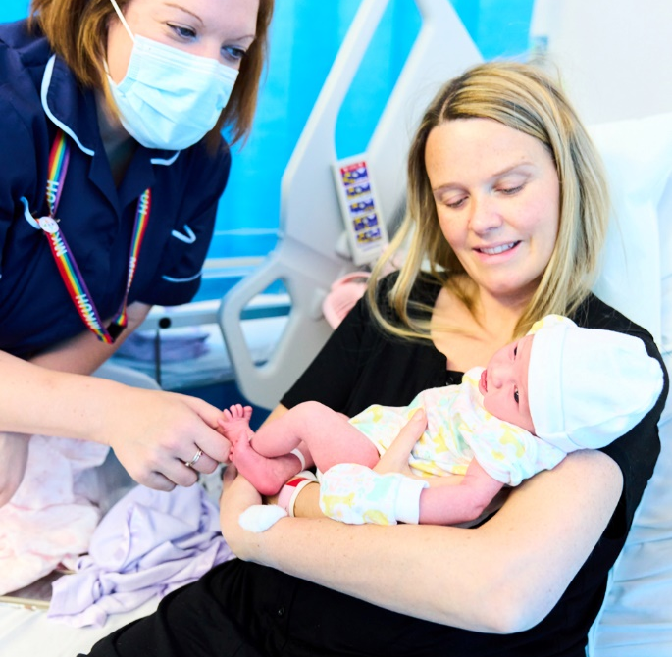
Maternity Services rated ‘Good’
Following an inspection of services in March 2023, MKUH Maternity Services were rated as ‘Good’ by the Care Quality Commission (CQC).
The domain of ‘Is the service well-led?’ was rated as outstanding, while ‘Is the service safe?’ was rated as good.
The inspection found leaders and staff actively and openly engaged with women and birthing people, staff, equality groups, the public and local organisations to plan and manage services.
The service continues to develop and evolve to meet the increasing health demands of our growing city.

Slide 9
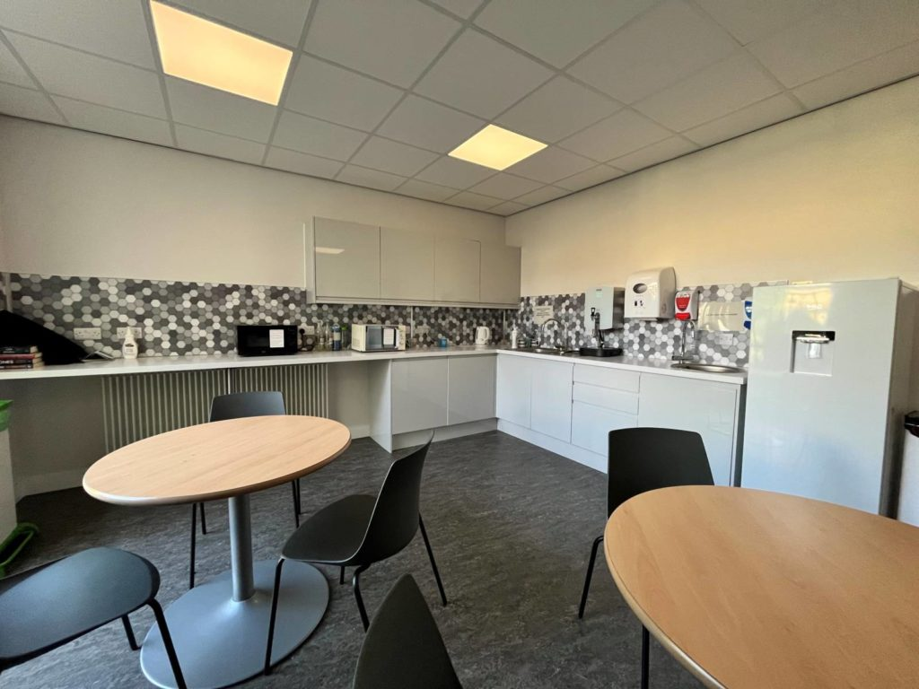
Staff engagement
Our exceptional NHS Staff Survey 2022 results showed that #TeamMKUH are the most engaged NHS workforce in the country.
The Trust scored above average in all other eight overarching elements, scoring highest nationally for the ‘We Are Always Learning’ category.
We also scored highest nationally in the areas of Autonomy and Control, Appraisals, Motivation and Involvement.
We are working hard to implement actions in areas where we would like to score higher.
Staff Awards 2023 was a record-breaking year for nominations, with over 900 received across all areas of the hospital.
Staff room refurbishment programme.
New Ward 1 & 2 Staff Room

Slide 10
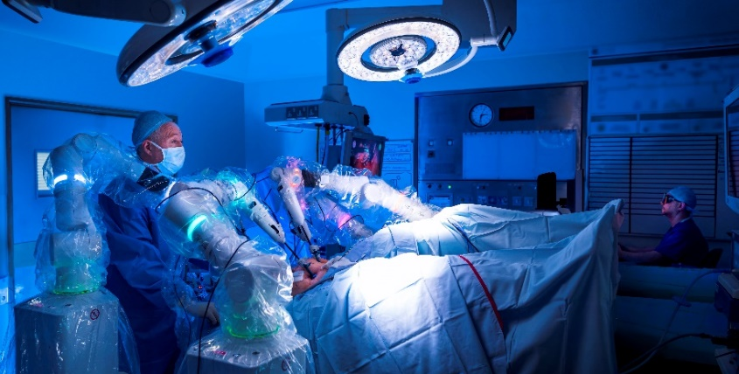
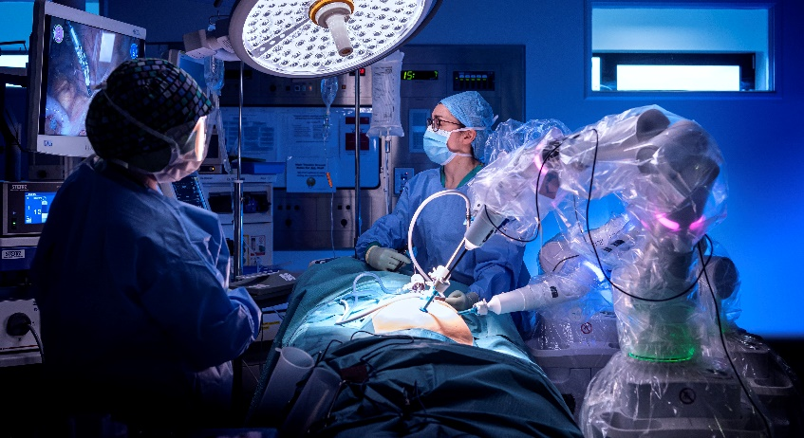
Leading the way in digital and robotics
MKUH continues to be a pioneer in the space of robotics, with the Versius surgical robot completing its 500th case in March 2023 – an astonishing achievement.
Some Pathology and Radiology reports and results now available to patients via the MyCARE patient portal, giving patients greater access to their health records.
Worked with Academy of Robotics to create and trial a delivery robot (or ‘Helper Bot’) called Milton, to help speed up hospital processes and relieve pressure on staff.
The Trust continued to deliver a significant amount of elective – and particularly outpatient – care by using alternative technologies, including virtual clinics either by video or telephone to our patients.
Mobile version of the Friends and Family Test platform introduced across all areas of the hospital, including for paediatric patients, and this has increased feedback significantly.

Slide 11
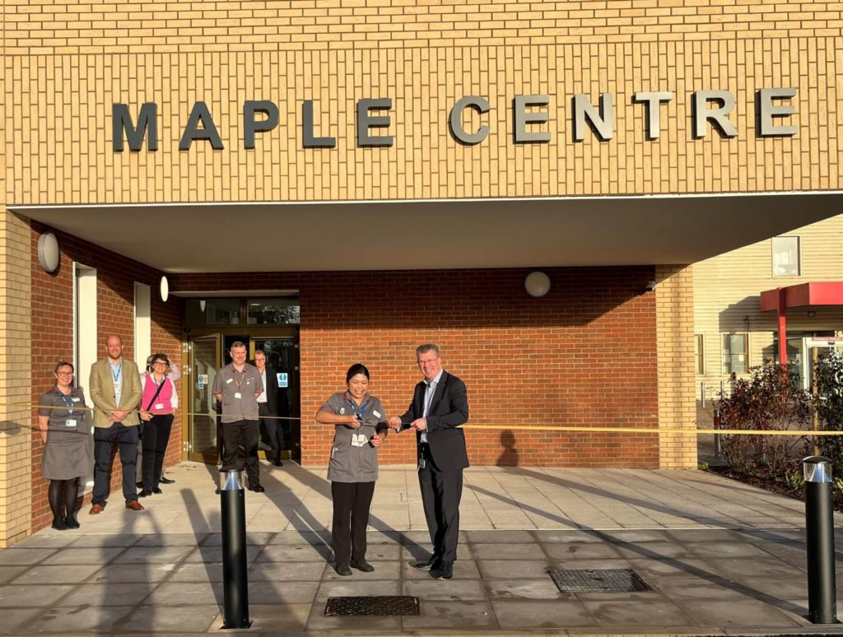
Estate development
The Maple Centre opened on 31 October 2022, reducing pressure on our Emergency Department, delivering an integrated approach to Same Day Emergency Care for patients, as well as an acute assessment ward.
Endoscopy services, as well as some Cardiac Echo and Respiratory Sleep Study diagnostic tests, now available at Whitehouse Health Centre.
The Trust continues to progress its ambitions to develop the estate, and its services, to meet the demands of the rapid development of Milton Keynes, and its ever-increasing population, as one of the UK’s fastest growing cities.

Slide 12
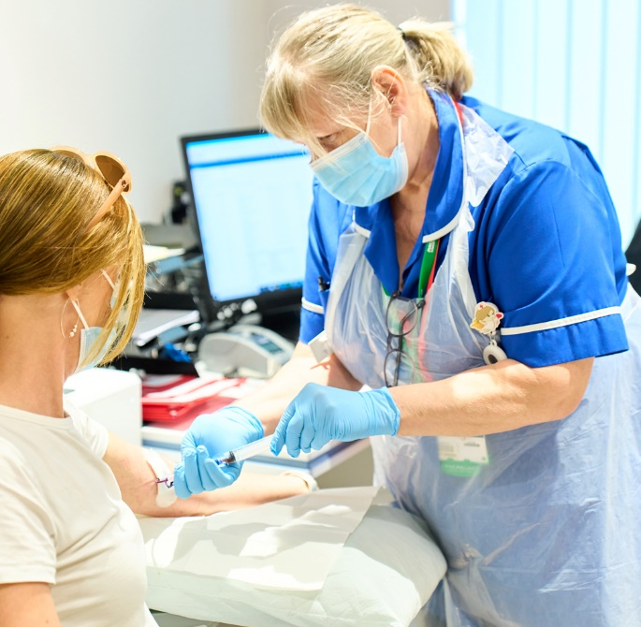
Patient safety and experience
MKUH awarded the Ministry of Defence (MOD) Employer Recognition Gold Award as part of our ongoing commitment to supporting the armed forces community.
MKUH awarded the NHS Pastoral Care Quality Award, recognising the fantastic work our teams have put in place to support our nursing and midwifery colleagues who have joined from countries around the world.
MKUH shortlisted in this year’s HSJ Patient Safety Awards, for our ‘Controlling the Built Environment with Digital Twins’ pilot project, under the ‘Early-Stage Patient Safety Innovation of the Year’ category.
Introduction of virtual wards.
MKUH partnered with Accessible, the UK’s leading provider of detailed disabled access information, to create Detailed Access Guides to facilities, wards and departments at the hospital.

Slide 13
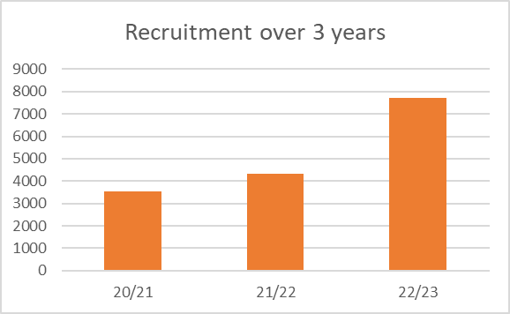
Research and Development
MKUH R&D Team have received several acknowledgements for high quality data and recruitment, including recruiting the first participants in England for a study.
 | Participants | Proportion
Total | 7,395 | 100.00%
Fetal Medicine | 3,650 | 49.40%
General Obstetrics (antenatal and postnatal care, perinatal mental health) | 2,510 | 33.90%
Allergy, Infection and Immunity | 313 | 4.20%
Anaesthesia, Perioperative Medicine and Pain Management | 190 | 2.60%
Critical Care | 155 | 2.10%
“I’m so pleased I was invited to take part in the trial and have all these things diagnosed before it’s too late. If it wasn’t for the study, I wouldn’t have known about my heart issues... the communication and the care I have received have been amazing. I don’t think I could have had better treatment.”
*Recruitment into 15 specialties in total

