Slide 1
Looking Ahead
Joe Harrison
Chief Executive Officer
Milton Keynes University Hospital
NHS Foundation Trust

Slide 2
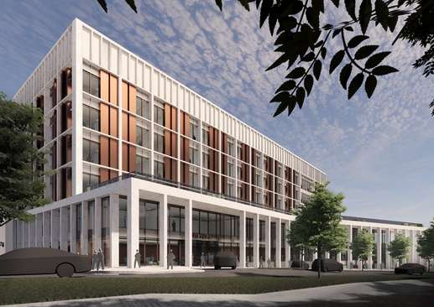
Women & Children’s Hospital
MKUH will receive funding to deliver a new Women and Children’s Hospital and enhanced surgical capacity by 2030 as part of the Government’s New Hospital Programme (NHP).
The building is essential to the Trust’s future growth strategy, with Milton Keynes’ population forecast to almost double to 500,000 by 2050.
The Trust is developing its Outline Business Case, which will involve further engagement with staff, patients, and the public, ensuring we continue to meet the acute care needs of our local community.

Slide 3
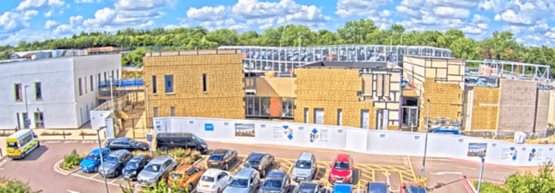
Other estate developments
We are working with a number of partners, including Milton Keynes City Council, to deliver our MK View: 2030 Estates Vision.
MHUH will construct a new 3-storey Imaging Centre to provide a central location for Imaging services.
Oak House Ward Capacity - We are currently looking into options to expand our ward capacity to meet ongoing and future demand.
Our new state-of-the-art Radiotherapy Centre is currently under construction - due to open summer 2024, completing the Cancer Services offering available at MKUH.

Slide 4
Looking ahead
New Community Diagnostic Centre - Community Eye Clinic, in Lloyd Court.
MKUH aims to reduce emissions from public sector buildings by 75% by 2037, following £4.8 million in funding received as part of the Government’s Public Sector Decarbonisation Scheme.
MKUH working with Milton Keynes City Council and local health partners to further improve the care and experience that our patients receive as they return home after a stay in hospital, with two new services currently in development – ‘live-in care’, and ‘bridging care’.

Slide 5
Thank you...
To our staff, who provide good, safe care every day for every patient…
To Lead Governor Babs Lisgarten…
To our volunteers…
To those who support our charity…
And to our community.

Slide 6
Any questions?

