Slide 1
MKUH Annual Members’ Meeting 2022

Slide 2
Welcome and Opening Address
Alison Davis
Chair
Milton Keynes University Hospital
NHS Foundation Trust

Slide 3
Review of 2021/22
Professor Joe Harrison
Chief Executive Officer
Milton Keynes University Hospital
NHS Foundation Trust

Slide 4
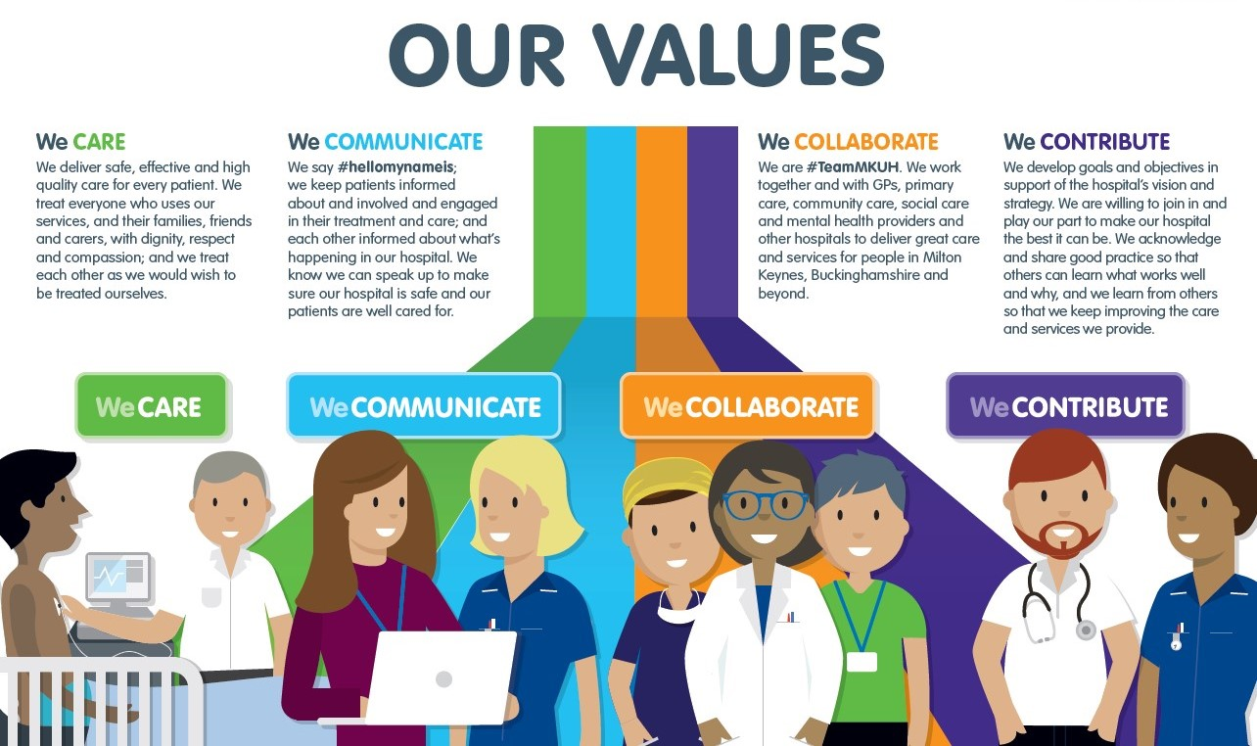

Slide 5
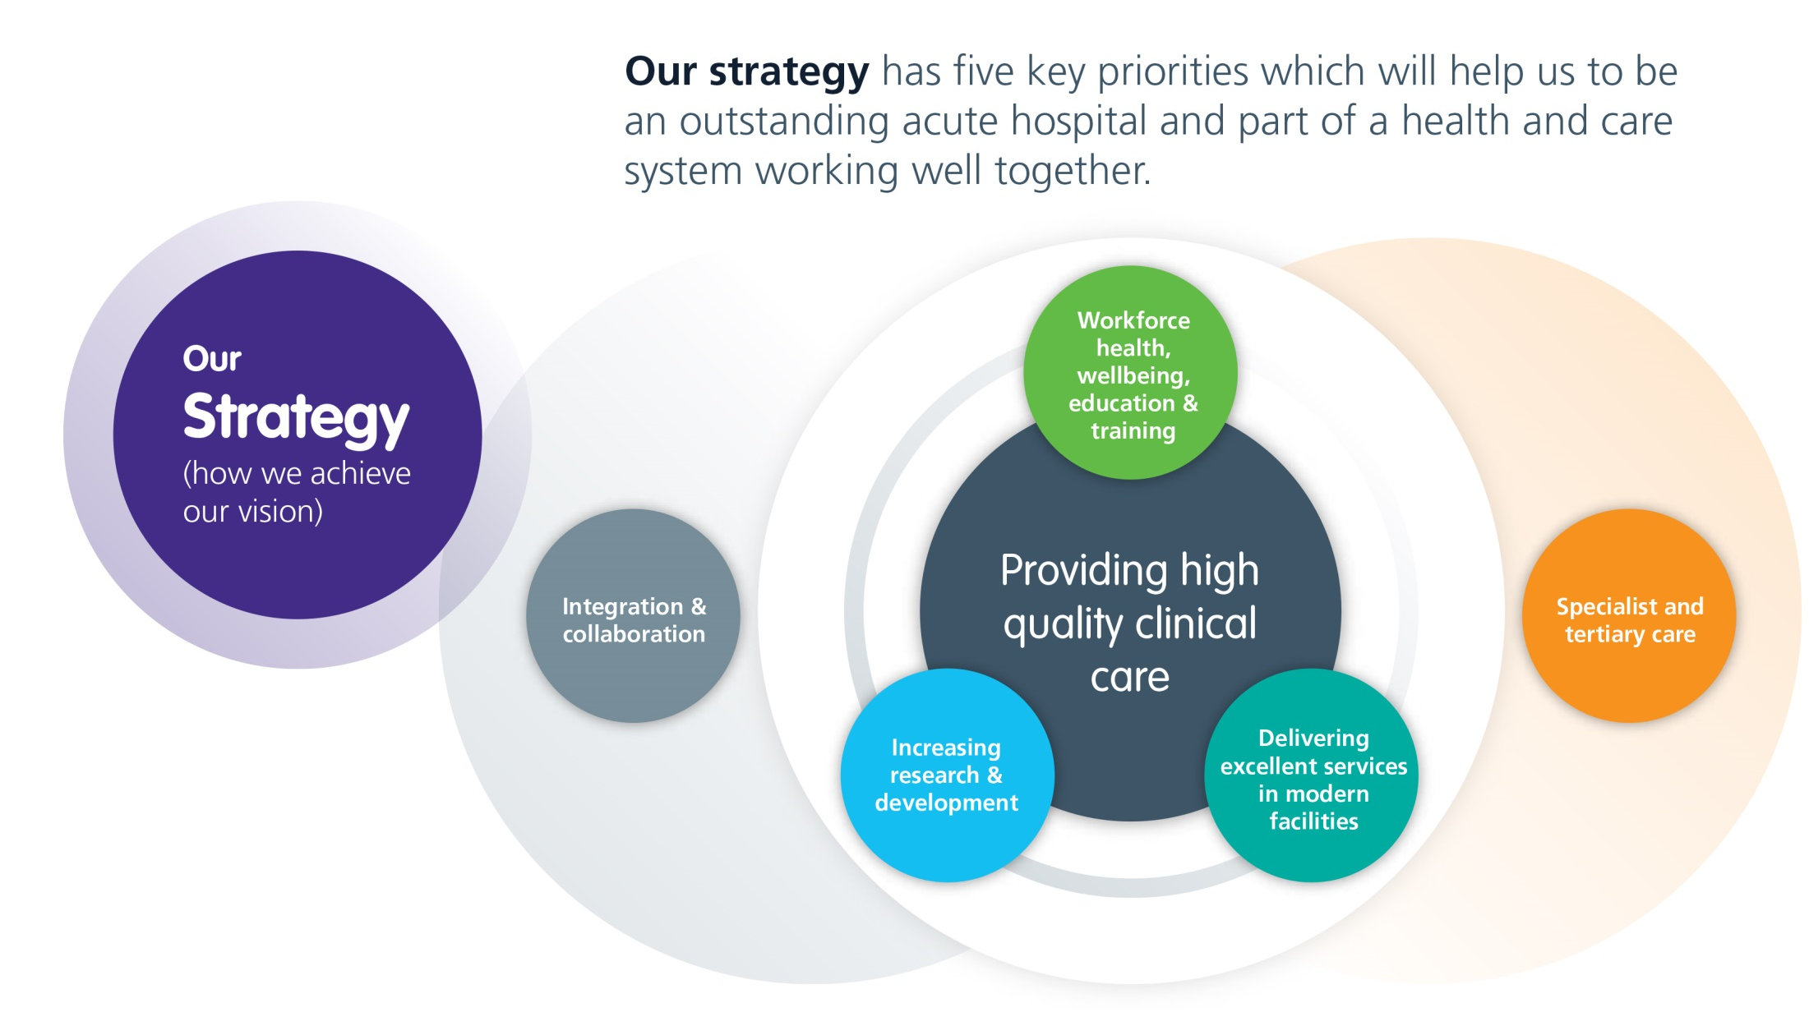

Slide 6
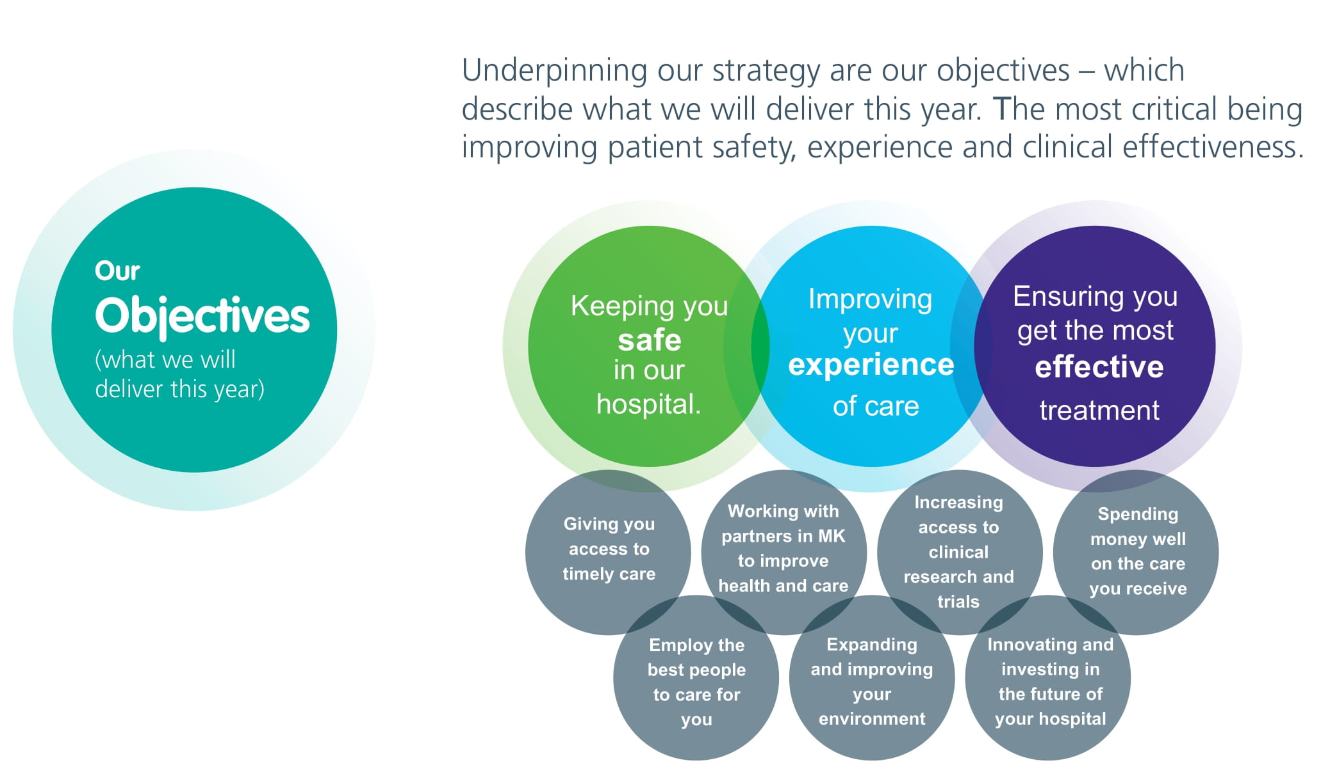

Slide 7
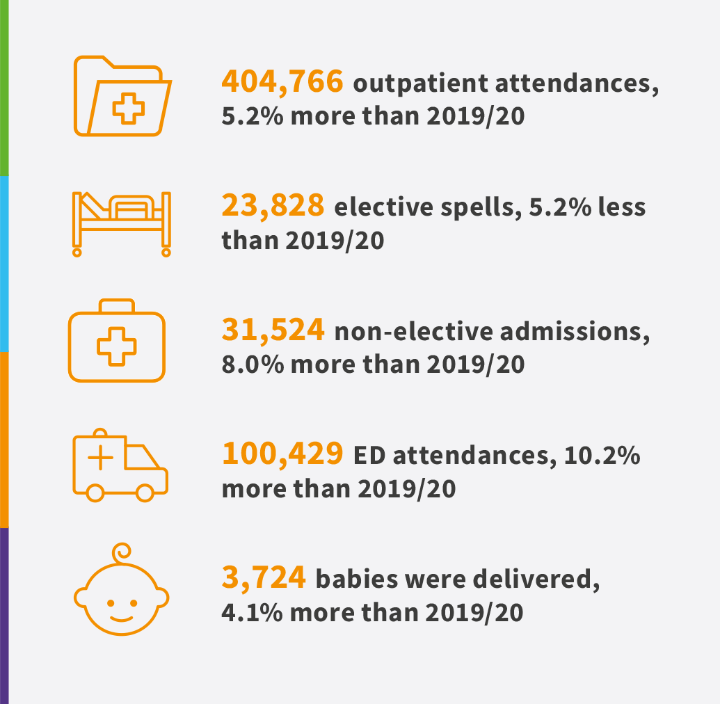
2021/22 in numbers
Activity levels during 2021/22 (compared to 2019/20 – pre-COVID-19)
Notes:
Pandemic impact meant the national standard for consultant-led Referral to Treatment waiting times of 92% was not viable for the Trust to achieve
The Trust did not achieve the target of treating 95% of patients attending the ED within 4 hours, although our overall performance of 93.1% (all types) for the year placed us among the top performing trusts with a Type 1 department nationally

Slide 8
The impact of COVID-19 on activity
Throughout 2021/22, the Trust experienced some very busy periods, including during the COVID-19 Omicron-variant wave which began in December 2021.
As demand for services returned to pre-pandemic levels, the Trust has seen a steady improvement across some performance targets.
Reacting to the pandemic, the Trust delivered a significant amount of elective – and particularly outpatient – care by using alternative technologies, including virtual clinics either by video or telephone to our patients.
In emergency care, the Trust’s performance in relation to the four-hour target was 80.5%, against a target of 95% (although still in the top 25% in the country).
The Trust achieved the national target set to have no patients waiting 104-plus weeks at the end of March 2022.

Slide 9
The impact of COVID-19 on staff and patients
Visiting, with a few exceptions, continued to be restricted until March 2022.
Face masks continued to be mandatory on the hospital site (until September 2022).
Our staff continued to work incredibly hard in response to the Omicron wave and other pandemic-related challenges, and also to reduce the elective backlog as quickly and as safely as possible.
Some staff continued to shield from their families for long periods, whilst others worked remotely as they were required to shield themselves.
Continued absences through sickness and COVID-19 isolation periods kept wards and departments under additional pressure.

Slide 10
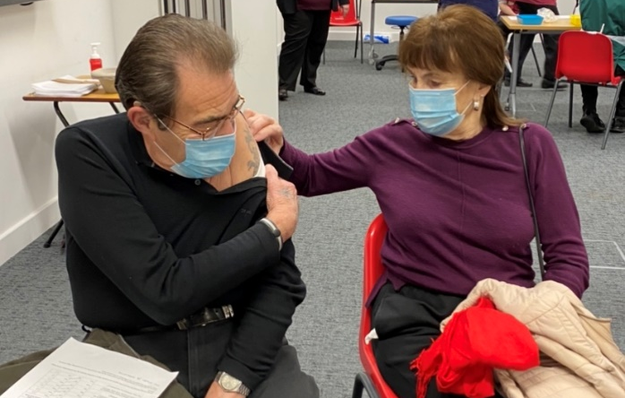
Vaccination Centre
The Vaccination Centre in the hospital’s Academic Centre closed in November 2021, having opened as one of the region’s first vaccination centres in December 2020.
The centre administered COVID-19 booster vaccines to about 2,950 patients and staff (having previously administered over 35,000 doses of the Pfizer/BioNTech vaccine).
Staff from all kinds of departments and wards across the Trust contributed to the running of the centre, in testament to the flexibility and willingness of our staff to support the wider health needs of our community.

Slide 11
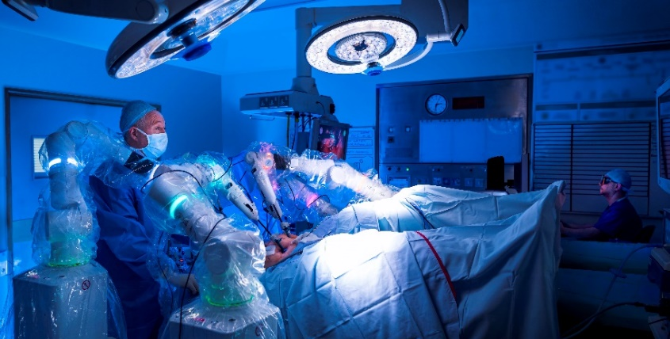
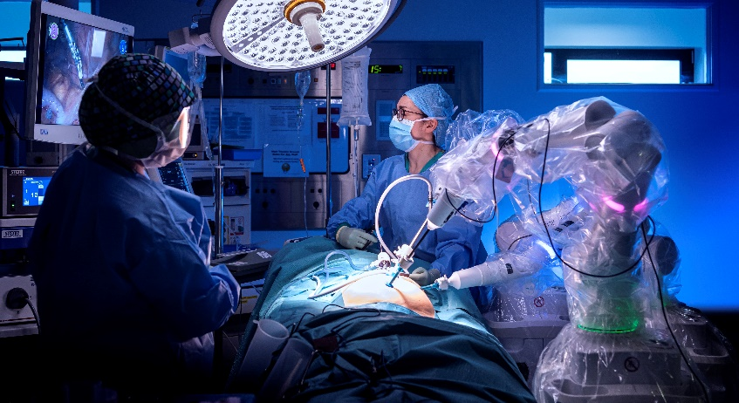
Surgery and safety advancements
CMR Surgical’s Versius Robot has performed over 100 complex surgeries across colorectal, gynaecological, and general surgery.
It is now used for major gynaecological surgery, including complex cancer cases.
As one of 18 hospitals named as a ‘fast follower’ of NHS England’s Global Digital Exemplars programme, MKUH has been a digital pioneer and leader in embracing new technologies, having first adopted Versius for colorectal surgery in 2019.
MKUH became the first Trust in the country in December 2021 to integrate the new national NHS Learning from the Patient Safety Events service, having partnered with software specialists Radar Healthcare.

Slide 12
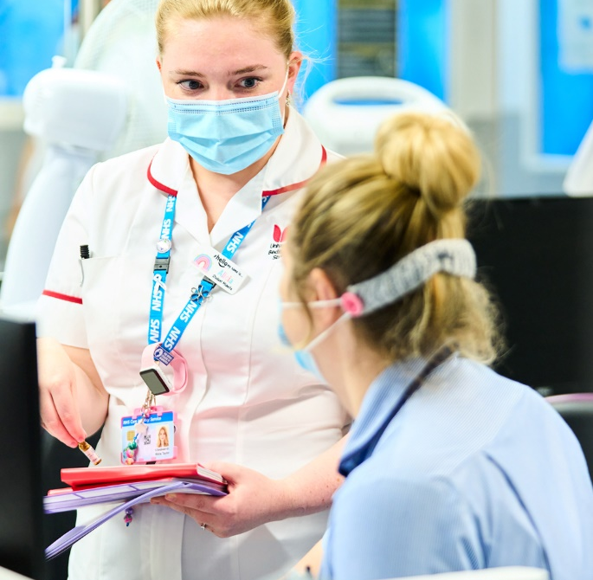
Staff engagement
The Staff Survey 2021 showed that, for staff engagement, MKUH was rated one of the best trusts in the country.
In this area, MKUH’s score was the best nationally for ‘motivation’ when compared to the benchmark group, with over 60% of respondents agreeing with the statement ‘I look forward to going to work’.
More than 1,000 staff tuned in for the Trust’s annual Event in
the Tent, held virtually in June 2021.
A new, improved platform for the Weekly staff newsletter went live in July 2021, making it easier for staff to view the content and provide feedback, and allowing them to ‘like’ articles.

Slide 13
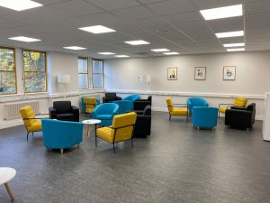
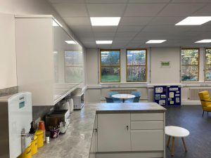
Supporting our staff
We opened our new staff hub (pictured) where colleagues can relax, thanks to donations from our COVID-19 appeal and a grant from NHS Charities Together.
Staff Survey 2021 results – MKUH was the highest scoring acute trust in the East of England, rating well above average in all nine of the areas.
In February 2022, all staff members were given an extra day of annual leave as a thank you for their incredible efforts.
We began offering new flexible annual leave options for staff, allowing staff to buy or sell annual leave.
Notes:
Also mention our P2P listening service, mental health first aiders and Vivup employee assistance programme

Slide 14
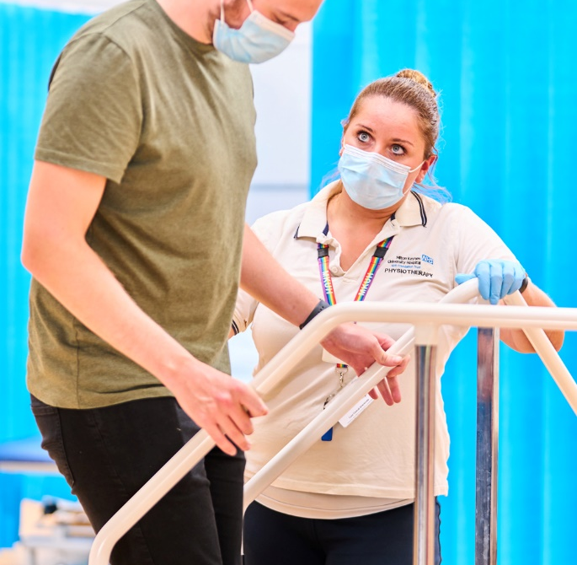
Patient experience
New beds and mattresses have been introduced across all wards, improving the safety and comfort of our patients.
The Trust’s new patient food service went live in May 2021, offering almost 30 dishes across lunch and dinner, containing maximum nutritional value.
The Eaglestone Restaurant has been reopened to patients and visitors and has also undergone a refurbishment.
The Trust’s Friends & Family Test mobile service was extended from Outpatients and Emergency Department to all adult inpatient wards, allowing patients to provide timely feedback via their phone and significantly increasing response rates.

Slide 15

Digital advancements
The Trust was recognised as a leading NHS organisation for digital innovation after receiving accreditation from NHS England and NHS Improvement (NHSEI) as part of its Global Digital Exemplar (GDE) programme.
In September 2021, the next phase of our electronic eCARE patient records system went live in Theatres, Anaesthetics, Paediatrics and the Intensive Care Unit.
The Trust now offers patients the simplicity and reassurance of using their single, secure NHS login to access their MyCARE patient portal.
MKUH became the first NHS hospital in the country to partner with digital pioneer ‘Haltian’ to pilot their Empathic Building Smart Hospital solution in our Cancer Centre, aimed at improving building productivity and efficiency using data-driven insights.
New Granicus community messaging email platform launched, with over 4,000 subscribers.

Slide 16
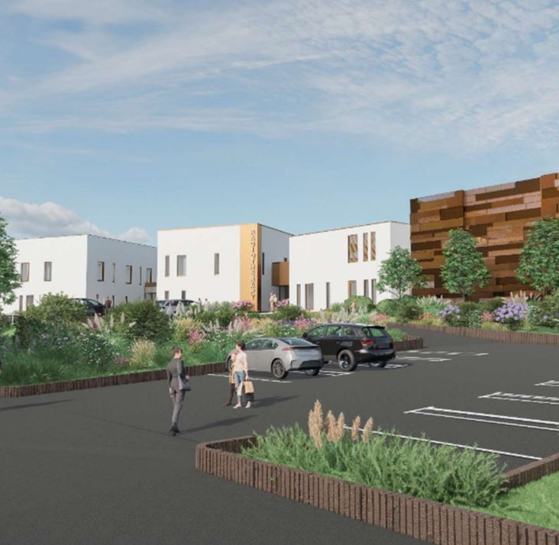
Estates developments
New Outpatient Pharmacy opened to improve patient experience by reducing waiting times, improve patient accessibility to their medicines and deliver specialist advice to patients about their ongoing medication management.
The upper deck to Car Park F (behind the Urgent Care Centre) is now open to staff adding to the ground deck completed in 2021, creating approximately 70 spaces.
New Cath Lab opened in the Cardiology Unit, as part of an ongoing project to
upgrade and enhance the diagnostic imaging service offered to patients.
Two new mobile MRI scanners were installed outside the Treatment Centre,
increasing our imaging capacity and providing patients with state-of-the-art
facilities.
New Hospital Programme: The Strategic Outline Case (SOC) was sent to the
Department for Health & Social Care (DHSC) in November 2020 and involved
feedback from staff, patients and our local community.

Slide 17
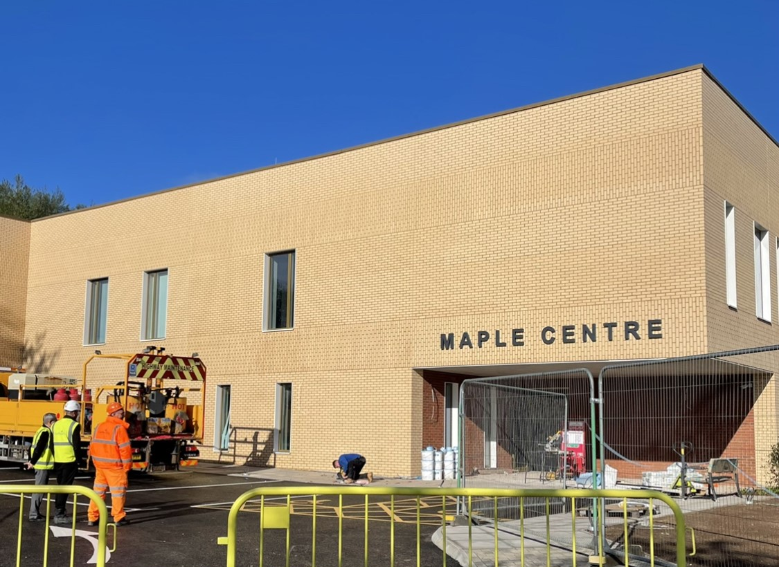
Maple Centre
The new Maple Centre is due to open on 31 October 2022, providing improved integrated access to primary care and community health services and social care for patients with complex or multiple needs who attend the Emergency Department.
26 beds and 16 assessment rooms on the upper level will help provide support to patients, returning them home at the earliest opportunity.
The ground floor will house Same Day Emergency Care, followed by the Willow Unit including the Ambulatory Emergency Care Unit, Bridging Clinic, OPAT and DVT/VTE Clinic, as well as Emergency Surgical Clinic from the Acorn Suite.

Slide 18
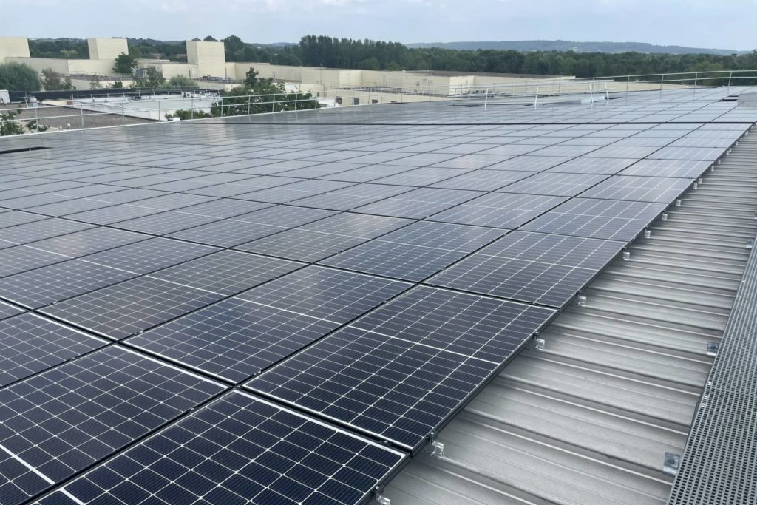
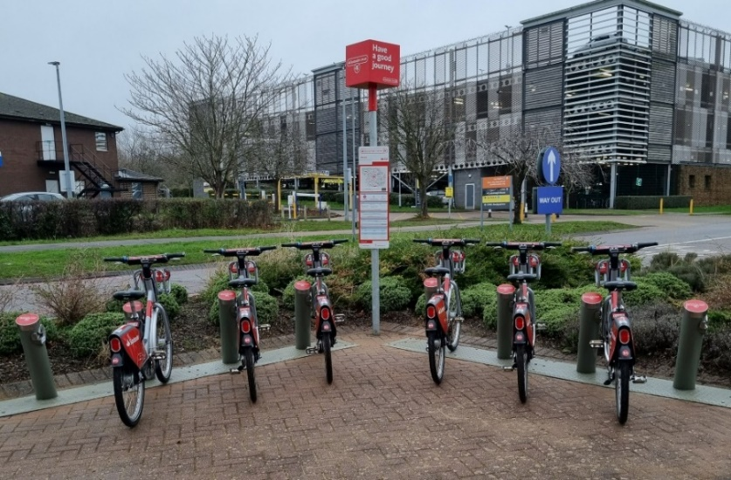
MKUH Green Plan
As a Trust, we are committed to becoming net carbon zero by 2030.
We have already made outstanding progress, including:
  Installing over 3,000 solar panels across the site, producing approx.10% of our total electricity output
  Switching to a fully renewable energy tariff
  Reduced patient food waste to 2% by introducing electronic meal ordering
  Purchasing from local food suppliers and introducing seasonal menus for staff (including vegan options)
  Installed a Santander bike station outside the main entrance.
The Trust’s revised Travel Plan includes responses from circa 1,000 colleagues.

Slide 19
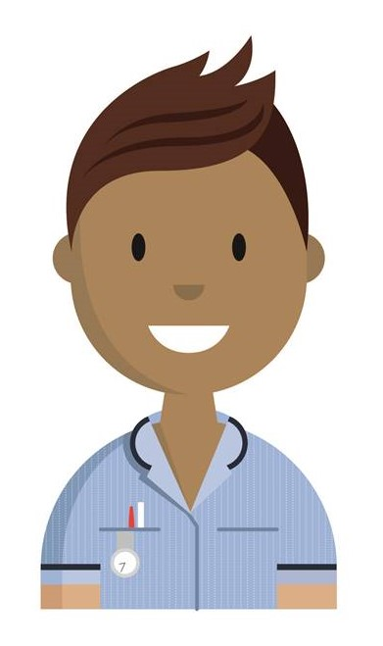
Research and development
Resumption of ‘normal’ research, whilst also continuing some COVID-19 research studies.
MKUH among the highest recruiting hospitals for our size to the RECOVERY trial that identified a number of interventions as having significant benefit in saving the lives of COVID-19 patients.
Continued high level of recruitment of participants to COVID-19 and other research studies (4,743), which is at the upper end of the NIHR Research Activity League Table for Small Acute Trusts.
Our R&D staff received a clutch of awards at the Thames Valley and South Midlands NIHR Clinical Research Network (CRN) Awards in 2021 for their outstanding contributions to research delivery.

Slide 20
Financial Review of 2021/22
Terry Whittle
Director of Finance
Milton Keynes University Hospital
NHS Foundation Trust

Slide 21
A year of transition and recovery​
During 2021/22, the NHS finance regime transitioned from the heavily centralised funding (national and regional) model that defined the initial phases of the COVID pandemic.
Key features of the funding model during 2021/22 included:​
​Delegation of funds for health services to Integrated Care Systems (Bedford, Luton and Milton Keynes ICS). Funding requirements were locally determined by ICS partners. Financial plans were agreed at an ICS level (historically by individual organisation).​
​Funding was provided in the form of a block based (fixed sum) model. This provided greater certainty compared to payment based on volumes of activity completed (eg due to potential COVID related service interruptions). ​
​Financial incentives were made available to healthcare providers (NHS and Independent Providers) to recover clinical care backlogs and return service delivery to pre-pandemic levels. Additional payment was linked to stepped increases in clinical activity during the year – ‘Elective Recovery Funding’ a signature NHS England policy. ​
​Continuation of national capital funding targeted towards diagnostic and elective care services to ensure treatment capacity and facilities (eg diagnostic scanners) were available as required.

Slide 22
Headline financial performance 2021/22​
The Trust agreed a £1.1m deficit plan (on a Control Total basis) for 2021/22 as part of a balanced Bedford, Luton and Milton Keynes ICS plan. The Trust ended the financial year with a deficit of £0.7m, £0.4m better than plan. ​
​The ICS in aggregate also delivered the financial performance required by our regulator NHS England.​
​Historical financial performance of the Trust is shown below. ​

Slide 23
How the money was spent​
During 2021/22 the Trust received funding of £327m, around 82% from local commissioners for acute services. We received £35m from NHS England (regionally commissioned services) and £20m from other (non-clinical) funding sources.
​The Trust spent £207m (>60%) of our funds on pay, £51m on drugs and clinical supplies (16%) and £21m on premises related expenses.​

Slide 24
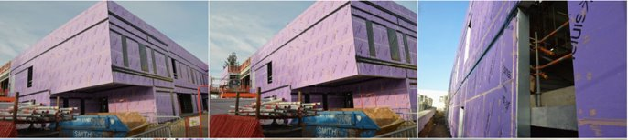
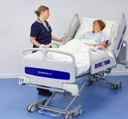
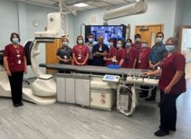
Capital spending 2021/22​
The Trust continued to make significant investments in healthcare facilities and equipment - £31.8m spent during 2021/22. At a national level capital investment accounts for a small share¹ of total health spending - at less than 6%. In Milton Keynes the capital investment is approaching 10% of total health spending. ​
Key capital investments included:​
​Maple Centre construction £8.3m​
Investment in diagnostic equipment (CT/MRI/Cardiac) £5.4m​
Information Technology (predominantly patient care systems) £2.9m​
Solar panels and roof enhancements £2.2m​
Replacement of hospital bed stock £1.5m; and ​
Staff room refurbishment programme​
¹ Source – Kings Fund NHS Capital Investment https://www.kingsfund.org.uk/projects/nhs-in-a-nutshell/nhs-capital-investment

Slide 25
Financial highlights from 2021/22​
Overall, 2021/22 was a successful year for the Trust, highlights from a financial perspective were:​
Continued delivery of financial performance - better than planned​.
Successfully securing additional resources of £12m for Elective Recovery Funding and £3m for accelerator schemes to provide additional care capacity​.
A significant capital investment of nearly £32m in estate modernisation and new medical equipment​.
Cash balance of £58m​.
Collaborating successfully with local partners to manage resources and risk for our local population​
Progress towards Future Focused Finance Accreditation Level 1​.
HFMA Eastern Branch award winning team member ‘Overcoming Adversity’ category​.

Slide 26

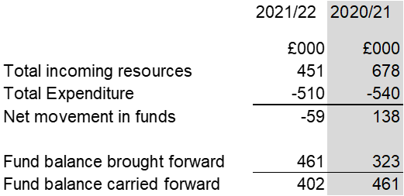
Milton Keynes Hospital Charity​
Fundraising appeals and activities included:
BabyLeo Neonatal Incubator x 3
Refurbishment of Intensive Care Unit staff room
Video Fiberscope for theatres to support diagnosis in young patients.
Accuvein “vein finder” supporting the experience of cancer patients when blood samples are taken.
Pastoral Support Worker offering signposting and support for patients and visitors
Meaningful Activities Facilitator, based within the Quality and Safeguarding team
A piano situated in the main entrance for staff and patients
Use of unrestricted funds to support a range of health related activities for the benefit of patients, their families and staff
Note – Figures are draft until final audit and adoption

Slide 27
Focus for 2022/23 and beyond​
The Trust continues to invest for the future. During the current financial year we are:​
Investing in our workforce to maximise our ability to recover the planned care waiting list backlog and meet other care priorities​.
Partnering with local independent healthcare providers to help reinforce our backlog recovery efforts​.
Completing construction and handover of the Maple Centre (November 2022)​.
Investing in green initiatives and facilities on-site​.
Developing community diagnostic care facilities​.
Progressing investment proposals for a Radiotherapy facility on-site​.
Continuing to progress business case development for the New Hospital Programme​.

Slide 28
Council of Governors and Membership Update
10 October 2022
Babs Lisgarten
Lead Governor and Public Governor for
Ashland, Bletchley, Denbigh, Eaton Manor, Fenny Stratford, Mount Farm, Simpson, Water Eaton, Whaddon
Milton Keynes University Hospital
NHS Foundation Trust

Slide 29
Our Governors
The Council of Governors is made up of different types of governors who are elected by their members and are direct representatives of our patients, their families, staff, members of the public and local organisations.
We currently have 18 Governors, comprising:
10 public governors - 8 constituencies (they must always be in the majority)
5 staff governors
3 appointed governors, including:
  Healthwatch Milton Keynes
  Milton Keynes Business representation
  Milton Keynes Council
  We currently have elections ongoing for a number of vacancies as some governors have come to the end of their terms. The elections will be completed in November 2022.
10 Public Governors
5 Staff Governors
3 Appointed Governors
Babs Lisgarten
Martin Nevin
William Butler
Jordan Coventry
Akin Soetan
Shirley Moon
Niran Seriki
Clare Hill
Ann Thomas
Robert Johnson-Taylor
Tracy Rea
Yolanda Potter
Emma Isted
Pirran Salter
Stevie Jones
Maxine Taffetani
Andrew Buckley
Councillor Keith McLean
We welcome our new Governors. All our Governors are volunteers and unpaid, thus ensuring our independence.

Slide 30
The role of the Council of Governors
The Council of Governors is authorised by statute with these duties:
  Be independent of the Board of Directors.
  To hold the Non-Executive Directors to account for the performance of the Board.
  To represent the interests of the general public including patients and members.
  To agree/approve certain large transactions.
  To appoint the Trust’s auditors.
  To appoint Non-Executive Directors, including the Chair, and agree remuneration.

Slide 31
What have we done in 2021/22?
The Council formally meets 4 times during the year.
We also have regular informal meetings with the Chair. The Chair and Lead Governor also have one-to-one meetings.
The Council of Governors is responsible for appointment of the Chair of the Board and the Non-Executive Directors.
The Appointments Committee, which I chair as Lead Governor, have appointed our new Non-Executive Directors.
The Council of Governors monitored Trust governance issues, received a range of reports on finance, performance, quality and workforce and are empowered to provide scrutiny and challenge.
Appointed new external auditors.
Reviewed and updated the constitution.
Received and reviewed formal reports, including the 2021/22 Annual Report and Accounts.

Slide 32
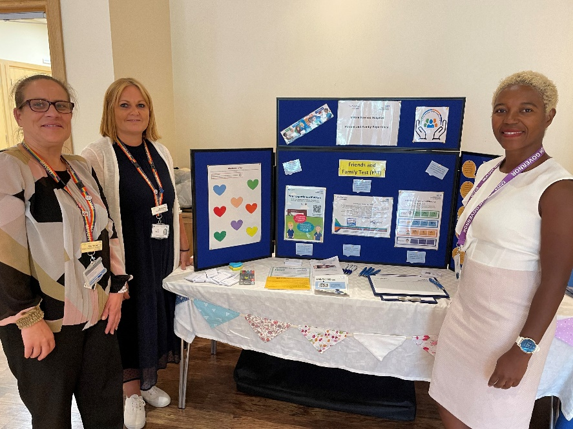
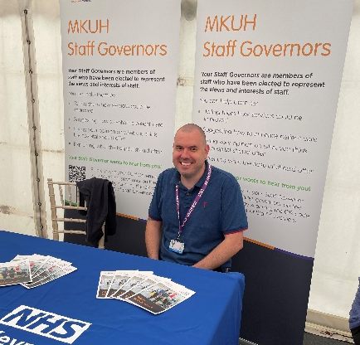
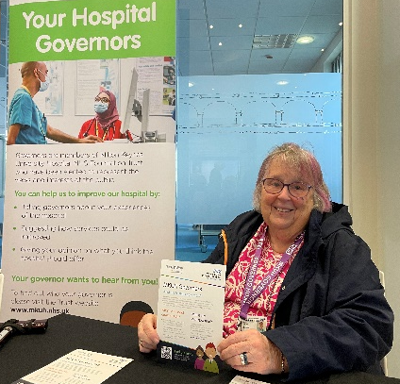
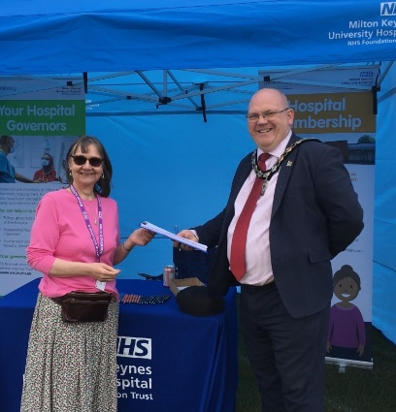
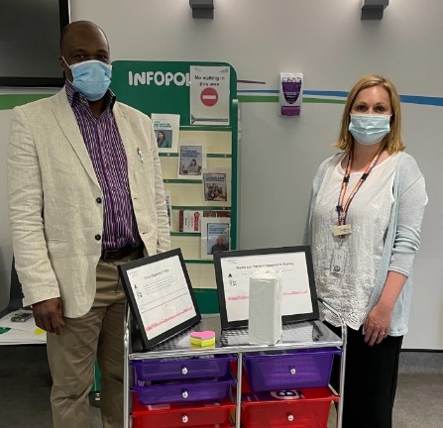
Other Governor activities
The Council of Governors:
Shared ‘Best Practice’ at meetings of the Lead Governors Network for the East of England area.
Observed Trust Board and Committee meetings.
Participated in the Staff Awards.
Have an ongoing drive to increase membership and enable patients and the public to have their say in the future development of the hospital through many activities and events:

Slide 33
Working Together
Governors observe Trust Board assurance committee meetings and have feedback sessions with Non-Executive Directors
Non–Executive Directors attend every Council of Governors meeting
Governors have an open invitation to attend all Trust Board meetings
Non–Executive Directors attend every Council of Governors meeting

Slide 34
Membership
Following a membership database cleanse, the total membership has been reduced from 9,000 to over 4,600, of which over 1,600 are public members approx. 3,000 are staff.
The revised Membership and Engagement Strategy continues to be implemented.
Every governor and member is asked to encourage our friends, family, general public to become members.

Slide 35
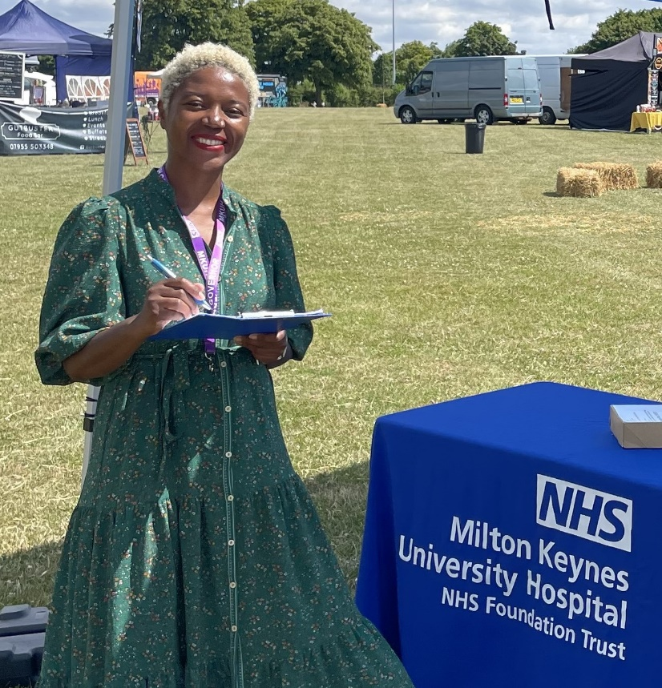
Membership activities
    Next year, we will be aiming for:
  More event attendance and participation, both face to face and digital.
  Increased visibility and presence in the community.
  Continued regular Members' Newsletter email updates.
  More working with schools, groups and diverse areas of the community.
  Closer working with our community partners.

Slide 36
Membership
As Governors we represent patients, members and the public.
We would love to hear from you so if you have any comments or would like to share your experience of the services at the hospital do please contact your Governor. Their email addresses are listed on the Trust website.

Slide 37
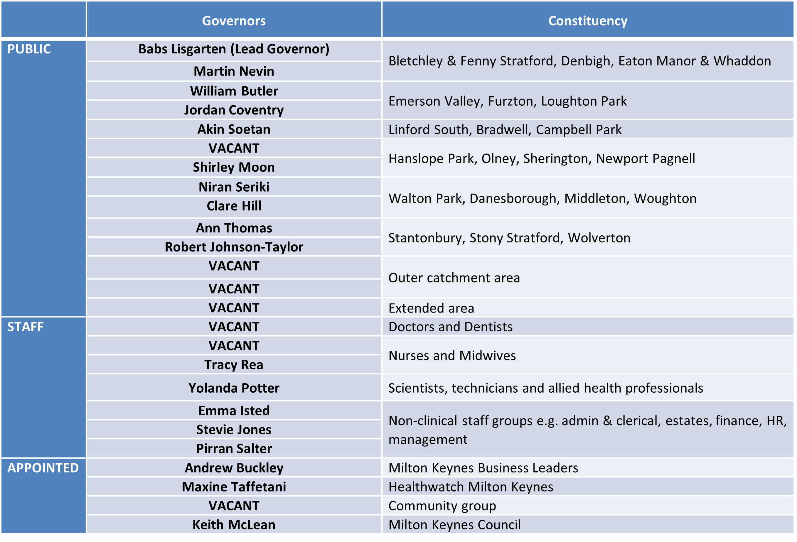
Our governors

Slide 38
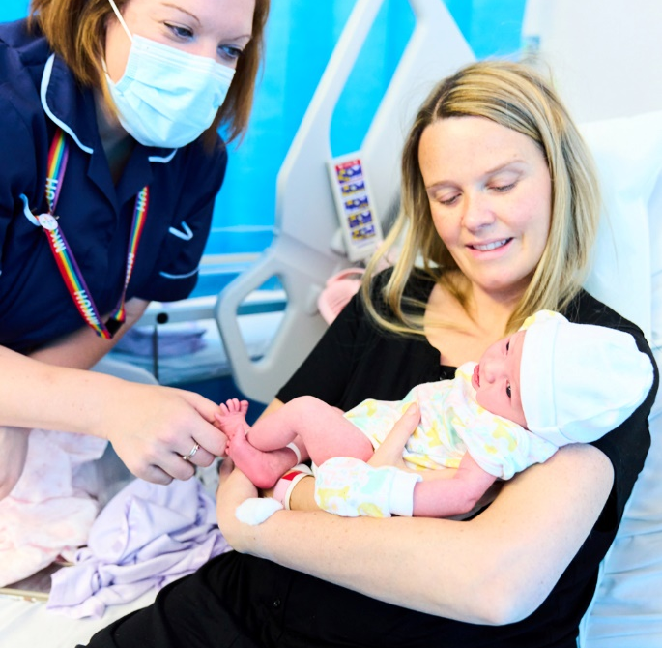
Come and join us!
OUR hospital is here FOR YOU.

Slide 39
Looking Ahead
Professor Joe Harrison
Chief Executive Officer
Milton Keynes University Hospital
NHS Foundation Trust

Slide 40
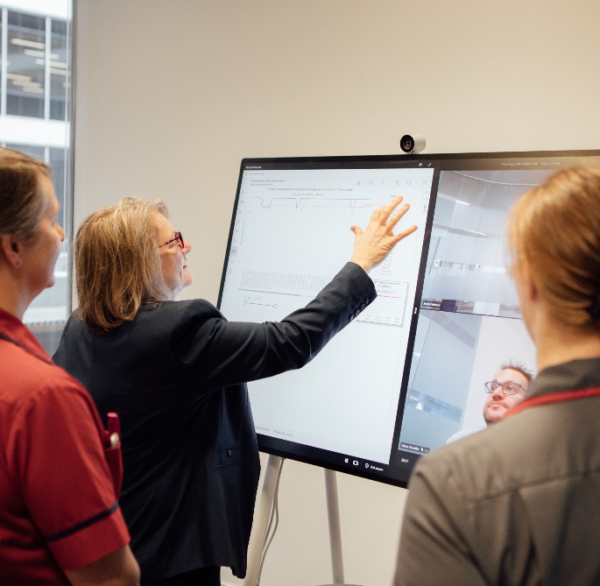
Looking ahead
We anticipate the pressures on the Emergency Department will continue next year and, as a Trust, we are actively working to improve our performance.
The challenge for the forthcoming year will be to achieve a target of having no patients waiting for elective (planned) treatment, including operations, over 52 weeks by the end of March 2023.
We are working with the Academy of Robotics on how we can use robots, technology and automation to improve how we move services, products and equipment across the site more effectively – from safely moving medications to delivering patient meals.

Slide 41
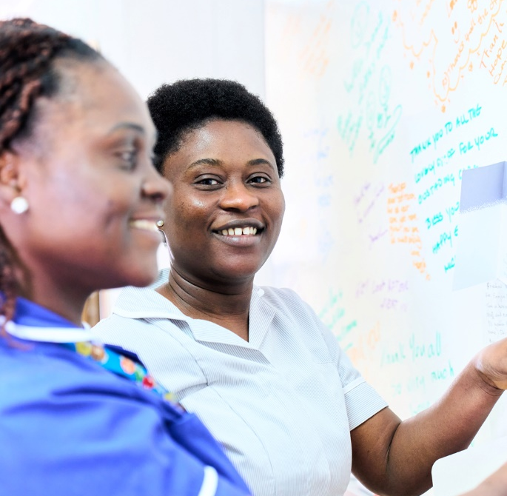
MKWay – Vision and values
Following the introduction of the MKWay in 2018, we have been holding a series of listening events to understand what our values been to our staff.
A revised vision and updated values will be created, demonstrating exactly what it means to be part of #TeamMKUH.
These behaviours are essential to provide a framework as to how we work, how we support one another and how we ensure that we continue to deliver an exceptional service to every single patient.
Our new vision and suite and values will continue to be further embedded with all staff across the hospital.

Slide 42
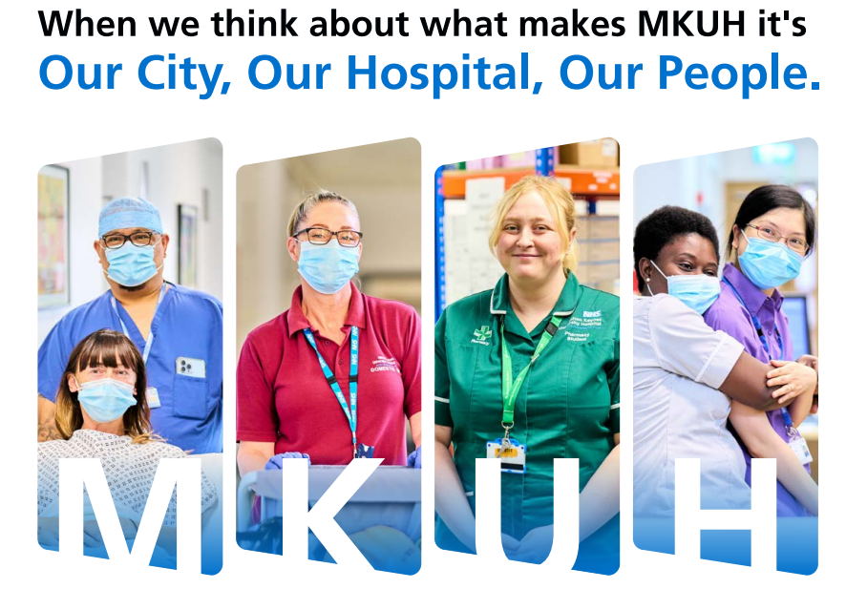
Recruitment and retention
A brand-new attraction campaign for the Trust launched last month, focussing on what it is like to live in Milton Keynes and work at MKUH.
As a Trust, we offer several unique benefits and it is important that we continue to attract the best talent.
As well as recruiting new colleagues, we are committed to developing our wellbeing and staff benefits programmes, ensuring our colleagues have access to the best possible support.
We are working with teams across the hospital so that we understand what is important to our staff and how we can improve their experience.

Slide 43
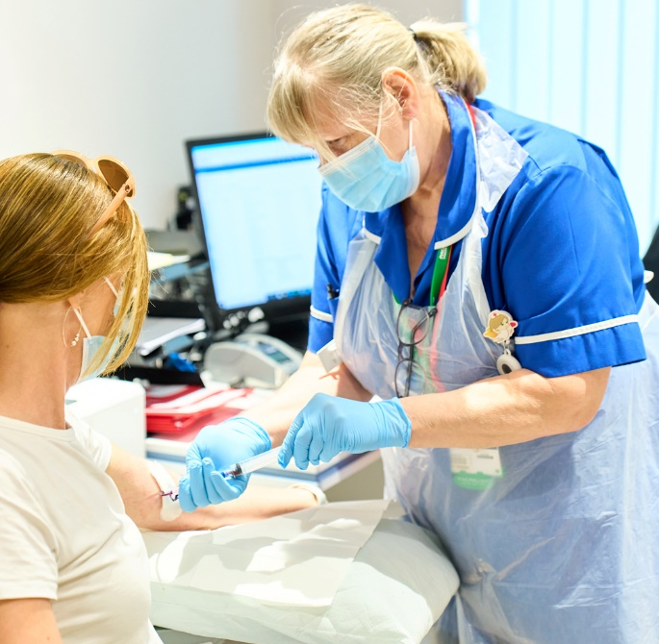
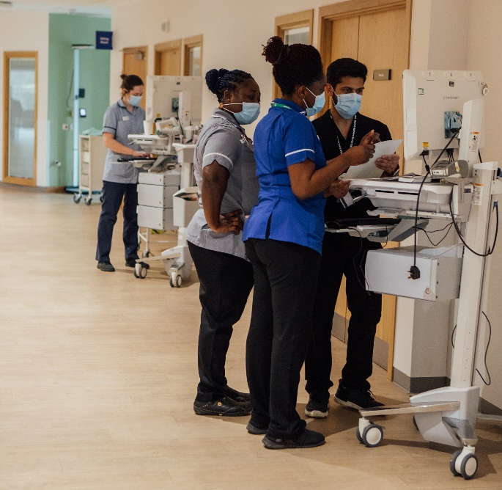
Patient safety and experience
15 Steps and PLACE programmes are just starting up again, following the lifting of restrictions.
Quality agenda
  No harm
Clinical Services – focus on:
  Frailty
  Paediatric and neonatal capacity expansion
  Maternity

Slide 44
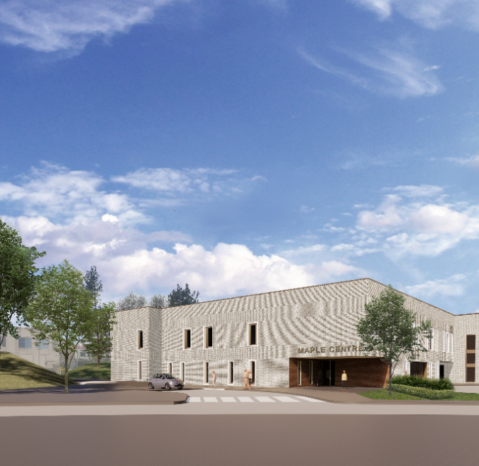
Estates developments
The Maple Centre to open on 31 October, reducing pressure on our Emergency Department.
Continued engagement with our communities in relation to plans to build a new Women’s & Children’s Hospital, Elective Surgery Centre and Imaging Centre as part of the New Hospital Programme (NHP).
Radiotherapy – Plans have been signed off to develop a new Radiotherapy Centre in partnership with the Oxford University Hospitals, adjacent to the Cancer Centre.
The Trust continues to progress its ambitions to develop the estate, and its services, to meet the demands of the rapid development of Milton Keynes, and its ever-increasing population, as one of the UK’s fastest growing cities.

Slide 45
#MKUHGreenerFuture
We have identified the following four themes that will underpin everything we do across the whole of the hospital:
    Net carbon zero
    Biodiversity
    Wellness
    Sustainable use of resources
Our plan has 11 areas of focus, each with three-year plans and 12-month action plans detailing how we will achieve our green goals.
Our plan has been co-created with all stakeholder groups, and a Green Committee will be open to individuals inside and outside the organisation to support our plan.
We will create Green Champion staff members who will celebrate and drive green practices within their areas.

Slide 46
Thank you...
To our staff, who provide good, safe care every day for every patient…
To Lead Governor Babs Lisgarten…
To our volunteers…
To those who support our charity…
And to our community.

Slide 47
Any questions?

