Slide 1
Financial Review of 2023/24
Jonathan Dunk
Chief Finance Officer
Milton Keynes University Hospital
NHS Foundation Trust

Slide 2
A Balanced Financial Position
MKUH delivered a balanced financial position for the financial year, with expenditure staying within its funding envelope. The key highlights of the financial year were:
MKUH successfully delivered its financial plan achieving a small surplus of £23,000 after removing the impact of Grant Income and depreciation .
MKUH is part of the Bedford, Luton and Milton Keynes Integrated Care System (BLMK ICS) which also achieved its budgeted financial plan.
We continued to increase our elective services for both outpatients and inpatient planned care, against a background of industrial action. This generated over £15m of additional income by delivering 125% of activity beyond the pre-pandemic 2019/20 baseline.
The efficiency target for the year of £17m (4.8% of expenditure) was fully delivered through a mix of income generation, productivity improvements, and elimination of waste. The Trust assesses the quality impact of financial efficiency schemes prior to approval and implementation to ensure services and quality are not compromised.

Slide 3
Headline Financial Performance 2023/24
The historical financial performance of the Trust by year is shown below.
Delivering a balanced financial position has taken a number of years to achieve in MK
The wider NHS financial outlook means continuing to achieve this is becoming ever harder.

Slide 4
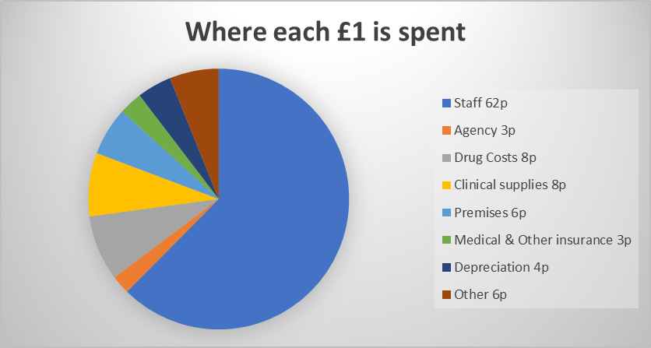
How the money was spent
The Trust receives funding for clinical service provision as income, payable under contracts from either local or regional commissioner organisations.
During 2023/24, the Trust received income totalling £417m, predominantly (c.79%) from local commissioners (Integrated Care Boards) for the provision of core acute services.

Slide 5
Capital Spending
The Trust continued to invest significantly in new infrastructure and equipment to support the delivery of quality healthcare. In 2023/24, capital investment totalled £41.4m.
This total includes the investment in the new Radiotherapy Centre, which is expected to be treating patients during the Autumn of 2024 enabling local patients to receive radiotherapy closer to home. £10m in year spend.
Two Community Diagnostic Centres (CDC's) for the population, one at Whitehouse Park offering Endoscopy and other diagnostic services, and the second located at LLoyds Court in Central Milton Keynes which will provide additional diagnostics services. £6.8 in year spend.
Infrastructure costs (including additional car park for chemotherapy and flat roofs replacements) £2.0m
Investment in diagnostics (including building refurbishment for Breast Screening and IT for Imaging and Pathology) £1.8m
Design work for the New Hospital Programme and enabling schemes and build for HV enabling scheme £2.7m
Refurbishment of existing estate: Milton Mouse and creation of Urology Investigation Unit £1.5m
Investment in sustainability and green initiatives ( including window replacement, replacement of HSDU washers, upgrading Led Lighting and EV chargers) £3.9m

Slide 6
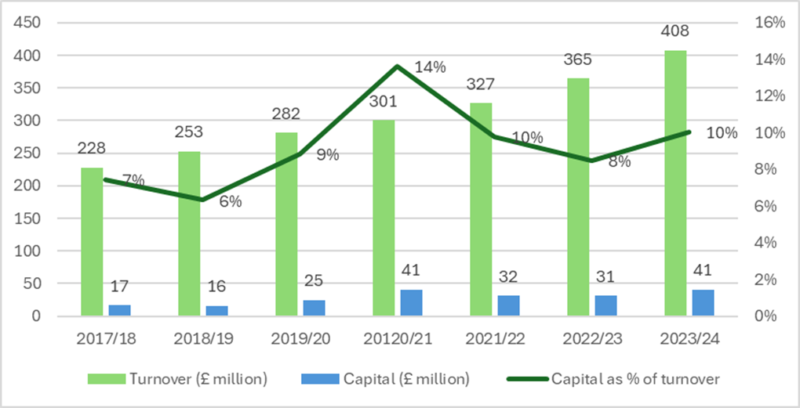
Our Growth Journey
Turnover has increased by 60% since 2017/18
Capital investment has increased by 141% since 2017/18
However less than half of this capital funding provision is recurrent. The rest is being achieved largely by the Trust successfully bidding for funding for specific scheme developments.

Slide 7
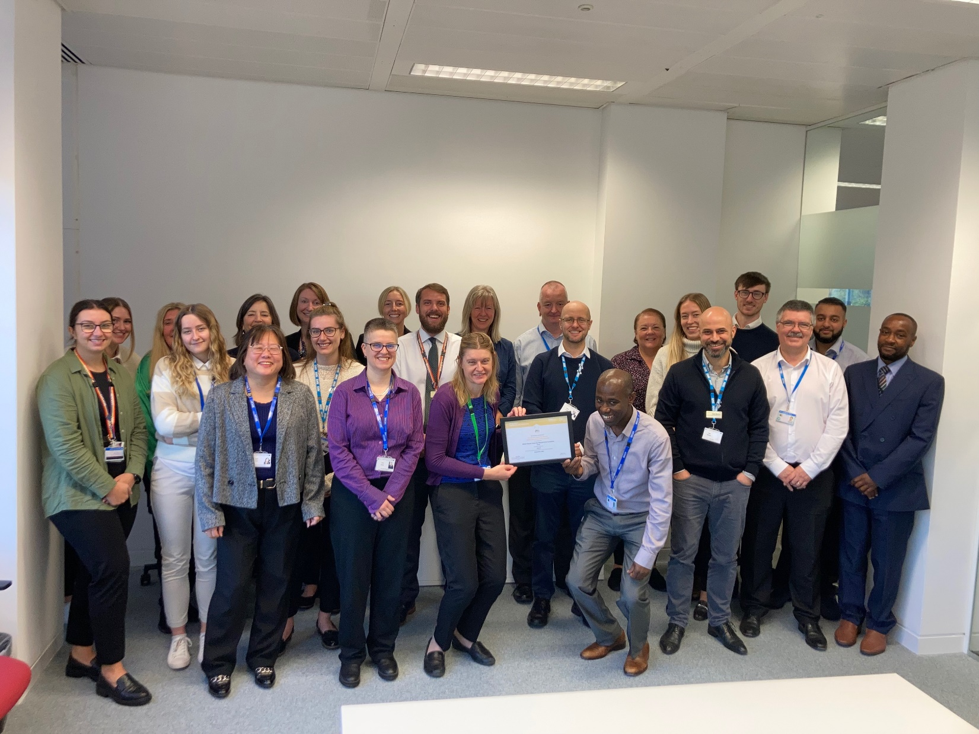
Other Notable Achievements!
Team achieved Level 2 accreditation from the National Finance Leadership Council in September 2023

Slide 8
Focus for 2024/25 and Beyond
There are extremely challenging financial conditions across the wider NHS in the current financial year and expected immediately beyond.
In this context the focus for the Trust is all about being as productive as possible to ensure we can continue to invest for the future and meet our populations health needs.
During the current financial year our financial priorities are therefore:
Investment in capacity/productivity to tackle elective care backlog
Delivering Value for Money by ensuring we are as effective and efficient as possible with every pound we spend.
Completing construction and handover of the Radiotherapy Centre
Completion of community diagnostic care facilities (Whitehouse Park and Lloyds Court)
Continuing to progress business case development for the New Hospital Programme

Slide 9
Any questions?

