Slide 1
Council of Governors and Membership Update
Babs Lisgarten
Lead Governor and Public Governor for
Ashland, Bletchley, Denbigh, Eaton Manor, Fenny Stratford, Mount Farm, Simpson, Water Eaton, Whaddon
Milton Keynes University Hospital
NHS Foundation Trust

Slide 2
Our Council of Governors
The Council of Governors is made up of different types of governors who are elected by their members and are direct representatives of our patients, their families, staff, members of the public and local organisations.
We currently have 22 Governors, comprising:
11 public governors
5 staff governors
4 appointed governors, including:
Healthwatch Milton Keynes
Milton Keynes Business representation
Milton Keynes Council
University of Buckingham
12 Public Governors
6 Staff Governors
Babs Lisgarten
William Butler
Andrea Vincent
John Gall
Adam Chapman-Ballard
Christine Thompson
Clare Hill
Andy Forbes
Francesca Vernon
Tom Daffurn
Ken Rowe
Ian Oswald
Caroline Kintu
Prof. Hany Eldeeb
Fiona Burns
Emma Isted
Matthew Burnett
David Cattigan
4 Appointed Governors
Maxine Taffetani
Nicholas Mann
Cllr Ansar Hussain
Doug McWhinnie
We welcome our new Governors. All our Governors are volunteers and independent of the Trust Board.

Slide 3
The role of the Council of Governors
The Council of Governors is authorised by statute to discharge these duties:
Be independent of the Board of Directors.
To hold the Non-Executive Directors to account for the performance of the board.
To represent the interests of the general public including patients and members.
To agree/approve certain large transactions.
To appoint the Trust’s auditors.
To appoint Non-Executive Directors, including the Chair and agree remuneration.

Slide 4
Working Together
Governors observe Trust
Board assurance
committee meetings and
have feedback sessions
with Non-Executive
Directors
Non–executive directors attend every Council of Governors’ meeting
Governors have an open invitation to attend all Trust Board meetings
Non–executive directors attend every Council of Governors’ meeting

Slide 5
Our activity in 2023/2024
The Council formally meets 4 times during the year.
We also have regular informal meetings with the Chair. The Chair and Lead Governor are in regular communications.
We have had very informative presentations from organisations such as Alzheimer's Society MK and Alcoholics Anonymous.
The Council of Governors is responsible for appointment of the Chair of the Board and the Non-Executive Directors.
The Non-Executive Directors Appointments Committee, which I chair as Lead Governor, have appointed our new Non-Executive Directors.
The Council of Governors monitored Trust governance issues, received a range of reports on finance, performance, quality and workforce and are empowered to provide scrutiny and challenge.
Received and reviewed formal reports, including the 2023/24 Annual Report and Accounts.
Notes:
Informal meetings now called Open Forum
Change in Chair, working out best interaction and communication with Heidi.
NED appointmens

Slide 6
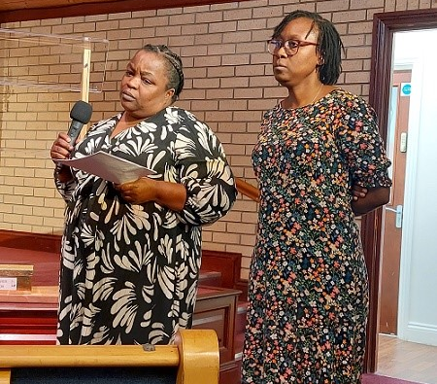
Other Governor activities
The Council of Governors:
Attended well over a dozen public events to engage with the public by signing up members, listening to people’s feedback and promoting the Governor role.
Participated in the MKUH Staff Awards.
Observed Trust Board and Committee meetings.
Participated in the PLACE audit.
Continued to increase their engagement activities and further increase the feedback from members, patients and the public in terms of the hospital’s services and its development.

Slide 7
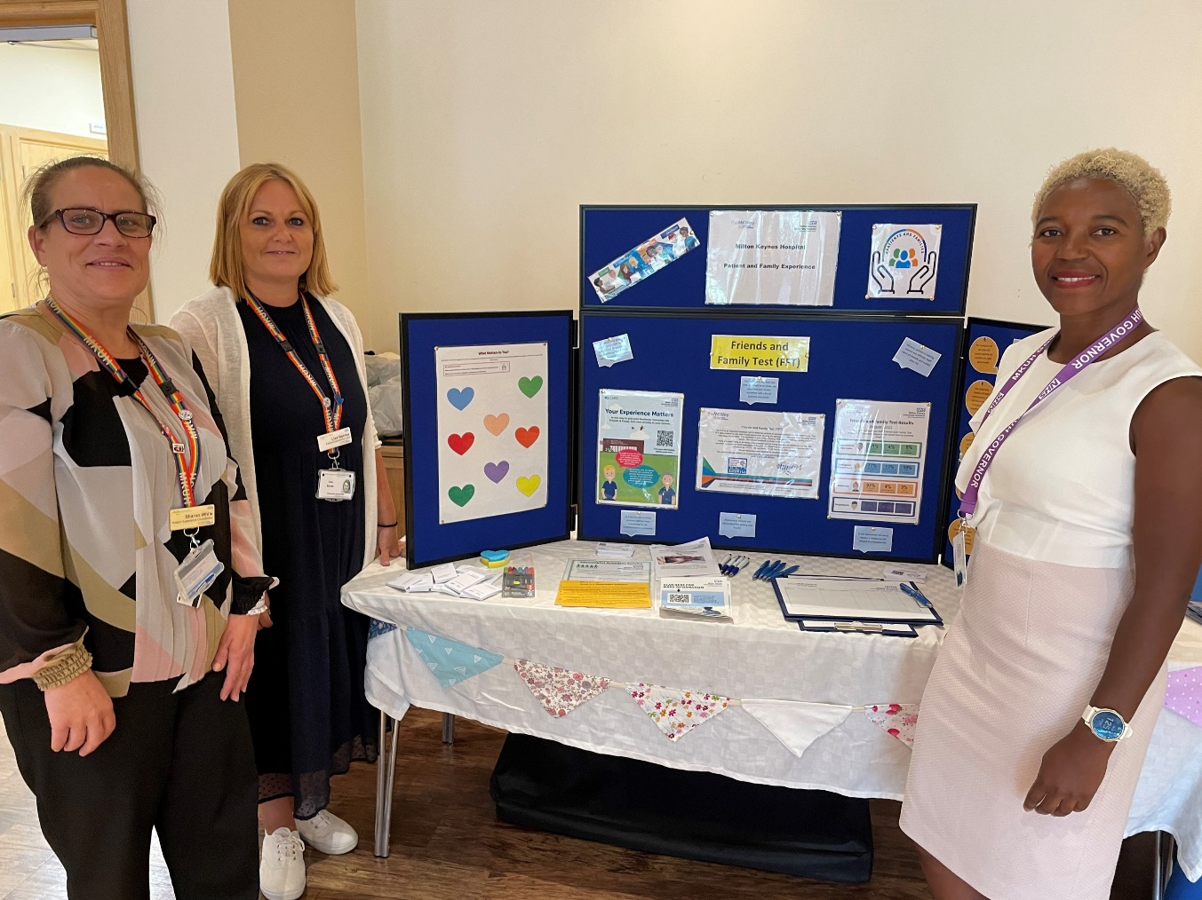
We listen
We would love to hear from you. If you have any comments or would like to share your experience of the services at the hospital, do please contact me or your local Governor via email addresses listed on the Trust website at www.mkuh.nhs.uk

Slide 8
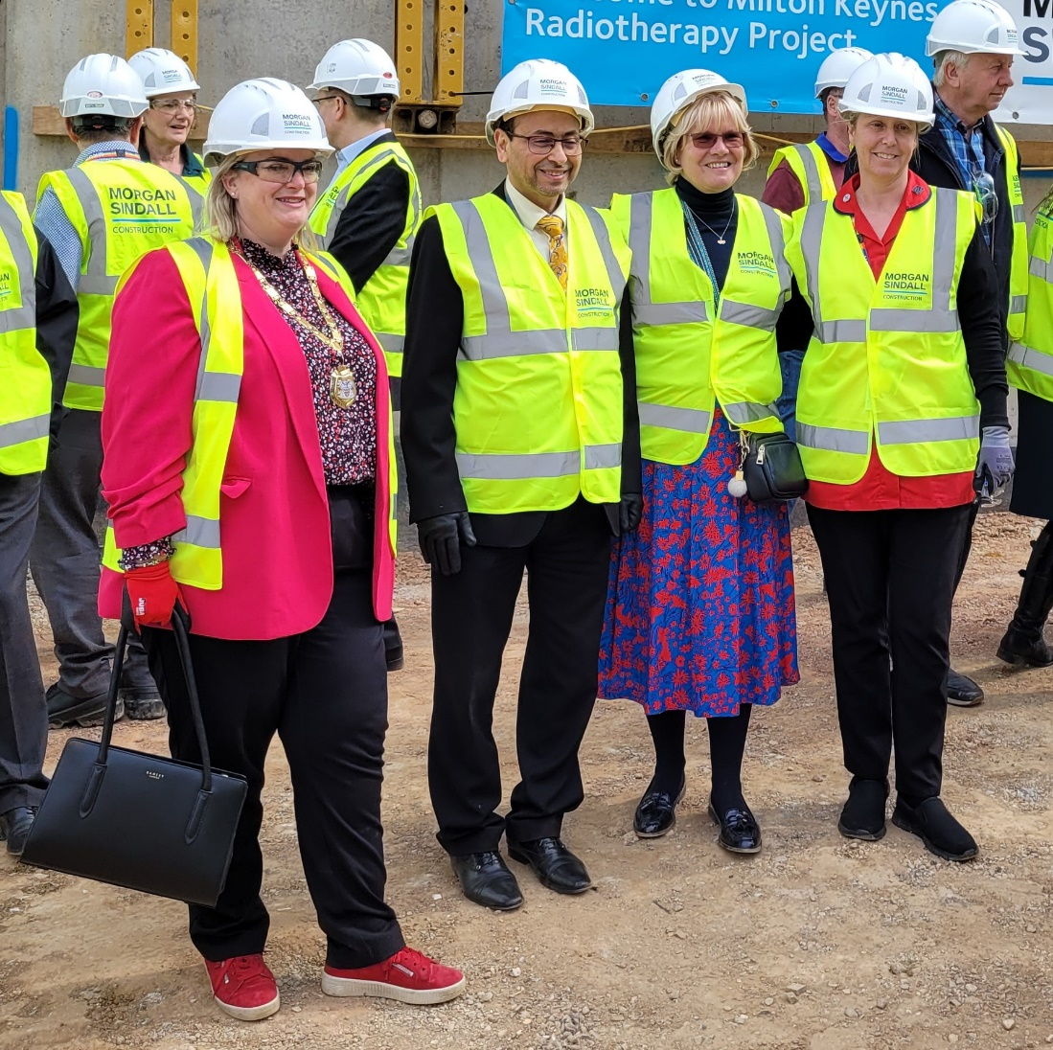
Trust membership
As Governors we represent patients, members and the public.
The total membership is now over 5,400, comprising over 2,400 public members and over 3,000 staff.
We aim to attend more events, increasing visibility and presence in the community, across diverse areas. We communicate regularly though regular membership newsletters, and we aim to engage more with local groups and young people.

Slide 9
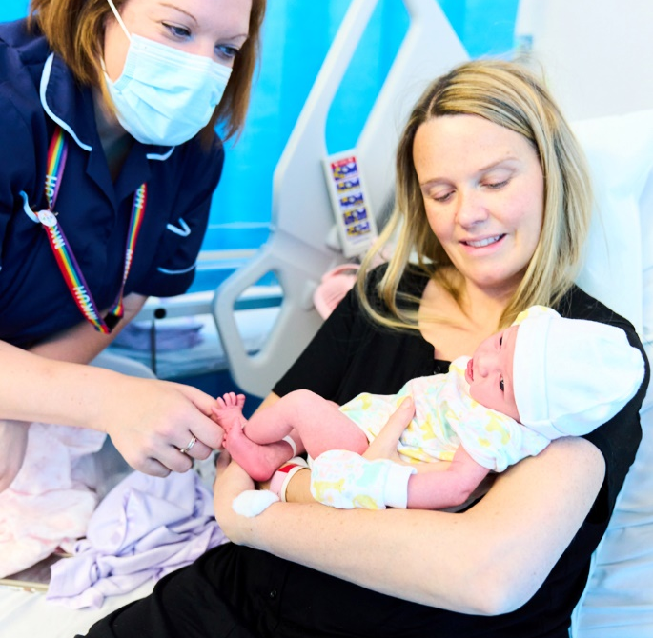
Come and join us!
Our hospital is here for you.

